Slide 1

Project Management
CLO1 - Introduction
Developed by: Dr. Rula Al Kayyali, Updated by Sharmila Siddartha, Reviewed by: Melina Silva
Materials in this course are based on the text, A Guide to the Project Management Body of Knowledge (PMBOK® Guide), Sixth edition, Project Management Institute, Inc. 2017
Notes:
Updated August 2019.

Slide 2
Learning Objectives
Introduction to foundation elements of projects and project management
Discuss project life cycles
Discuss role of project manager and the project management profession
The PMI Registered Education Provider logo is a registered mark of the Project Management Institute, Inc.

Slide 3
Foundation Elements
What is a Project?
*A project is a temporary endeavor undertaken to create a unique product, service, or result.
Examples of projects include, but are not limited to:
Constructing a building
Developing a new software application
Improving a business process within an organization
Exploring for oil in a region
Project
Is temporary effort with Start and End dates
Is NOT a routine operation
Has a scope and needs resources
Creates a unique output having business value
The PMI Registered Education Provider logo is a registered mark of the Project Management Institute, Inc.
This definition is taken from the Glossary of Project Management Institute, A Guide to the Project Management Body of Knowledge, (PMBOK® Guide) – Sixth Edition, Project Management Institute Inc., 2017.

Slide 4
Foundation Elements
What is a Project?
Projects create unique products, services or outcomes known as deliverables
Projects can involve
A single individual or a group
A single organizational unit or multiple units from multiple organizations
Projects are temporary in nature and have a definite beginning and ending date.​
A project is a temporary endeavor of inter-related activities undertaken to create a unique product, service, or result​
A project ends when the objectives are achieved, or it is terminated by the sponsor ​
Projects create business value for the organization and initiate change
The PMI Registered Education Provider logo is a registered mark of the Project Management Institute, Inc.

Slide 5
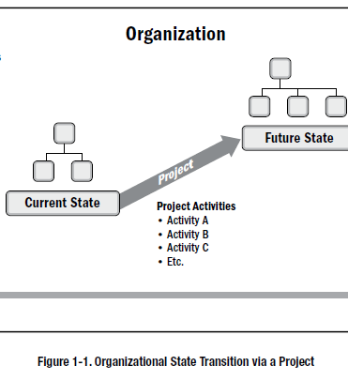
Foundation Elements
Projects drive change and create business value:
Organizations move from current state to future state by implementing projects.
Time is used up and business value is achieved
The PMI Registered Education Provider logo is a registered mark of the Project Management Institute, Inc.
Project Management Institute, A Guide to the Project Management Body of Knowledge, (PMBOK® Guide) – Sixth Edition, Project Management Institute Inc., 2017, Page 6.

Slide 6
Foundation Elements
Discuss: How are projects different from operations
Projects | Operations
Are temporary Have specific start and end dates Have well defined scope Require resources Create a unique output and business value | Operations are ongoing activities in any organization​ Daily activities of a business​ Repetitive tasks ​ Use standard operational procedures Require resources Sustain the business
The PMI Registered Education Provider logo is a registered mark of the Project Management Institute, Inc.
Notes:
​

Slide 7
Activity: Discussion
Are these projects or Operations? Explain why?
Building the Museum of Future in Dubai
Building a new terminal at the Abu Dhabi International Airport
Preparing annual reports for the CEO of HCT
Upgrading communication infrastructure in HCT
Resolving student laptop issues at your college
Registering students for the new semester
A teacher preparing a test for his/her course
Course leaders are preparing 10 versions of the final exam for to be delivered to students in 5 campuses of a university
Notes:
Students will upload their answers to a padlet in NP

Slide 8
Activity1- Answer using collaborate board on Nearpod
Foundation elements- Is this a project?

Slide 9
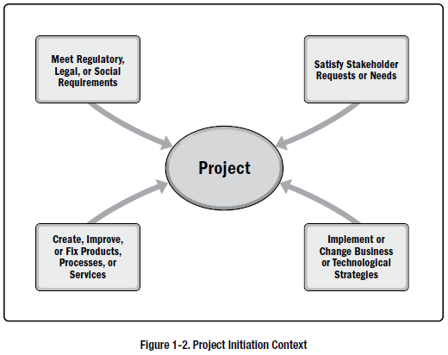
Foundation Elements
Context for Project Initiation – Why are projects necessary?
Organization leaders initiate projects in response to four fundamental demands as shown in this figure
The PMI Registered Education Provider logo is a registered mark of the Project Management Institute, Inc.
Project Management Institute, A Guide to the Project Management Body of Knowledge, (PMBOK® Guide) – Sixth Edition, Project Management Institute Inc., 2017, Page 8.
Notes:
Project
Meet regulatory , legal , or social requirements
Create , improve or fix product processes or services
Satisfy stakeholder requests or needs
Implement or change business or technological strategles

Slide 10
Questions: Why is this project necessary? What is the unique product created by this project? What is the business value of this project? What changes will this project create?
Project Description:
The Director has authorized the building of a mini-hospital within the campus at Dubai Men’s College. Mini hospital includes facilities and essential medical equipment to treat emergencies and injuries. Employees of the hospital should have access to computing and other comfort facilities.
Duration – 1.5 years
Budget – 3 million Dhs.
Requirements: Clinic with 2 emergency rooms, 2 in-patient rooms, 1 resting room, 1 office with 4 workstations for medical staff and pharmacy, 2 restrooms and 1 pantry. Must have a ramp access wheelchairs and stretchers and special parking for ambulances.

Slide 11
Activity2- Matching Pairs on Nearpod
Case based activity

Slide 12
Foundation Elements
What is Project Management?
“Project management is the application of knowledge, skills, tools, and techniques to project activities to meet the project requirements.
Project management is accomplished through the appropriate application and integration of the project management processes identified for the project”.
The PMI Registered Education Provider logo is a registered mark of the Project Management Institute, Inc.
*This definition is taken from the Glossary of Project Management Institute, A Guide to the Project Management Body of Knowledge, (PMBOK® Guide) – Sixth Edition, Project Management Institute Inc., 2017.

Slide 13
Foundation Elements
Effective project management helps in | Poor project management can lead to:
Meeting business objectives Satisfying stakeholders expectations Optimizing the use of resources Managing change Responding to risks in a timely manner | Missing deadlines Poor quality of project Cost overruns Scope creep Unsatisfied stakeholders Project failure
The PMI Registered Education Provider logo is a registered mark of the Project Management Institute, Inc.
*This definition is taken from the Glossary of Project Management Institute, A Guide to the Project Management Body of Knowledge, (PMBOK® Guide) – Sixth Edition, Project Management Institute Inc., 2017.

Slide 14
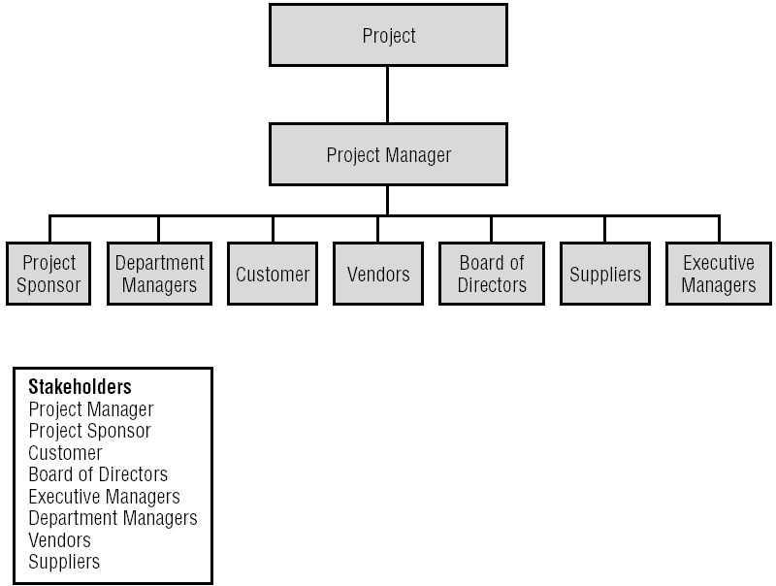
Foundation Elements
Project Stakeholders: Any individual or party that has interest in the project.
*
The PMI Registered Education Provider logo is a registered mark of the Project Management Institute, Inc.

Slide 15
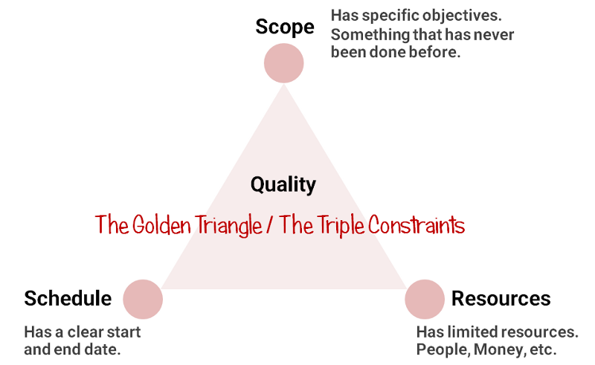
Foundation Elements
The Triple Constraints: Scope, Schedule and Resources
Project managers must balance the three constraints to complete a project successfully .
The PMI Registered Education Provider logo is a registered mark of the Project Management Institute, Inc.

Slide 16
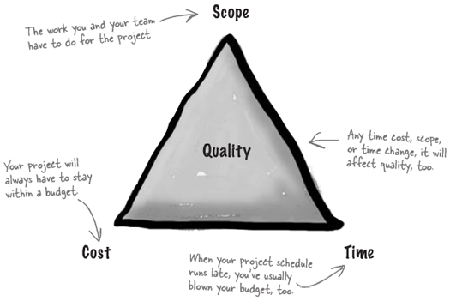
Discussion:
The Triple Constraints: Scope, Resource(cost), Schedule(time)
Discussion:
What are some examples of changes to scope, time and cost in IT projects?
Why is the project quality affected when the scope of a project changes?
Why does a delay in the project schedule increase the cost of a project?
Adopted from: http://www.stellman-greene.com
The PMI Registered Education Provider logo is a registered mark of the Project Management Institute, Inc.
Notes:
Students will upload answers in NP canvas

Slide 17
Foundation Elements
Project Success Measures
Project must have clearly stated project objectives that are measurable
Some questions that the key stakeholders and the project manager should address are
What does success look like for this project?
How will success be measured?
What factors may impact success?
The answer to these questions should be documented and agreed upon by the key stakeholders and the project manager
Project success may include additional criteria linked to the organizational strategy and to the delivery of business results

Slide 18
Activity3- Quiz on Nearpod
Pm basics

Slide 19
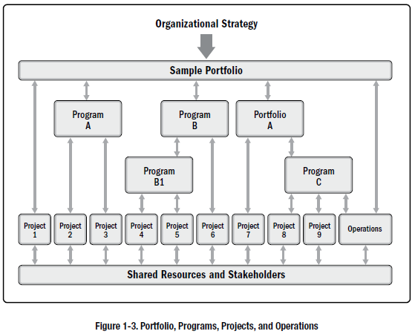
Foundation Elements – Grouping Projects
Project, Programs, and Portfolios:
The PMI Registered Education Provider logo is a registered mark of the Project Management Institute, Inc.
Project Management Institute, A Guide to the Project Management Body of Knowledge, (PMBOK® Guide) – Sixth Edition, Project Management Institute Inc., 2017, Page 12.

Slide 20
Foundation Elements
Project, Programs, and Portfolios:
*A project is a temporary endeavor undertaken to create a unique product, service, or result.
*A program is a group of related projects, subsidiary programs, and program activities that are managed in a coordinated manner to obtain benefits not available from managing them individually.
“A portfolio is a collection of projects, programs, and operations managed as a group to achieve strategic objectives.”
Excerpt from Project Management Institute, A Guide to the Project Management Body of Knowledge, (PMBOK® Guide) – Sixth Edition, Project Management Institute Inc., 2017, Page 52.
Program and project management focus on doing them the right way.
Portfolio management is about doing the right programs and projects to meet the strategic goals.
The PMI Registered Education Provider logo is a registered mark of the Project Management Institute, Inc.
*These definitions are taken from the Glossary of Project Management Institute, A Guide to the Project Management Body of Knowledge, (PMBOK® Guide) – Sixth Edition, Project Management Institute Inc., 2017.

Slide 21
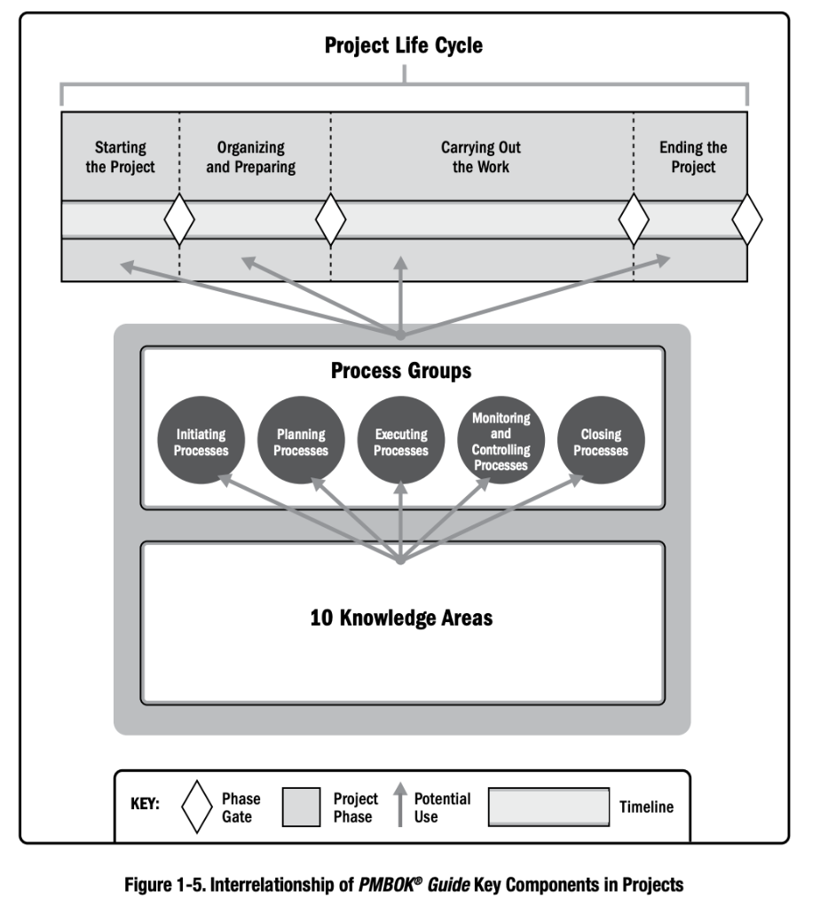
PMBOK’s Key Components of Projects
Project Life Cycle
Process Groups
Knowledge Areas
Processes
Inputs
Outputs
Tools and Techniques

Slide 22

Foundation Elements
Project Management Process Groups: Project Management Processes are grouped under one of these 5 process groups:
Initiating
Planning
Monitoring and Controlling
Executing
Closing
Initiating
Processes
Planning
Processes
Monitoring
And
Controlling
Processes
Executing
Processes
Closing
Processes
*
The PMI Registered Education Provider logo is a registered mark of the Project Management Institute, Inc.

Slide 23
Foundation Elements
Knowledge Areas
A Knowledge Area is an identified as an area of project management defined by its knowledge requirements or skills
These areas are described in terms of its component processes, practices, inputs, outputs, tools, and techniques.
There are 10 Knowledge Areas
Knowledge areas are mapped to process groups
Note these knowledge areas are explained in detail later in the course

Slide 24
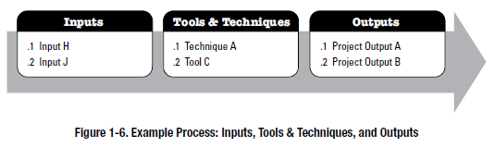
Foundation Elements
Project Management Processes:
*A project life cycle is the series of phases that a project passes through from its start to its completion.
A project life cycle is managed by executing a series of project management processes.
Every project management process produce one or more outputs, from one or more inputs, using appropriate project management tools and techniques.
Tools are templates or software applications necessary to produce outputs
Techniques are procedures like meetings, interviews etc. necessary to produce outputs
The PMI Registered Education Provider logo is a registered mark of the Project Management Institute, Inc.
Project Management Institute, A Guide to the Project Management Body of Knowledge, (PMBOK® Guide) – Sixth Edition, Project Management Institute Inc., 2017, Page 22.

Slide 25
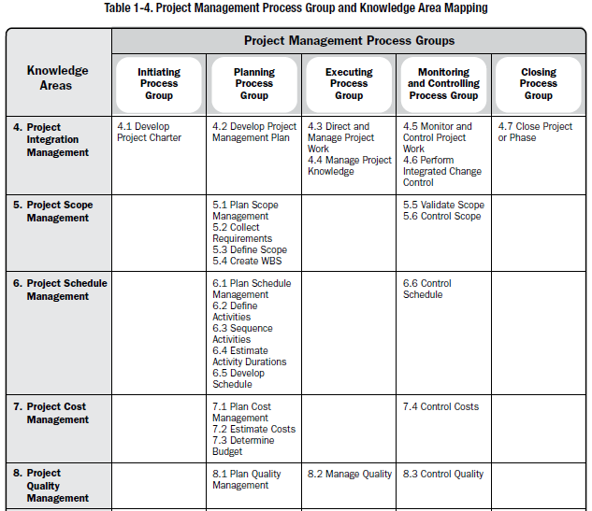
PG/KA Mapping – 1
d Education Provider logo is a registered mark of the Project Management Institute, Inc.
Project Management Institute, A Guide to the Project Management Body of Knowledge, (PMBOK® Guide) – Sixth Edition, Project Management Institute Inc., 2017, Page 25.

Slide 26
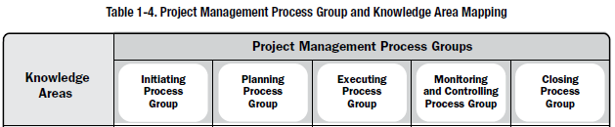
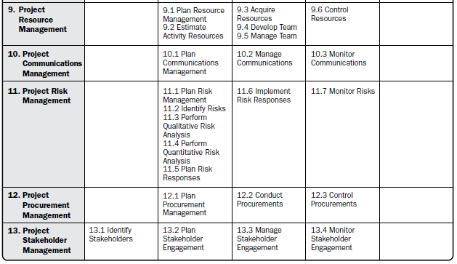
PG/KA Mapping - 2
The PMI Registered Education Provider logo is a registered mark of the Project Management Institute, Inc.
*Project Management Institute, A Guide to the Project Management Body of Knowledge, (PMBOK® Guide) – Sixth Edition, Project Management Institute Inc., 2017, Page 25.

Slide 27
Foundation Elements
Characteristics of the Process Groups over time? Fill with High, Medium, or Low
 | INITIATING | PLANNING | EXECUTING | MONITORING AND CONTROL | CLOSING
Costs or Expenditure | Low | Low | Highest | Lower | Lowest
Staffing Levels | Low | Low | High | High | Low
Chances for Successful Completion | Lowest | Low | Medium | High | Highest
Stakeholder Influence | Highest | High | Medium | Low | Lowest
Risk Probability of Occurrence | Lowest | Low | High | High | Lower
The PMI Registered Education Provider logo is a registered mark of the Project Management Institute, Inc.
Notes:
Ask students:
Why is expenditure the highest during executing projects and lowest during initiation?
Why is stakeholder influence highest during the project initiation?

Slide 28
Activity3- Matching Pairs on Nearpod
Elements of framework

Slide 29
Foundation Elements: Organizational Systems
Projects operate within organizations.
The project manager needs to understand where the authority reside in the organization so that he/she operates effectively.
Factors that affect this include:
Management elements
Governance frameworks, and
Organizational types
The PMI Registered Education Provider logo is a registered mark of the Project Management Institute, Inc.

Slide 30
Organizational Structures
There are several types of organization structures. This course will focus on the following:
Projects and project managers operate within organizations
Organizational structure determines the hierarchy of people, their function, workflow, and reporting system
Organizational structure influences the project manager’s role and authority
Functional
Projectized
Matrix
Strong
Balanced
Weak

Slide 31
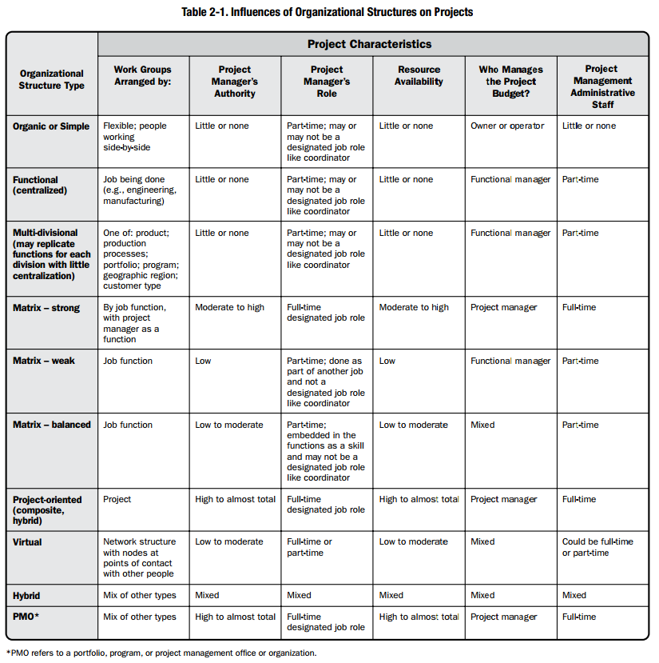
Organizational Structures and their Influence on Projects
Authority
Role
Management
Assignment to Projects
Notes:
Reference only

Slide 32

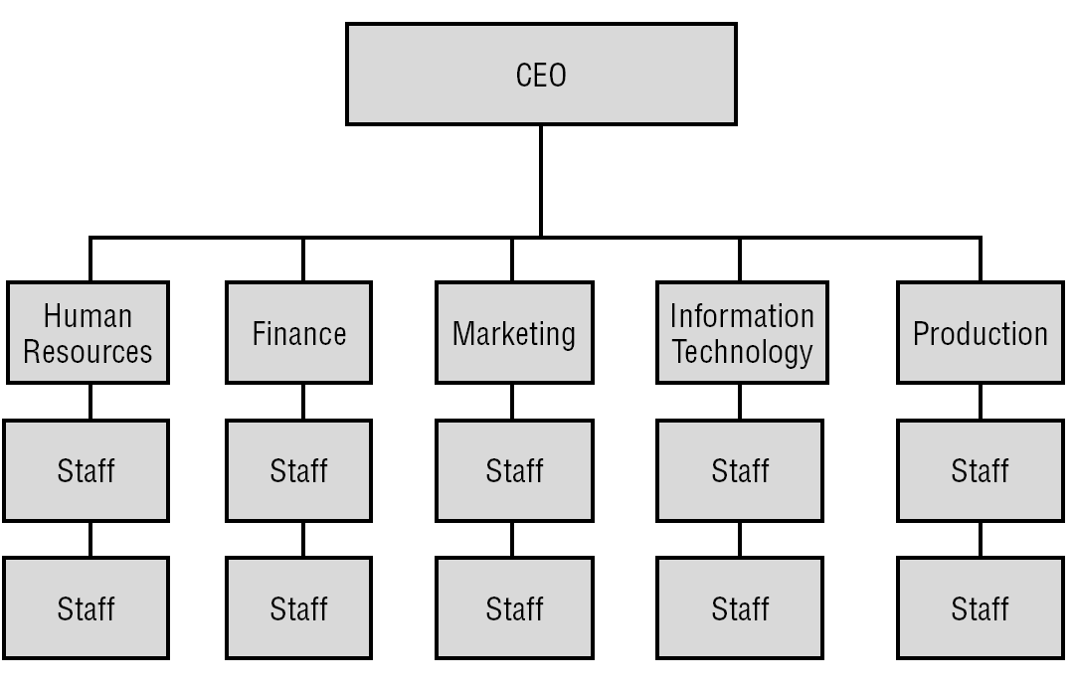
Functional Organization Structure – Employees are grouped by the work they do
The PMI Registered Education Provider logo is a registered mark of the Project Management Institute, Inc.
Notes:
Activity: use the crown picture to stimulate students thinking of where the power lies at various structures from projects sponsorship point of view (i.e. how much management actually empowers their project managers). This activity will continue with every slide talking about different type of organization structure and communicates the concept so effectively to students … give it a try ☺

Slide 33
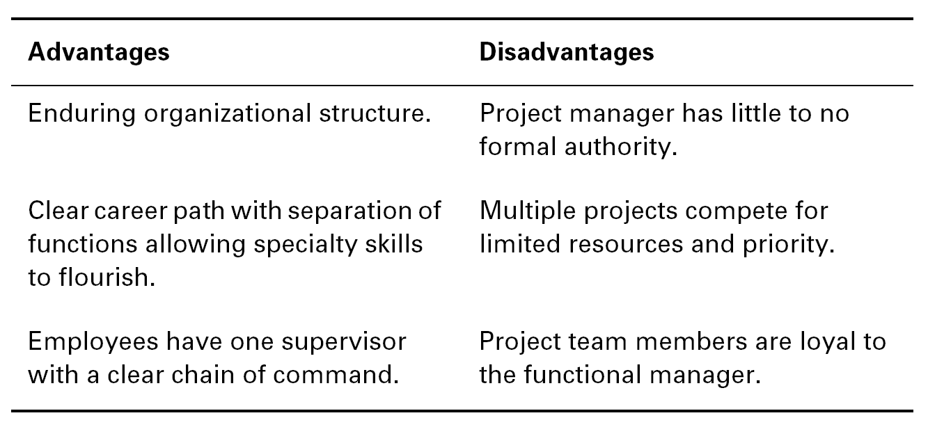
Functional Organizations
The PMI Registered Education Provider logo is a registered mark of the Project Management Institute, Inc.

Slide 34
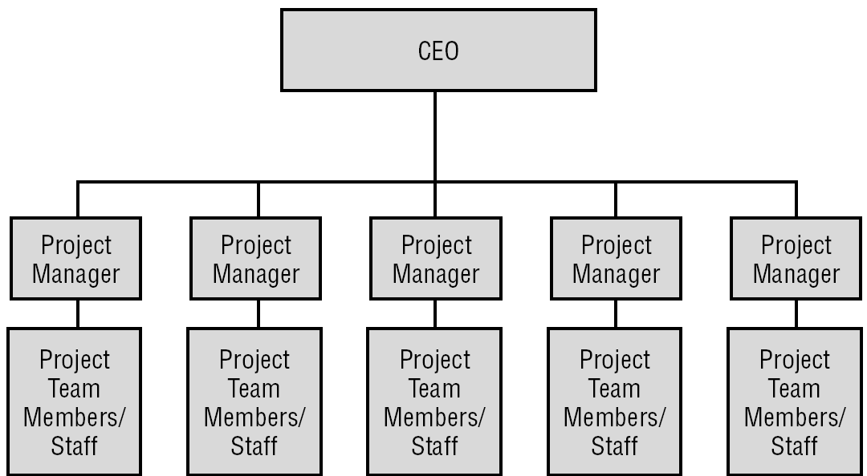
Projectized Organization Structure Employees are grouped by their projects
The PMI Registered Education Provider logo is a registered mark of the Project Management Institute, Inc.

Slide 35
Projectized Organization Structure
The focus of the organization is the project.
The organization’s resources are focused on projects and project work.
Project managers have the ultimate authority over the project.
Project budget and resources are managed by the project manager
Team members are collocated
Communication is good within a project
Loyalties are formed to the project, not to a functional manager.
Resources may be duplicated
Project team may be dissolved or removed at the end of the project
The PMI Registered Education Provider logo is a registered mark of the Project Management Institute, Inc.

Slide 36
Matrix Organizational Structure
This type of a structure is blend of Functional and Projectized
Matrix organizations are termed as weak matrix, balanced matrix and strong matrix depending on the power and influence of the project manager.
This structure uses resources efficiently
There two chains of command. Employees report to two bosses

Slide 37
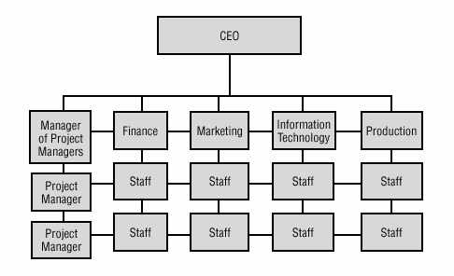
Strong Matrix Org Chart
The PMI Registered Education Provider logo is a registered mark of the Project Management Institute, Inc.

Slide 38
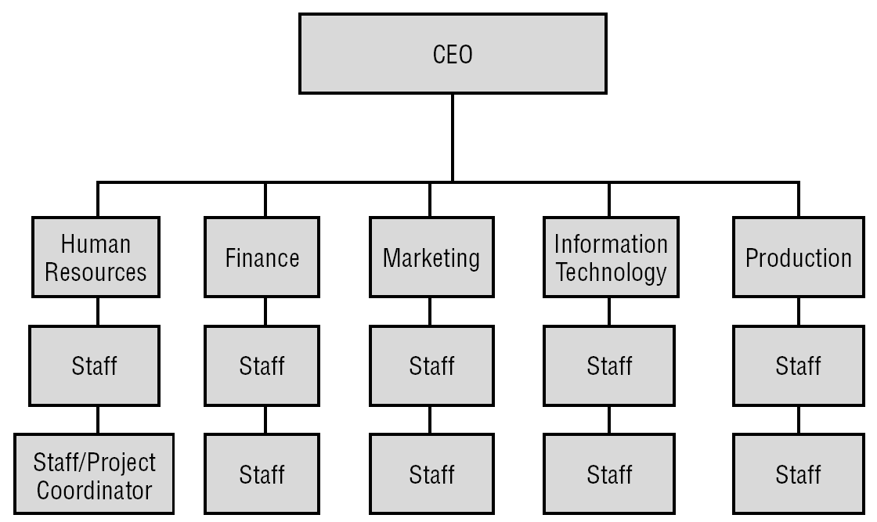
Weak Matrix Org Chart
The PMI Registered Education Provider logo is a registered mark of the Project Management Institute, Inc.

Slide 39
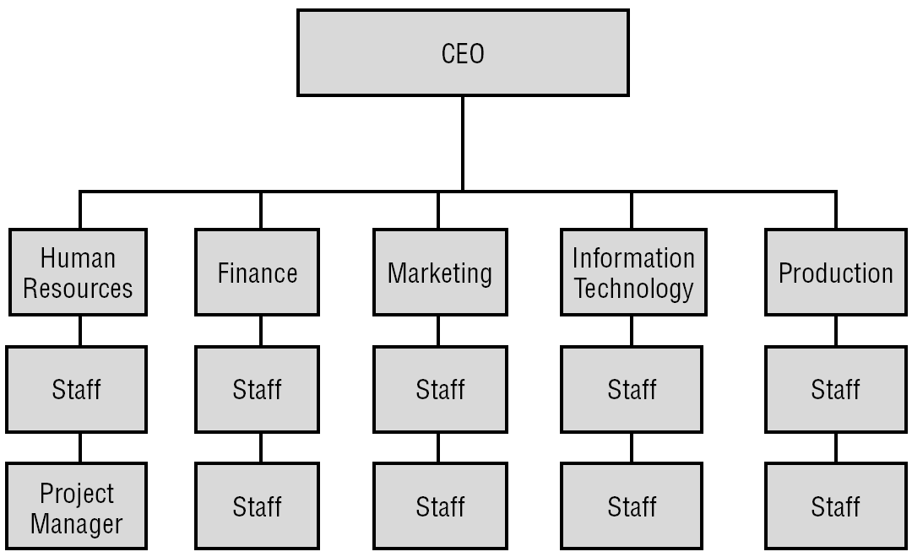
Balanced Matrix Org Chart
The PMI Registered Education Provider logo is a registered mark of the Project Management Institute, Inc.

Slide 40
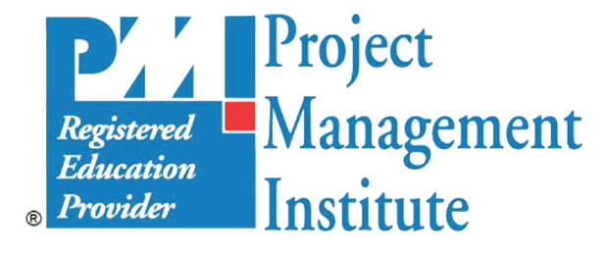
Comparing Matrix Structures – Quick Summary
 | Weak Matrix | Balanced Matrix | Strong Matrix
PM’s Title | Project coordinator, project leader, or project expeditor | Project manager | Project manager
PM’s Focus | Split focus between project and functional responsibilities | Projects and project work | Projects and project work
PM’s Power | Minimal authority and power | Balance of authority and power | Full time on projects
Org Style | Most like functional organization | Blend of both weak and strong matrix | Most like a projectized organization
PM Reports to | Functional manager | A functional manger, but shares authority and power | Manager of project managers
The PMI Registered Education Provider logo is a registered mark of the Project Management Institute, Inc.

Slide 41
Project Manager’s Authority
Functional
Weak Matrix
Balanced Matrix
Strong Matrix
Projectized
Little or None
High or Full

Slide 42
Organizational Systems
PROJECT MANAGEMENT OFFICE
A project management office (PMO) is an organizational structure that standardizes the project-related governance processes and facilitates the sharing of resources, methodologies, tools, and techniques. The responsibilities of a PMO can range from providing project management support functions to the direct management of one or more projects.
There are several types of PMOs in organizations. Each type varies in the degree of control and influence it has on projects within the organization, such as:
Supportive. Supportive PMOs provide a consultative role to projects by supplying templates, best practices, training, access to information, and lessons learned from other projects. This type of PMO serves as a project repository. The degree of control provided by the PMO is low.
Controlling. Controlling PMOs provide support and require compliance through various means. The degree of control provided by the PMO is moderate. Compliance may involve:
Adoption of project management frameworks or methodologies;
Use of specific templates, forms, and tools; and
Conformance to governance frameworks.
Directive. Directive PMOs take control of the projects by directly managing the projects. Project managers are assigned by and report to the PMO. The degree of control provided by the PMO is high.
The PMI Registered Education Provider logo is a registered mark of the Project Management Institute, Inc.
Notes:
Notes: The project management office may have organization-wide responsibility. It may play a role in supporting strategic
alignment and delivering organizational value. The PMO integrates data and information from organizational strategic
projects and evaluates how higher-level strategic objectives are being fulfilled. The PMO is the natural liaison between the
organization’s portfolios, programs, projects, and the organizational measurement systems (e.g., balanced scorecard).

Slide 43
Activity4- Question Time on Nearpod
Power and authority of a project manager

Slide 44
Summary
Projects have specific characteristics. They create business value and changes to organizational processes
Project Management is about the successful management of projects so that the objectives are achieved
The project management framework suggested by PMI includes:
Project Life Cycle, Process Groups, Knowledge Areas, Processes, Inputs, Outputs, Tools and Techniques
Power and authority of the project manager is influenced by the organization structure
The project manager should have skills relating to the business strategy, leadership and technical project management

Slide 45
The role and skills of a Project Manager
INDEPENDENT LEARNING
The following section is marked for independent learning.
Review slides in the section Project Manager Skills
Go to BBLearn Course: Additional Resources>>Week 01-02
Watch the video Business Acumen for Project Managers - The talent triangle
Complete the formative assessment

Slide 46
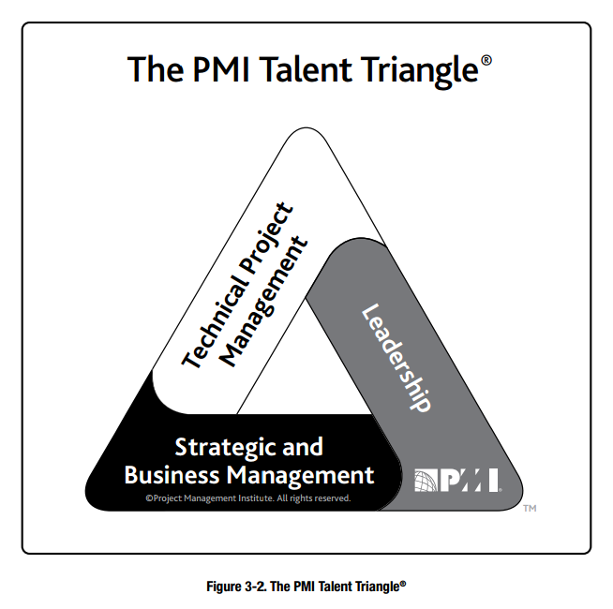
Project Manager's Role
The project manager is an assigned role to lead a project team
The responsibility of the project team is to achieve the project objectives
The project manager is responsible about performing integration on the project processes
The Project manager must be competent technically with sound domain or business knowledge and must have leadership and soft skills

Slide 47
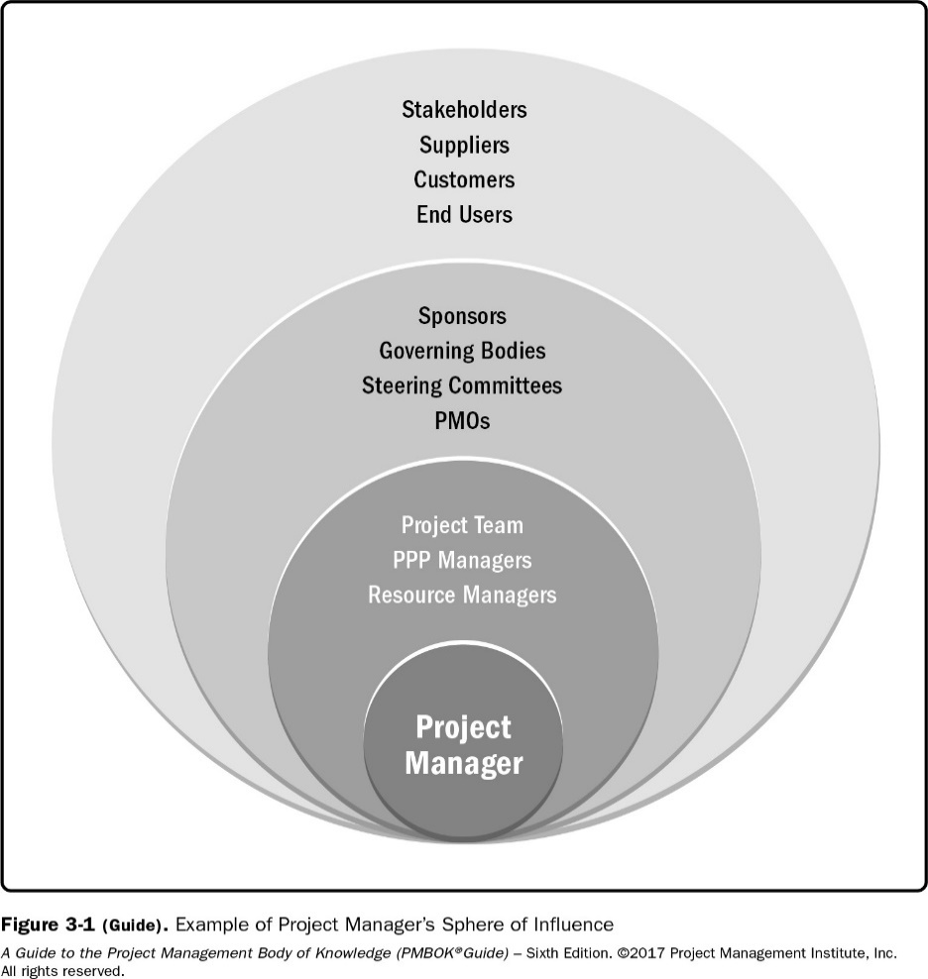
The Project Manager Sphere of Influence
The project,
The organization,
The industry,
The professional discipline, and
Across disciplines
The PMI Registered Education Provider logo is a registered mark of the Project Management Institute, Inc.
Project Management Institute, A Guide to the Project Management Body of Knowledge, (PMBOK® Guide) – Sixth Edition, Project Management Institute Inc., 2017, Page 53

Slide 48

A Project Manager’s Skills
Technical project management
The knowledge, skills, and competencies related to specific domains of the project. Eg. IT, construction, event management, health care etc.
Leadership
The knowledge, skills, and behaviors needed to guide, motivate, and direct a team, to help the project achieve goals
Strategic and business management
The knowledge of and expertise in the industry and the operations of the organization that helps to deliver better project performance
The PMI Registered Education Provider logo is a registered mark of the Project Management Institute, Inc.

Slide 49
Skills of a Project Manager
Technical project management
Agile practices
Data gathering and modeling
Earned value analysis
Lifecycle management
Performance management
Requirements management and traceability
Risk management
Schedule management
Time, budget, cost estimation
Governance of projects
Leadership
Brainstorming
Coaching and mentoring
Conflict management
Emotional intelligence
Influencing
Interpersonal skills
Listening
Negotiation
Problem Solving
Team Building
Strategic and Business Management
Benefits management and realization
Business acumen
Competitive analysis
Customer relationship and satisfaction
Legal and regulatory compliance
Market awareness and conditions
Operational functions such as finance, marketing
Strategic planning and analysis
Scope management
Notes:
Activity based on this slide

Slide 50
Performing Integration
The project manager is responsible about performing integration on the project processes
Integration is an important and critical skill for project managers, integration is done in two ways
Working with the project sponsor to ensure that they meet requirements and map the project with the organization strategies.
Working with the project team to ensure that the project is running effectively and that it is delivered on time and within budget.
The PMI Registered Education Provider logo is a registered mark of the Project Management Institute, Inc.

Slide 51
The Difference between Leadership and Management
Management
Accomplish near-term goals
Directs using positional power
Administrate
Accepts status quo or the current state
Do things right
Leadership
Set long-term vision
Guides and influences
Innovate
Challenge status quo or the current state
Do the right thing
The PMI Registered Education Provider logo is a registered mark of the Project Management Institute, Inc.
* Adapted from Project Management Institute, A Guide to the Project Management Body of Knowledge, (PMBOK® Guide) – Sixth Edition, Project Management Institute Inc.

Slide 52
Self-Evaluation: The education and skills necessary for a Project Manager
The project manager leads the project team in order to achieve the project objectives. A project manager needs various skills. Review skills in the three categories. List 6-8 skills that you already have. Which courses gave you these skills? How do you rate your skills?
Describe a situation that needed you to apply a skill from the "Leadership" category.
Describe a situation that needed you to apply a skill from the "Technical Project Management" category
The PMI Registered Education Provider logo is a registered mark of the Project Management Institute, Inc.

Slide 53
End of Lesson Checklist
Task | Status
Review slides
Complete Independent Learning
Complete Self-assessments in BBlearn
Complete Kahoot Quiz
Complete Activity

Slide 55
Project Management
Project management framework
Project Environment
Developed by: Dr. Tina Gates, Updated By Sharmila Siddartha, Reviewed by Melina Silva.
The PMI Registered Education Provider logo is a registered mark of the Project Management Institute, Inc.
Materials in this course are based on the text, A Guide to the Project Management Body of Knowledge (PMBOK® Guide), Sixth edition, Project Management Institute, Inc. 2017
Notes:
Updated August 2019

Slide 56
Document Revision Control
Version | Date | Change Description | Reviewers
1.1 | 11-July-2020 | Added sections and activities. Improved content Added Summary Slides and Nearpod activities | Sharmila Siddartha, Rula Al Kayyali

Slide 57
Learning Objectives
Understand the Project Management Framework
Describe Enterprise Environmental Factors
Describe Organizational Process Assets
The PMI Registered Education Provider logo is a registered mark of the Project Management Institute, Inc.

Slide 58
PROJECT MANAGEMENT FRAMEWORK

Slide 59
PMBOK PM framework***
A FRAMEWORK is a structure that helps project managers manage projects. The PMBOK framework includes the following:
Project Process Groups and processes. There are 5 process groups, and 49 processes
Knowledge Areas. There are 10 knowledge areas
Inputs
Tools and techniques
Outputs
Templates for Creating Project Outputs

Slide 60
PG/KA Mapping – 1
d Education Provider logo is a registered mark of the Project Management Institute, Inc.
Project Management Institute, A Guide to the Project Management Body of Knowledge, (PMBOK® Guide) – Sixth Edition, Project Management Institute Inc., 2017, Page 25.

Slide 61
PG/KA Mapping - 2
The PMI Registered Education Provider logo is a registered mark of the Project Management Institute, Inc.
*Project Management Institute, A Guide to the Project Management Body of Knowledge, (PMBOK® Guide) – Sixth Edition, Project Management Institute Inc., 2017, Page 25.

Slide 62
PM Process Groups
Initiating
Processes
Planning
Processes
Monitoring
And
Controlling
Processes
Executing
Processes
Closing
Processes

Slide 63
Summary of process groups
The PMBOK® Guide describes the nature of project management processes in terms of the integration between the processes, their interactions, and the purposes they serve. Project management processes are grouped into five categories known as Project Management Process
Initiating Process Group. Those processes performed to define a new project or a new phase of an existing project by obtaining authorization to start the project or phase.
Planning Process Group. Those processes required to establish the scope of the project, refine the objectives, and define the course of action required to attain the objectives that the project was undertaken to achieve.
Executing Process Group. Those processes performed to complete the work defined in the project management plan to satisfy the project specifications.
Monitoring and Controlling Process Group. Those processes required to track, review, and regulate the progress and performance of the project; identify any areas in which changes to the plan are required; and initiate the corresponding changes.
Closing Process Group. Those processes performed to finalize all activities across all Process Groups to formally close the project or phase.
Notes:
Reference:
Project, Management Institute, and Management Institute Project. A Guide to the Project Management Body of Knowledge ( PMBOK® Guide )—Fifth Edition (ENGLISH), Project Management Institute, 2012. ProQuest Ebook Central, . Created from hct-ebooks on 2017-08-28 08:14:06.
Extra Reading:
http://projectmanagementacademy.net/articles/five-traditional-process-groups/
https://www.projectsmart.co.uk/project-management-process-groups-explained.php

Slide 64
Activity1- Open Ended Question on Nearpod
Framework-question

Slide 65
Project Integration Management
Defines the processes and activities that integrate the various elements of project management. This includes:
Develop Project Charter (Initiating)
Develop Project Management Plan (Planning)
Direct and Manage Project Work (Executing)
Monitor and Control Project Work – (M & C)
Perform Integrated Change Control – (M & C)
Close Project or Phase - Closing
Notes:
Project Integration Management includes the processes and activities to identify, define, combine, unify, and coordinate the various processes and project management activities within the Project Management Process Groups.
Develop Project Charter—The process of developing a document that formally authorizes the existence of a project and provides the project manager with the authority to apply organizational resources to project activities.
Develop Project Management Plan—The process of defining, preparing, and coordinating all subsidiary plans and integrating them into a comprehensive project management plan. The project’s integrated baselines and subsidiary plans may be included within the project management plan.
Direct and Manage Project Work—The process of leading and performing the work defined in the project management plan and implementing approved changes to achieve the project’s objectives.
Monitor and Control Project Work—The process of tracking, reviewing, and reporting project progress against the performance objectives defined in the project management plan.
Perform Integrated Change Control—The process of reviewing all change requests; approving changes and managing changes to deliverables, organizational process assets, project documents, and the project management plan; and communicating their disposition.
Close Project or Phase—The process of finalizing all activities across all of the Project Management Process Groups to formally complete the phase or project.

Slide 66
Project Scope Management
j
Shows the processes involved in ensuring the project includes all the work required, and only the work required, for completing the project successfully. This includes:
Plan Scope Management (Planning)
Collect Requirements (Planning)
Define Scope (Planning)
Create WBS (Planning)
Validate Scope (M&C)
Control Scope (M&C)
Notes:
Project Scope Management includes the processes required to ensure that the project includes all the work required, and only the work required, to complete the project successfully. Managing the project scope is primarily concerned with defining and controlling what is and is not included in the project.
Plan Scope Management—The process of creating a scope management plan that documents how the project scope will be defined, validated, and controlled.
Collect Requirements—The process of determining, documenting, and managing stakeholder need and requirements to meet project objectives.
Define Scope—The process of developing a detailed description of the project and product.
Create WBS—The process of subdividing project deliverables and project work into smaller, more manageable components.
Validate Scope—The process of formalizing acceptance of the completed project deliverables.
Control Scope—The process of monitoring the status of the project and product scope and managing changes to the scope baseline.
These processes interact with each other and with processes in other Knowledge Areas.
In the project context, the term scope can refer to:
Product scope. The features and functions that characterize a product, service, or result; and/or
Project scope. The work performed to deliver a product, service, or result with the specified features and functions. The term project scope is sometimes viewed as including product scope.
The processes used to manage project scope, as well as the supporting tools and techniques, can vary by project. The scope baseline for the project is the approved version of the project scope statement, work breakdown structure (WBS), and its associated WBS dictionary. A baseline can be changed only through formal change control procedures and is used as a basis for comparison while performing Validate Scope and Control Scope processes as well as other controlling processes.

Slide 67
Project Schedule Management
Focuses on the processes that are used to help ensure the timely completion of the project. This includes:
Plan Schedule Management (Planning)
Define Activities (Planning)
Sequence Activities (Planning)
Estimate Activity Resources (Planning)
Estimate Activity Durations (Planning)
Develop Schedule (Planning)
Control Schedule (M&C)
Notes:
Project Schedule Management includes the processes required to manage the timely completion of the project.
Plan Schedule Management—The process of establishing the policies, procedures, and documentation for planning, developing, managing, executing, and controlling the project schedule.
Define Activities—The process of identifying and documenting the specific actions to be performed to produce the project deliverables.
Sequence Activities—The process of identifying and documenting relationships among the project activities.
Estimate Activity Resources—The process of estimating the type and quantities of material, human resources, equipment, or supplies required to perform each activity.
Estimate Activity Durations—The process of estimating the number of work periods needed to complete individual activities with estimated resources.
Develop Schedule—The process of analyzing activity sequences, durations, resource requirements, and schedule constraints to create the project schedule model.
Control Schedule—The process of monitoring the status of project activities to update project progress and manage changes to the schedule baseline to achieve the plan.

Slide 68
Project Cost Management
Describes the processes involved in planning, estimating, budgeting, and controlling cost so that the project can be completed within the approved budget. This includes:
Plan Cost Management (Planning)
Estimate Costs (Planning)
Determine Budget (Planning)
Control Costs (M&C)
Notes:
Project Cost Management includes the processes involved in planning, estimating, budgeting, financing, funding, managing, and controlling costs so that the project can be completed within the approved budget.
Plan Cost Management—The process that establishes the policies, procedures, and documentation for planning, managing, expending, and controlling project costs.
Estimate Costs—The process of developing an approximation of the monetary resources needed to complete project activities.
Determine Budget—The process of aggregating the estimated costs of individual activities or work packages to establish an authorized cost baseline.
Control Costs—The process of monitoring the status of the project to update the project costs and managing changes to the cost baseline.
These processes interact with each other and with processes in other Knowledge Areas.
On some projects, especially those of smaller scope, cost estimating and cost budgeting are tightly linked and can be viewed as a single process that can be performed by a single person over a relatively short period of time. These are presented here as distinct processes because the tools and techniques for each are different.

Slide 69
Project Stakeholder Management
Describes the processes involved with managing the stakeholders for the project. This includes:
Identify Stakeholders (Initiating)
Plan Stakeholder Management (Planning)
Manage Stakeholder Engagement (Executing)
Monitor Stakeholder Engagement(M&C)
Notes:
Project Stakeholder Management includes the processes required to identify the people, groups, or organizations that could impact or be impacted by the project, to analyze stakeholder expectations and their impact on the project, and to develop appropriate management strategies for effectively engaging stakeholders in project decisions and execution.
Stakeholder management also focuses on continuous communication with stakeholders to understand their needs and expectations, addressing issues as they occur, managing conflicting interests and fostering appropriate stakeholder engagement in project decisions and activities. Stakeholder satisfaction should be managed as a key project objective.
Identify Stakeholders—The process of identifying project stakeholders regularly and analyzing and documenting relevant information regarding their interests, involvement, interdependencies, influence, and potential impact on project success.
Plan Stakeholder Engagement—The process of developing approaches to involve project stakeholders based on their needs, expectation, interests, and potential impact on the project.
Manage Stakeholder Engagement—The process of communicating and working with stakeholders to meet their needs and expectations, address issues, and foster appropriate stakeholder engagement involvement.
Monitor Stakeholder Engagement—The process of monitoring project stakeholder relationships and tailoring strategies for engaging stakeholders through the modification of engagement strategies and plans.

Slide 70
Project Communications Management
Identifies the processes involved in ensuring timely and appropriate generation, collection, dissemination, storage, and ultimate disposition of project information. This includes:
Plan Communications Management (Planning)
Manage Communications (Executing)
Control Communications (M&C)
Notes:
Project Communications Management includes the processes that are required to ensure timely and appropriate planning, collection, creation, distribution, storage, retrieval, management, control, monitoring, and the ultimate disposition of project information. Project managers spend most of their time communicating with team members and other project stakeholders, whether they are internal (at all organizational levels) or external to the organization.
Effective communication creates a bridge between diverse stakeholders who may have different cultural and organizational backgrounds, different levels of expertise, and different perspectives and interests, which impact or have an influence upon the project execution or outcome.
Plan Communications Management—The process of developing an appropriate approach and plan for project communications based on stakeholder’s information needs and requirements, and available organizational assets.
Manage Communications—The process of creating, collecting, distributing, storing, retrieving and the ultimate disposition of project information in accordance with the communications management plan.
Control Communications—The process of monitoring and controlling communications throughout the entire project life cycle to ensure the information needs of the project stakeholders are met.
The communication activities involved in these processes may often have many potential dimensions that need to be considered, including, but not limited to:
Internal (within the project) and external (customer, vendors, other projects, organizations, the public);
Formal (reports, minutes, briefings) and informal (emails, memos, ad-hoc discussions);
Vertical (up and down the organization) and horizontal (with peers);
Official (newsletters, annual report) and unofficial (off the record communications); and
Written and oral, and verbal (voice inflections) and nonverbal (body language).

Slide 71
Activity 2- Collaborative Activity on Nearpod
framework – knowledge areas
Pick one of these knowledge areas and write a short paragraph about the associated skills and activities: Integration, Scope, Cost, Schedule, Communication and Stakeholder Management. Paste your answer on the collaborate board.

Slide 72
Project Quality Management
Describes all the processes for incorporating the organization’s quality policy regarding planning, managing, and controlling project and product quality requirements, in order to meet stakeholders’ expectations. This includes:
Plan Quality Management (Planning)
Manage Quality (Executing)
Control Quality (M&C)
Notes:
Project Quality Management includes the processes and activities of the performing organization that determine quality policies, objectives, and responsibilities so that the project will satisfy the needs for which it was undertaken. Project Quality Management uses policies and procedures to implement, within the project’s context, the organization’s quality management system and, as appropriate, it supports continuous process improvement activities as undertaken on behalf of the performing organization. Project Quality Management works to ensure that the project requirements, including product requirements, are met and validated.
1. Plan Quality Management—The process of identifying quality requirements and/or standards for the project
and its deliverables, and documenting how the project will demonstrate compliance with quality requirements and/
or standards.
2. Manage Quality—The process of translating the quality management plan into executable quality activities that
incorporate the organization’s quality policies into the project.
3. Control Quality—The process of monitoring and recording the results of executing the quality management
activities to assess performance and ensure the project outputs are complete, correct, and meet customer expectations.

Slide 73
Project Resource Management
Describes the processes involved in the planning, acquisition, development, and management of the project team. This includes:
Plan Resource Management (Planning)
Estimate Activity Resources (Planning)
Acquire Resources (Executing)
Develop Team (Executing)
Manage Team (Executing)
Control Resources (M&C)
Notes:
Project Resource Management includes the processes to identify, acquire, and manage the resources needed for
the successful completion of the project. These processes help ensure that the right resources will be available to the
project manager and project team at the right time and place.
Plan Resource Management Plan Resource Management—The process of defining how to estimate, acquire, manage, and utilize physical
and team resources.
1. Plan Resource Management—The process of defining how to estimate, acquire, manage, and utilize physical
and team resources.
2. Estimate Activity Resources—The process of estimating team resources and the type and quantities of
material, equipment, and supplies necessary to perform project work.
3. Acquire Resources—The process of obtaining team members, facilities, equipment, materials, supplies, and
other resources necessary to complete project work.
4. Develop Team—The process of improving competencies, team member interaction, and the overall team
environment to enhance project performance.
5. Manage Team—The process of tracking team member performance, providing feedback, resolving issues,
and managing team changes to optimize project performance.
6. Control Resources—The process of ensuring that the physical resources assigned and allocated to the
project are available as planned. Monitoring the planned versus actual use of resources, and performing
corrective action as necessary.

Slide 74
Project Risk Management
Describes the processes involved with identifying, analyzing, and controlling risks for the project. This includes:
Plan Risk Management (Planning)
Identify Risks (Planning)
Perform Qualitative Risk Analysis (Planning)
Perform Quantitative Risk Analysis (Planning)
Plan Risk Responses (Planning)
Implement Risk Responses (Executing)
Monitor Risk (M&C)
Notes:
Project Risk Management includes the processes of conducting risk management planning, identification, analysis, response planning, and controlling risk on a project. The objectives of project risk management are to increase the likelihood and impact of positive events, and decrease the likelihood and impact of negative events in the project.
Plan Risk Management—The process of defining how to conduct risk management activities for a project.
Identify Risks—The process of identifying individual project risks as well as sources of overall project risk, and documenting their characteristics.
Perform Qualitative Risk Analysis—The process of prioritizing individual project risks for further analysis or action by assessing their probability of occurrence and impact as well as other characteristics.
Perform Quantitative Risk Analysis—The process of numerically analyzing the combined effect of identified individual project risks and other sources of uncertainty on overall project objectives.
Plan Risk Responses—The process of developing options, selecting strategies, and agreeing on actions to address overall project risk exposure, as well as to treat individual project risks.
Implement Risk Responses—The process of implementing agreed-upon risk response plans.
Monitor Risks—The process of monitoring the implementation of agreed-upon risk response plans, tracking identified risks, identifying and analyzing new risks, and evaluating risk process effectiveness throughout the project.

Slide 75
Project Procurement Management
Describes the processes involved with purchasing or acquiring product, services, or results for project. This includes:
Plan Procurement Management (Planning)
Conduct Procurements (Executing)
Control Procurements (M&C)
Notes:
Project Procurement Management includes the processes necessary to purchase or acquire products, services, or results needed from outside the project team. The organization can be either the buyer or seller of the products, services, or results of a project.
Project Procurement Management includes the contract management and change control processes required to develop and administer contracts or purchase orders issued by authorized project team members.
Project Procurement Management also includes controlling any contract issued by an outside organization (the buyer) that is acquiring deliverables from the project from the performing organization (the seller), and administering contractual obligations placed on the project team by the contract.
Plan Procurement Management— The process of documenting project procurement decisions, specifying the approach, and identifying potential sellers.
Conduct Procurements— The process of obtaining seller responses, selecting a seller, and awarding a contract.
Control Procurements— The process of managing procurement relationships, monitoring contract performance, making changes and corrections as appropriate, and closing out contracts.

Slide 76
Activity 3- Quiz on Nearpod
FRAMEWORK-Activity-Quiz1

Slide 77
Processes
The PMBOK Guide defines a process as "a set of interrelated actions and activities performed to achieve a specified set of products, results, or services.”
Processes transform inputs to outputs applying tools and techniques

Slide 78
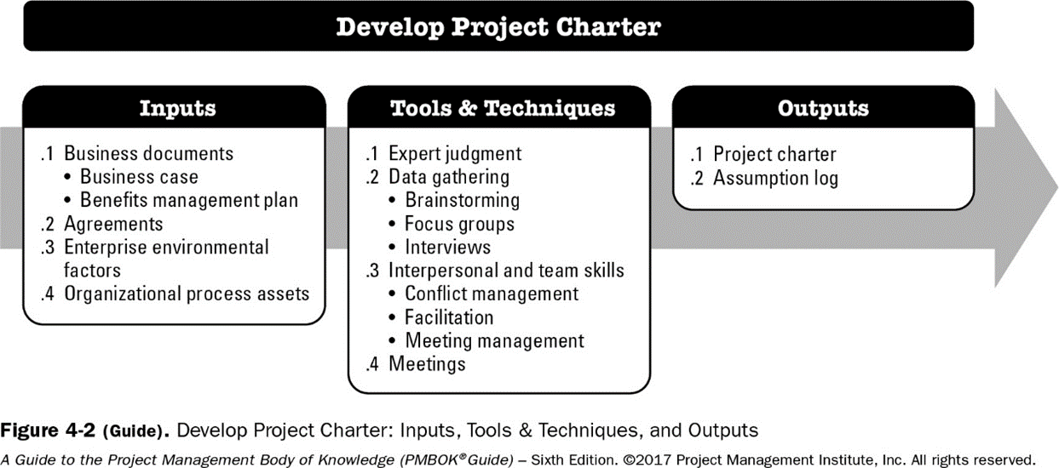
Tools and Techniques
Project Management Processes use inputs, tools and techniques to produce project outputs. Tools and techniques help project manager manage projects efficiently and effectively. Tools and techniques are grouped into 6 categories and are considered best practices. PMBOK recommends 132 tools and techniques.
.

Slide 79
GROUPINGS OF TOOLS AND TECHNIQUES
Data gathering techniques. Used to collect data and information from a variety of sources.
Data analysis techniques. Used to organize, assess, and evaluate data and information.
Data representation techniques. Used to show graphic representations or other methods used to convey data and information.
Decision-making techniques. Used to select a course of action from different alternatives.
Communication skills. Used to transfer information between stakeholders.
Interpersonal and team skills. Used to effectively lead and interact with team members and other stakeholders.
Ungrouped techniques: There are 60 ungrouped tools and techniques.

Slide 80
Some examples of Tools and Techniques
Data Gathering Tools and Techniques
Brainstorming
Interviews
Focus Groups
Data Analysis Tools and Techniques
Document Analysis
Assumption and Constraint Analysis
Earned Value Analysis
Stakeholder Analysis
Communication Tools and Techniques
Feedback
Presentations
Decision Making Tools and Techniques
Voting
Data Representation Tools and Techniques
Histograms
Flowcharts
Cause-and-effect diagrams
Ungrouped Tools and Techniques
Critical Path Method

Slide 81
Activity 4- Matching Pairs1on Nearpod
Framework-Tools and techniques

Slide 82
Tailoring
Project managers apply a project management framework to their work. All 49 processes are not always used.
The appropriate project management processes, inputs, tools, techniques, outputs, and life cycle phases should be selected to manage a project, based on project requirements, resources available and capabilities of the organization
This selection activity is known as tailoring project management to the project.
The project manager collaborates with the project team, sponsor, organizational management, or a combination of these people in the tailoring.

Slide 83
Project Environments - Overview
Projects exist and operate in environments that may have influence on them.
Influences can have favorable or unfavorable impact on the project.
Two major categories of influences are
Enterprise Environmental Factors (EEF)
Organizational Process Assets (OPA)
* Enterprise Environmental Factors: Conditions, not under the immediate control of the team, that influence, constrain, or direct the project, program, or portfolio.
* Organizational Process Assets: Plans, processes, policies, procedures, and knowledge bases that are specific to and used by the performing organization.
The PMI Registered Education Provider logo is a registered mark of the Project Management Institute, Inc.
This definition is taken from the Glossary of Project Management Institute, A Guide to the Project Management Body of Knowledge, (PMBOK® Guide) – Sixth Edition, Project Management Institute Inc., 2017.
Notes:
Notes:
EEFs may have an impact at the organizational, portfolio, program, or project level.
These may arise from the organization itself, a portfolio, a program, another project, or a combination of these.

Slide 84
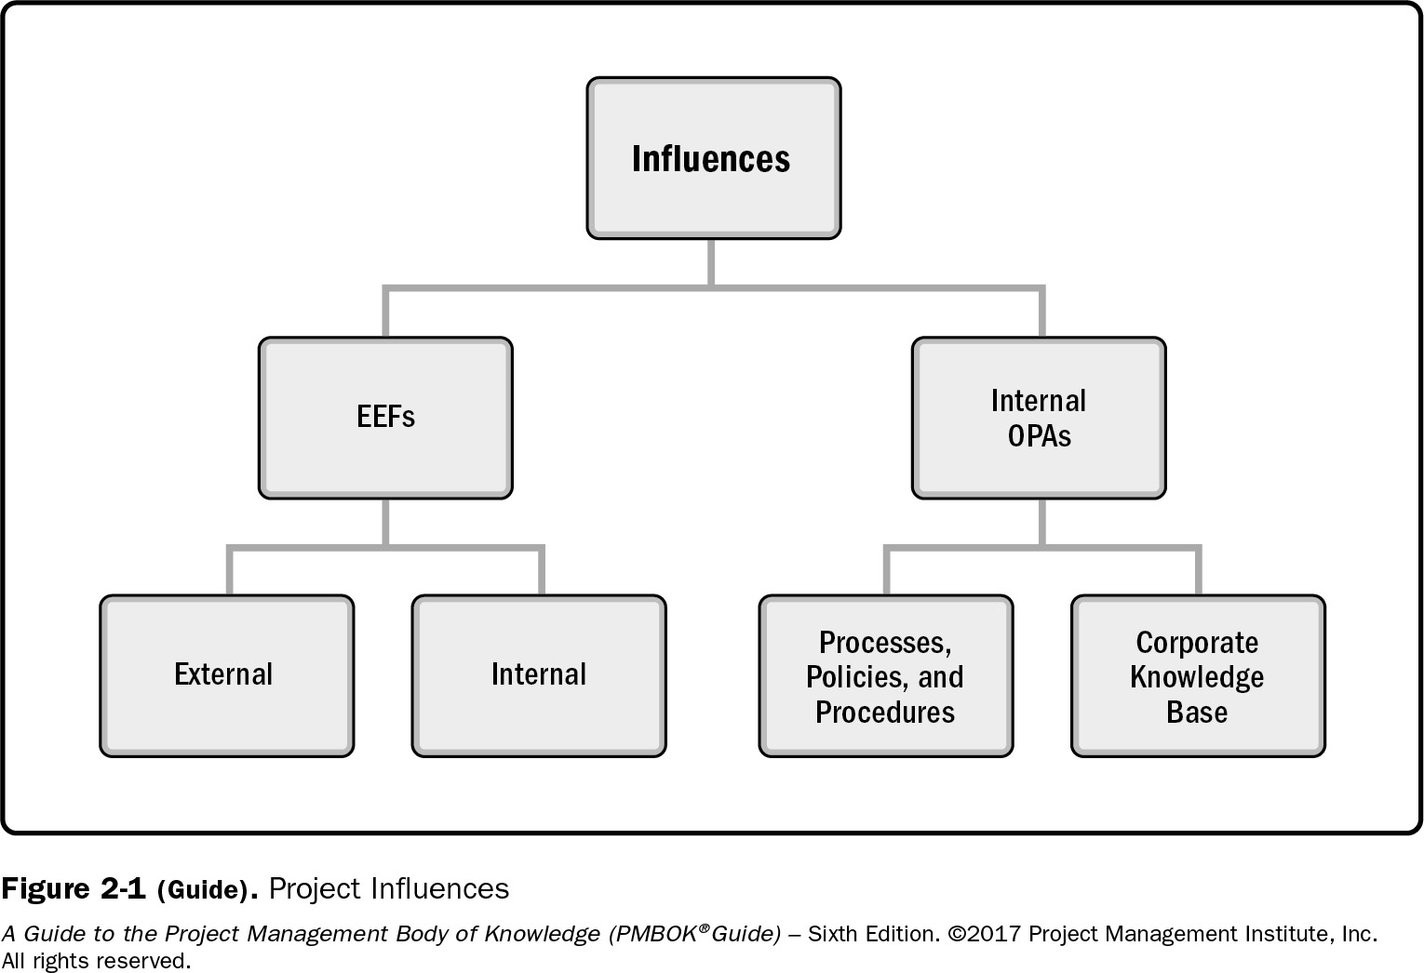
Overview
Breakdown of project influences into EFF and OPA.
These play a significant role in the life cycle of the project.
The PMI Registered Education Provider logo is a registered mark of the Project Management Institute, Inc.
Project Management Institute, A Guide to the Project Management Body of Knowledge, (PMBOK® Guide) – Sixth Edition, Project Management Institute Inc., 2017, Page 37.
Notes:
Notes: In addition to EEFs and OPAs, organizational systems play a significant role in the life cycle of the project. System
factors that impact the power, influence, interests, competencies, and political capabilities of the people to act within the
organizational system are discussed further in the section on organizational systems (See Section 2.4).

Slide 85
Enterprise Environmental Factors
Enterprise Environmental Factors: These are factors that influence, constrain, or direct the project, program, or portfolio. , These factors are not under the immediate control of the project manager or the team,
For example:
Political Decisions
Financial Market Changes
Disruptions caused by weather
Government/Legal policies
The PMI Registered Education Provider logo is a registered mark of the Project Management Institute, Inc.
This definition is taken from the Glossary of Project Management Institute, A Guide to the Project Management Body of Knowledge, (PMBOK® Guide) – Sixth Edition, Project Management Institute Inc., 2017.
Notes:
Notes: EEFs are considered as “Inputs” to many project management processes, specifically for most planning processes. These factors may enhance or constrain project management options.
Inputs can be the result of a compilation of various phases of a particular project. It could be the result of one specific work activity, or it can be data that is independent of the project process.

Slide 86
Enterprise Environmental Factors
EEFS INTERNAL TO THE ORGANIZATION
Organizational culture, structure, and governance
Geographic distribution of facilities and resources
Infrastructure
Information technology software
Resource availability
Employee capability
The PMI Registered Education Provider logo is a registered mark of the Project Management Institute, Inc.

Slide 87
Organizational Process Assets
*Organizational process assets (OPAs) are the plans, processes, policies, procedures, and knowledge bases specific to and used by the performing organization.
OPAs include any artifact, practice, or knowledge from any or all of the performing organizations involved in the project that can be used to execute or govern the project.
Can include:
Charters of current and previous projects
Completed schedules
Risk Data
Data relating to purachase of materials for projects
Lessons learnt on projects
The PMI Registered Education Provider logo is a registered mark of the Project Management Institute, Inc.
This definition is taken from the Glossary of Project Management Institute, A Guide to the Project Management Body of Knowledge, (PMBOK® Guide) – Sixth Edition, Project Management Institute Inc., 2017.
Notes:
Notes:
The OPAs also include the organization’s lessons learned from previous projects and historical information.
OPAs are internal to the organization.

Slide 88
Organizational Process Assets
OPAs are internal to the organization, the project team members may be able to update and add to the organizational process assets as necessary throughout the project.
OPAs Grouped into two categories:
Processes, policies, and procedures
Organizational knowledge bases
The PMI Registered Education Provider logo is a registered mark of the Project Management Institute, Inc.

Slide 89
Organizational Process Assets
OPA Category: Processes, policies, and procedures
Not updated as part of the project work.
Processes, policies, and procedures are usually established by the project management office (PMO) or another function outside of the project.
These can be updated only
by following the appropriate
organizational policies associated
with updating processes, policies,
or procedures.
The PMI Registered Education Provider logo is a registered mark of the Project Management Institute, Inc.
Notes:
Notes: Some organizations encourage the team to tailor templates, life cycles, and checklists for the project. In these instances, the project management team should tailor those assets to meet the needs of the project.

Slide 90
Organizational Process Assets
OPA Category: Organizational knowledge bases
Updated throughout the project with project information.
For example, information on financial performance, lessons learned, performance metrics and issues, and defects are continually updated
throughout the project.
The PMI Registered Education Provider logo is a registered mark of the Project Management Institute, Inc.

Slide 91
Activity 5- Matching Pairs2 on Nearpod
Framework- EEFS

Slide 92
Summary
The PMBOK framework includes
Project Process Groups, processes and Knowledge Areas
Processes require inputs and produce outputs relating to the project or product
Processes apply tools and techniques to inputs and generate outputs

Slide 93
End of Lesson Checklist
End of Lesson Checklist
Task | Status
Review slides
Complete Independent Learning
Complete Self-assessments in BBlearn
Complete Kahoot Quiz
Complete Activity

Slide 95
Project Integration Management (PIM)
Developed by: Dr. Nafeth Al hashlamoun, Reviewed by: Baraa Yousuf and Dr. Muawia Ramadan
The PMI Registered Education Provider logo is a registered mark of the Project Management Institute, Inc.
Materials in this course are based on the text, A Guide to the Project Management Body of Knowledge (PMBOK® Guide), Sixth edition, Project Management Institute, Inc. 2017

Slide 96
Document Revision Control​
Version​ | Date​ | Change Description​ | Reviewers​
1.1​ | 15-July-2020​ | Added sections. ​ Reorganized Content​ Improved slides on Integrated Change Control and Project Closing | SharmilaSiddartha, RulaAl Kayyali​

Slide 97
Learning Objectives
Explain what Project Integration is.
Produce a Project Charter
Develop a Project Management Plan
Explain how to Direct and Manage Project Work
Show how to Manage Project Knowledge
Illustrate how to Monitor and Control Project Work
Describe Perform Integrated Change Control
Recognize the importance of closing a Project or Phase
The PMI Registered Education Provider logo is a registered mark of the Project Management Institute, Inc.

Slide 98
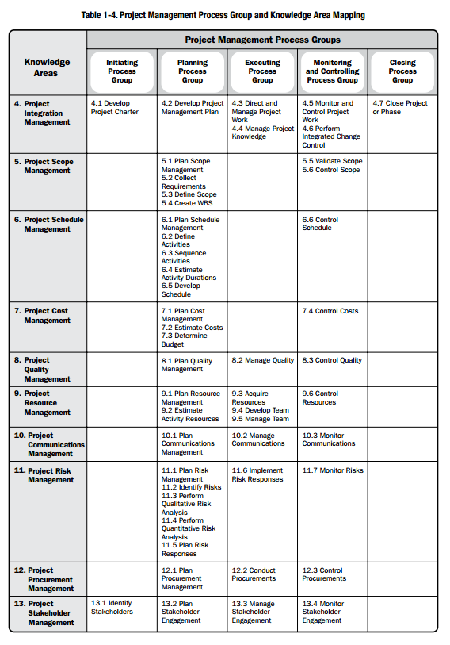
Mapping of Process Groups to Knowledge Areas

Slide 99
What is Project Integration Management?***
“Project Integration Management includes the processes and activities to identify, define, combine, unify, and coordinate the various processes and project management activities within the Project Management Process Groups.”
“Project Integration Management is specific to Project Managers whereas other Knowledge Areas may be managed by specialists (e.g., cost analysis, scheduling specialists, risk management experts).”
“The Project Manager is the one who combines the results in all the other Knowledge Areas and has the overall view of the project. The project manager is ultimately responsible for the project as a whole.”
The PMI Registered Education Provider logo is a registered mark of the Project Management Institute, Inc.
Excerpt from Project Management Institute, A Guide to the Project Management Body of Knowledge, (PMBOK® Guide) – Sixth Edition, Project Management Institute Inc., 2017, Pages 69, 72.
Notes:
What is PI Management? Who is responsible for this knowledge area?

Slide 100
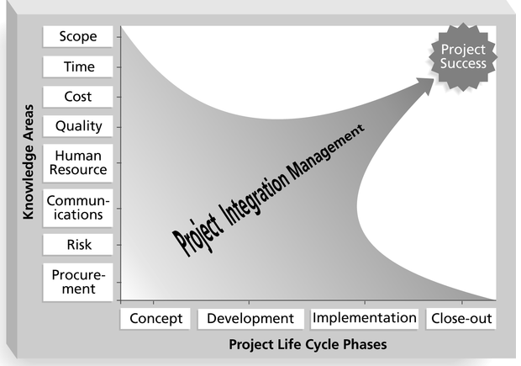
Framework for Project Integration Management
Focus on pulling everything to-
gether to reach project success!

Slide 101
Integration Management Processes - Summary***
Develop Project Charter—The process of developing a document that formally authorizes the existence of a project and provides the project manager with the authority to apply organizational resources to project activities.
Develop Project Management Plan—The process of defining, preparing, and coordinating all plan components and consolidating them into an integrated project management plan.
Direct and Manage Project Work—The process of leading and performing the work defined in the project management plan and implementing approved changes to achieve the project’s objectives.
Manage Project Knowledge—The process of using existing knowledge and creating new knowledge to achieve the project’s objectives and contribute to organizational learning.
Monitor and Control Project Work—The process of tracking, reviewing, and reporting overall progress to meet the performance objectives defined in the project management plan.
Perform Integrated Change Control—The process of reviewing all change requests; approving changes and managing changes to deliverables, organizational process assets, project documents, and the project management plan; and communicating the decisions.
Close Project or Phase—The process of finalizing all activities for the project, phase, or contract.
The PMI Registered Education Provider logo is a registered mark of the Project Management Institute, Inc.
*These definitions are taken from the Glossary of Project Management Institute, A Guide to the Project Management Body of Knowledge, (PMBOK® Guide) – Sixth Edition, Project Management Institute Inc., 2017.

Slide 102
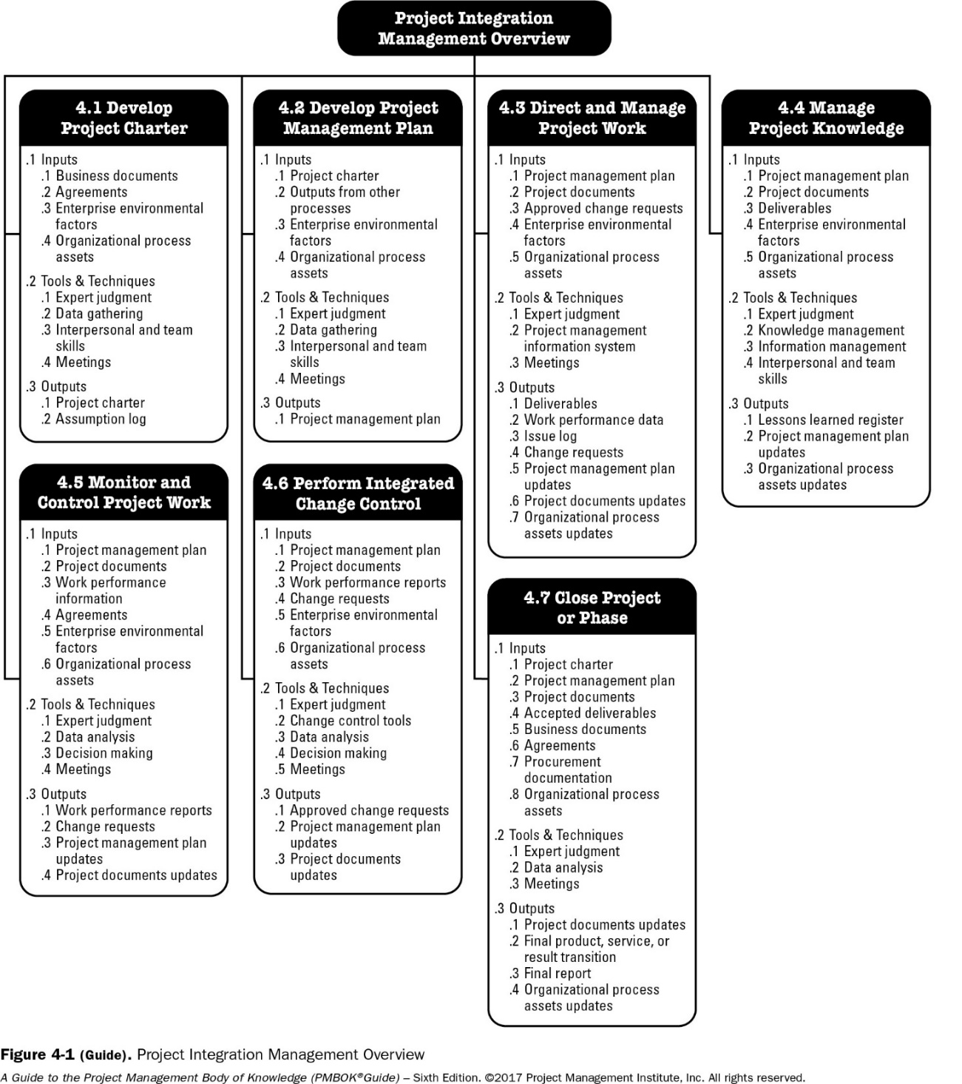
Project Integration Management Overview*
(Inputs, Tools & Techniques, and Outputs of each one of the Project Integration processes)
The PMI Registered Education Provider logo is a registered mark of the Project Management Institute, Inc.
Project Management Institute, A Guide to the Project Management Body of Knowledge, (PMBOK® Guide) – Sixth Edition, Project Management Institute Inc., 2017, Page 71.
Notes:
*Students should understand the concept of ITTO in general. For assessment purposes focus on: 4.1, 4.2 and 4.7 only

Slide 103
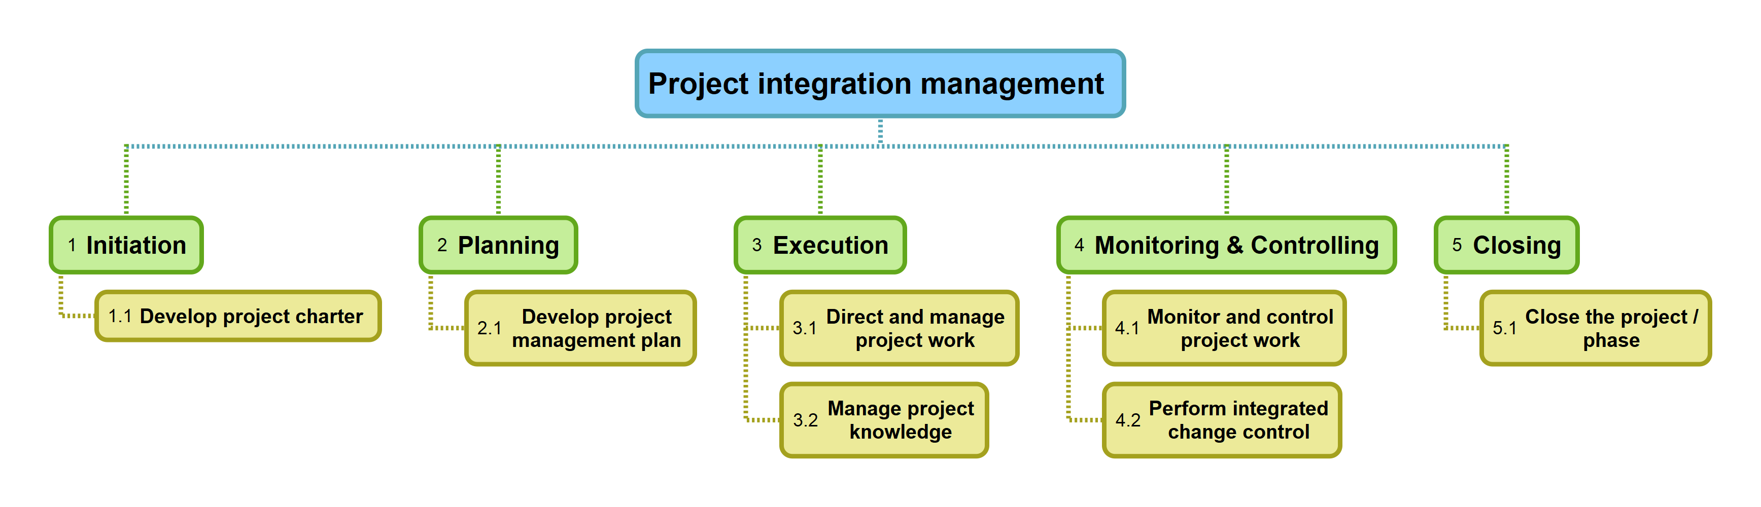
PIM Mind-Map

Slide 104
Identify projects
A Project generally comes about to address a Need or Demand, e.g.:
Market demand
Strategic opportunity/Business need
Customer request
Technological advance
Legal requirement
Social need
A Feasibility Study is carried as a separate project or subproject, or as the first lifecycle phase of the project, and is required to confirm the:
Feasibility of the project
Feasibility of the product
Notes:
Market demand: applying for new loans or refinance online due to drop in interest rates
Business need: a call center reaching its maximum capacity and affecting customer satisfaction
Customer request: a customer asking to automate some of its operations to improve productivity
Technological advance: mobile phones with high quality embedded cameras
Legal requirement: Emirate ID implied endless series of reprogramming projects for current systems
Social need: the need for H1N1 Flu vaccination and medical supplies introduced series of projects in 2009!

Slide 105
Activity1- Quiz on Nearpod
PIM-Activity-Quiz1

Slide 106

4.1 Develop Project Charter
The PMI Registered Education Provider logo is a registered mark of the Project Management Institute, Inc.
Project Management Institute, A Guide to the Project Management Body of Knowledge, (PMBOK® Guide) – Sixth Edition, Project Management Institute Inc., 2017, Page 75.
Notes:
Note: Develop Project Charter is the process that creates the outputs Project Charter and Assumption log.

Slide 107
What is Develop Project Charter?
The process of developing a document that formally authorizes a project or a phase and documenting the initial requirements that satisfy the stakeholder’s needs and expectations (Project Birth Certificate)
Projects must be authorized by someone external to the project such as the sponsor, or the PMO, or the Portfolio Steering Committee.
The Project charter is normally created by the above or delegated to the Project Manager.
The PMI Registered Education Provider logo is a registered mark of the Project Management Institute, Inc.

Slide 108
Develop Project Charter: Inputs
Business documents
Business case. The approved business case, or similar, is the business document most commonly used to create the project charter.
The business case describes the necessary information from a business standpoint to determine whether the expected outcomes of the project justify the required investment.
Typically, the business need and the cost benefit analysis are contained in the business case to justify and establish boundaries for the project.
Benefits management plan
A benefits management plan describes how and when the benefits of the project will be delivered and how they will be measured.
Agreements
Agreements are used to define initial intentions for a project. Agreements may take the form of contracts, memorandums of understanding (MOUs), service level agreements (SLA), letters of agreement, letters of intent, verbal agreements, email, or other written agreements.
Typically, a contract is used when a project is being performed for an external customer.
The PMI Registered Education Provider logo is a registered mark of the Project Management Institute, Inc.

Slide 109
Develop Project Charter: Inputs (Cont.)
Enterprise Environmental Factors: This includes: “Government or industry standards (e.g., product standards, quality standards, safety standards, and workmanship standards), Legal and regulatory requirements and/or constraints, Marketplace conditions, Organizational culture and political climate, Organizational governance framework (a structured way to provide control, direction, and coordination through people, policies, and processes to meet organizational strategic and operational goals), and Stakeholders’ expectations and risk thresholds.*
Organizational Process Assets. This includes: “Organizational standard policies, processes, and procedures; Portfolio, program, and project governance framework (governance functions and processes to provide guidance and decision making); Monitoring and reporting methods; Templates (e.g., project charter template); and Historical information and lessons learned repository (e.g., project records and documents, information about the results of previous project selection decisions, and information about previous project performance).”*
The PMI Registered Education Provider logo is a registered mark of the Project Management Institute, Inc.
*Based on Project Management Institute, A Guide to the Project Management Body of Knowledge, (PMBOK® Guide) – Sixth Edition, Project Management Institute Inc., 2017, Page 78.

Slide 110
Develop Project Charter: Tools and Techniques
Expert Judgment, knowledgeable and experienced people:
Other units within the organization
Consultants
Different Stakeholders (including the customer)
Project Management Office
Facilitation Techniques:
Brainstorming,
conflict resolution,
problem solving,
and meetings
The PMI Registered Education Provider logo is a registered mark of the Project Management Institute, Inc.

Slide 111
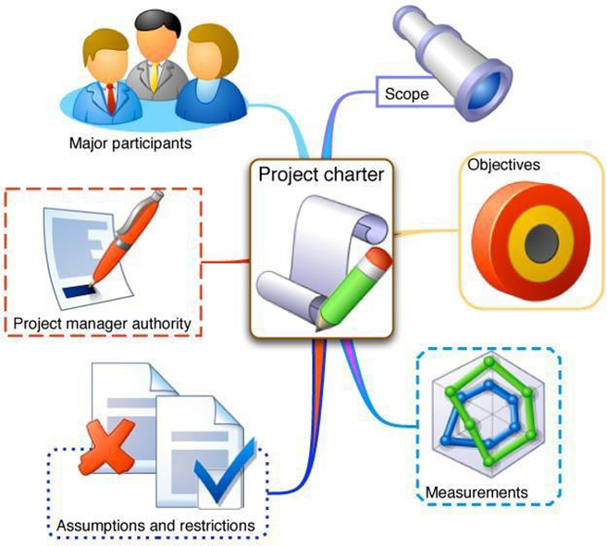
Develop Project Charter: Outputs
The main output of this process is the Project Charter. Following is what the charter contains:
Project Purpose/Justification
Measurable Project Objectives
High-level requirements
Assumptions and Constraints
High level project description
High level Risks
Summary budget & milestones
Initial Stakeholder List
Project Approval Requirements
Assigned Project Manager
Name and Authority of the sponsor
The PMI Registered Education Provider logo is a registered mark of the Project Management Institute, Inc.

Slide 112
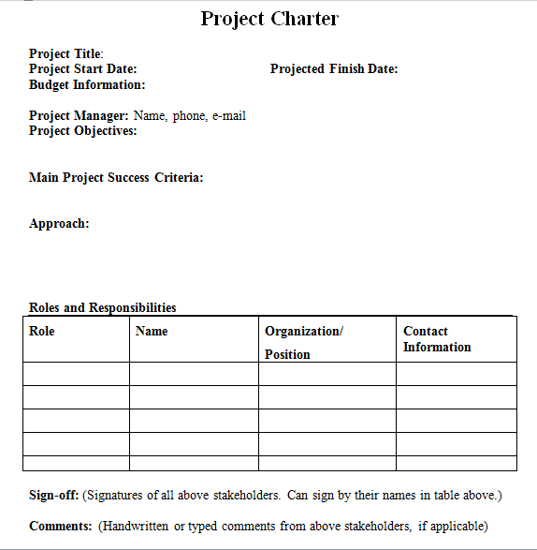
Sample Project Charter
The image on the right shows a very simplified sample of a Project Charter.
The PMI Registered Education Provider logo is a registered mark of the Project Management Institute, Inc.

Slide 113
Activity2- Inspect charter and answer questions on Nearpod collaborate board

Slide 114
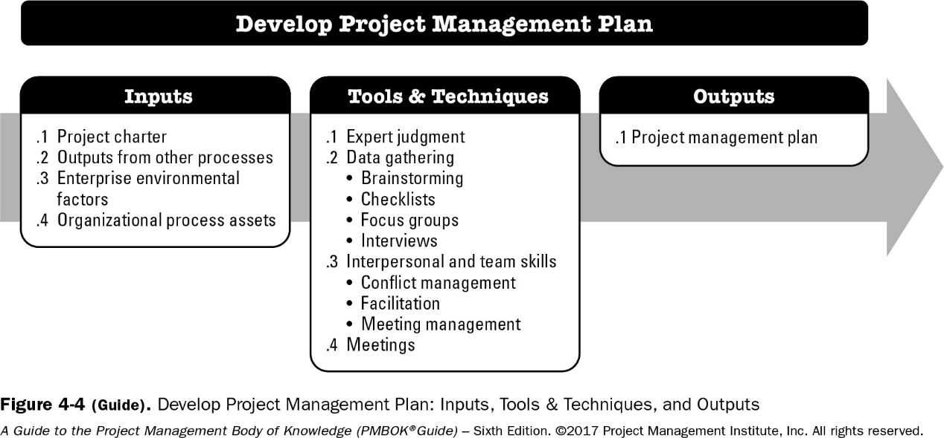
4.2 Develop Project Management Plan
The PMI Registered Education Provider logo is a registered mark of the Project Management Institute, Inc.
Project Management Institute, A Guide to the Project Management Body of Knowledge, (PMBOK® Guide) – Sixth Edition, Project Management Institute Inc., 2017, Page 82.

Slide 115
What is Develop Project Management Plan?
The process of documenting the actions necessary to define, prepare, integrate and coordinate all subsidiary plans. The key benefit of this process is the production of a comprehensive document that defines the basis of all project work and how the work will be performed.
It integrates and consolidates all of the subsidiary management plans and baselines, and other information necessary to manage the project
The project management plan defines how the project is executed, monitored and controlled, and closed.
The project management plan should be baselined; that is, it is necessary to define at least the project references for scope, time, and cost, so that the project execution can be measured and compared to those references and performance can be managed.
Once it is baselined, it may only be changed through the Perform Integrated Change Control process.
The PMI Registered Education Provider logo is a registered mark of the Project Management Institute, Inc.

Slide 116
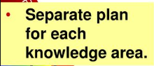
What are the Subsidiary Management Plans?
Scope management plan.
Requirements management plan.
Schedule management plan.
Cost management plan.
Quality management plan.
Resource management plan.
Communications management plan.
Risk management plan.
Procurement management plan.
Stakeholder engagement plan.
The PMI Registered Education Provider logo is a registered mark of the Project Management Institute, Inc.

Slide 117
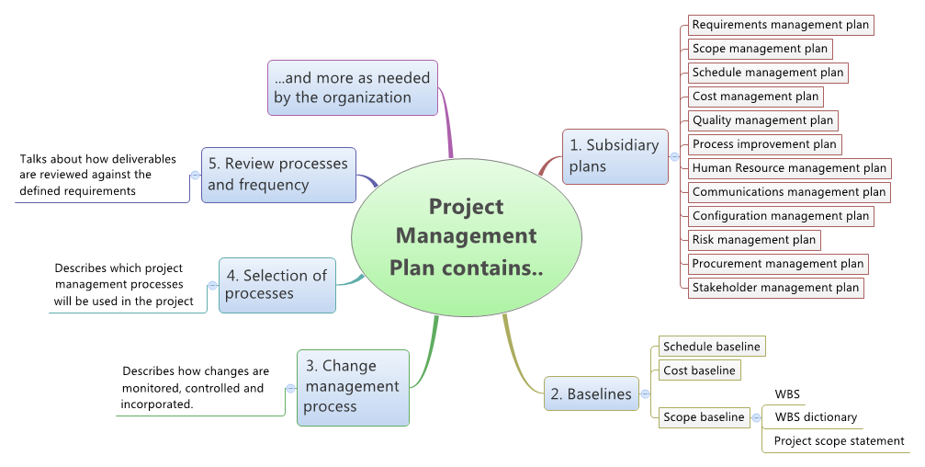
Project Management Plan Mind-Map

Slide 118
Activity3- Quiz on Nearpod
PIM-Project Planning Quiz

Slide 119
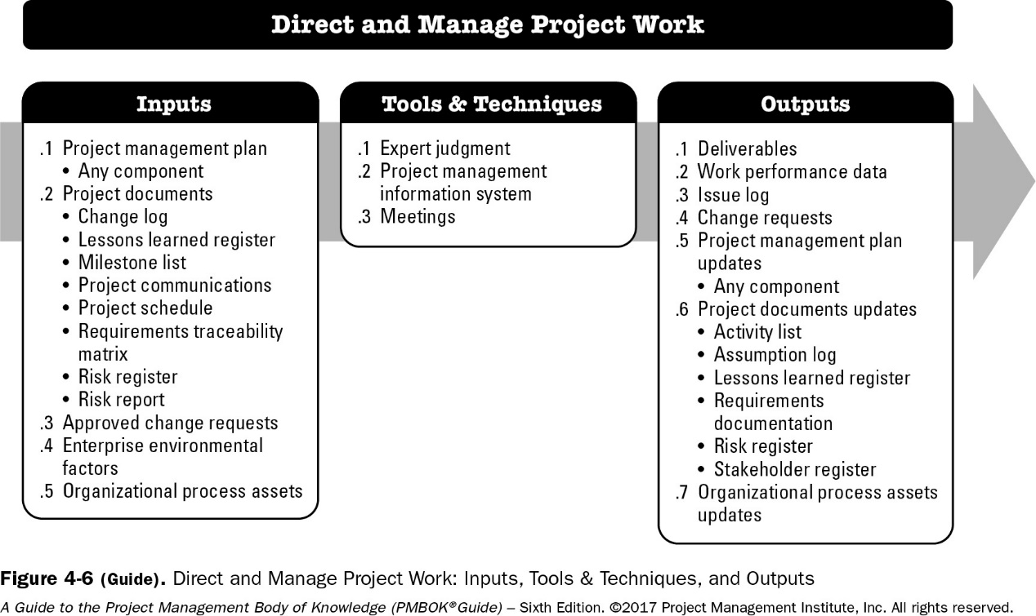
4.3 Direct and Manage Project Work
The PMI Registered Education Provider logo is a registered mark of the Project Management Institute, Inc.
Project Management Institute, A Guide to the Project Management Body of Knowledge, (PMBOK® Guide) – Sixth Edition, Project Management Institute Inc., 2017, Page 90.
Notes:
optional

Slide 120
What is the Direct and Manage Project Work process?
Direct and Manage Project Work is the process of leading and performing the work defined in the project management plan and implementing approved changes to achieve the project’s objectives.
This process provides overall management of the project work and project deliverables
It is performed throughout the project.
It mainly refers to the execution of the planned project activities to complete project deliverables
The PM directs the execution of the planned project activities.
The PMI Registered Education Provider logo is a registered mark of the Project Management Institute, Inc.

Slide 121
What is involved in the Direct and Manage Project Work process?*
Performing activities to accomplish project objectives
Creating project deliverables to meet the planned project work
Providing, training & managing team members assigned to the project
Obtaining, managing & using resources
Implementing planned methods & standards
Establishing communication channels
Generating work performance data
Issuing change requests
Managing risks
Managing stakeholders’ engagement
The PMI Registered Education Provider logo is a registered mark of the Project Management Institute, Inc.
Notes:
*No need to memorize

Slide 122
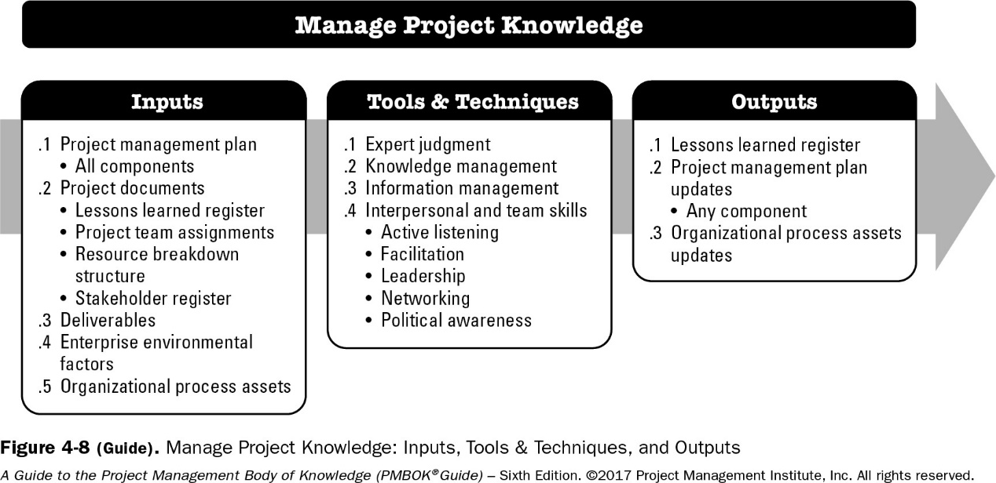
4.4 Manage Project Knowledge {*NEW*}
Manage Project Knowledge is the process that uses existing or historical knowledge about projects and contributes to the creation of new knowledge for the benefit of organization.
The PMI Registered Education Provider logo is a registered mark of the Project Management Institute, Inc.
Project Management Institute, A Guide to the Project Management Body of Knowledge, (PMBOK® Guide) – Sixth Edition, Project Management Institute Inc., 2017, Page 98.

Slide 123
What is the Manage Project Knowledge Process?
Manage Project Knowledge is a NEW process that was included in the PMBOK Guide 6th Edition.
It is the process of “using existing knowledge and creating new knowledge to achieve the project’s objectives and contribute to organizational learning” *
The key benefits of this process are that prior organizational knowledge is leveraged to produce or improve the project outcomes, and knowledge created by the project is available to support organizational operations and future projects or phases.
This process is performed throughout the project.
The inputs, tools and techniques, and outputs of the process are depicted in Figure 4-8 that is displayed in the previous slide
The PMI Registered Education Provider logo is a registered mark of the Project Management Institute, Inc.

Slide 124
Manage Project Knowledge: Inputs
Project Management Plan: All components of the project management plan are inputs.
Project Documents: Project documents that can be considered as inputs for this process include but are not limited to:
Lessons learned register. The lessons learned register provides information on effective practices in knowledge management.
Project team assignments. Project team assignments provide information on the type of competencies and experience available in the project and the knowledge that may be missing.
Resource breakdown structure. The resource breakdown structure includes information on the composition of the team and may help to understand what knowledge is available as a group and what knowledge is missing.
Stakeholder register. The stakeholder register contains details about the identified stakeholders to help understand the knowledge they may have.
Deliverables:
A deliverable is any unique and verifiable product, result, or capability to perform a service that is required to be produced to complete a process, phase, or project.
Deliverables are typically tangible components completed to meet the project objectives and can include components of the project management plan.
Enterprise Environmental Factors
Organizational Process Assets
The PMI Registered Education Provider logo is a registered mark of the Project Management Institute, Inc.
Notes:
optional

Slide 125
Manage Project Knowledge: Tools & Techniques
Expert Judgment
Knowledge Management
Knowledge management tools and techniques connect people so they can work together to create new knowledge, share tacit knowledge, and integrate the knowledge of diverse team members. The tools and techniques appropriate in a project depend on the nature of the project, especially the degree of innovation involved, the project complexity, and the level of diversity (including diversity of disciplines) among team members.
Information Management
Information management tools and techniques are used to create and connect people to information. They are effective for sharing simple, unambiguous, codified explicit knowledge
Interpersonal and Team Skills
For example: Active listening, Facilitation Leadership, Networking, and Political awareness.
The PMI Registered Education Provider logo is a registered mark of the Project Management Institute, Inc.
Notes:
optional

Slide 126
Manage Project Knowledge: Outputs
Lessons Learned Register
The lessons learned register can include the category and description of the situation. The lessons learned register may also include the impact, recommendations, and proposed actions associated with the situation.
The lessons learned register may record challenges, problems, realized risks and opportunities, or other content as appropriate.
Project Management Plan Updates
Any change to the project management plan goes through the organization’s change control process via a change request. Any component of the project management plan may be updated as a result of this process
Organizational Process Assets Updates
Existing knowledge can also be added or embedded for the first time as a result of this process; for example, if an existing idea for a new procedure is piloted in the project and found to be successful.
The PMI Registered Education Provider logo is a registered mark of the Project Management Institute, Inc.
Notes:
optional

Slide 127
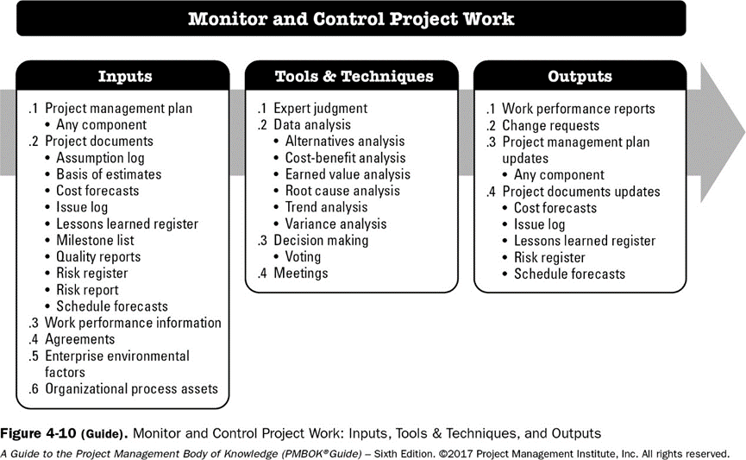
4.5 Monitor and Control Project Work
The PMI Registered Education Provider logo is a registered mark of the Project Management Institute, Inc.
Project Management Institute, A Guide to the Project Management Body of Knowledge, (PMBOK® Guide) – Sixth Edition, Project Management Institute Inc., 2017, Page 105.
Notes:
optional

Slide 128
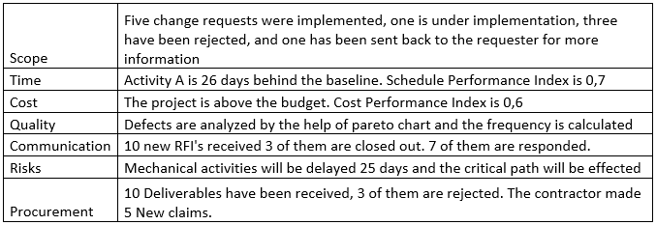
Work Performance Information and Reports
While project work is performed, information is collected and distributed as per the communication plan
Source:
https://www.projectcubicle.com/work-performance-data-work-performance-information/

Slide 129
What is the Monitor and Control Project Work process?
Monitor and Control Project Work is the process of tracking, reviewing, and reporting the overall progress to meet the performance objectives defined in the project management plan.
The key benefits of this process are that it allows stakeholders to understand the current state of the project, to recognize the actions taken to address any performance issues, and to have visibility into the future project status with cost and schedule forecasts.
This process is performed throughout the project.
The inputs, tools and techniques, and outputs of the process are depicted in Figure 4-10 that is displayed in the previous slide.
The PMI Registered Education Provider logo is a registered mark of the Project Management Institute, Inc.

Slide 130
What are some tasks in monitoring and controlling projects?
Comparing actual project performance against the project management plan;
Assessing performance periodically to determine whether any corrective or preventive actions are indicated, and then recommending those actions as necessary;
Checking the status of individual project risks;
Maintaining an accurate, timely information base concerning the project’s product(s) and their associated documentation through project completion;
Providing information to support status reporting, progress measurement, and forecasting;
Providing forecasts to update current cost and current schedule information;
Monitoring implementation of approved changes as they occur;
Providing appropriate reporting on project progress and status to program management when the project is part of an overall program; and
Ensuring that the project stays aligned with the business needs.
The PMI Registered Education Provider logo is a registered mark of the Project Management Institute, Inc.
Notes:
No need to memorize all the activities.

Slide 131
Activity4- Matching activity on Nearpod

Slide 132
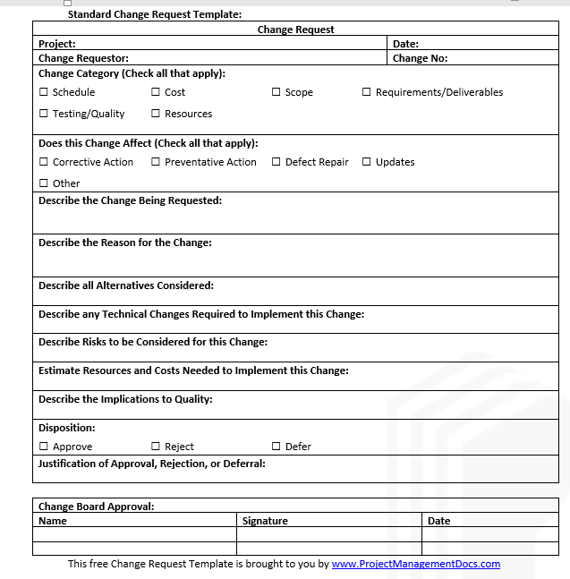
Change Requests
A project can have several change requests relating to:
Scope
Costs
Schedule
Constraints
Technology
Resources
Changes must be requested using a formal document and must be approved
The impact of change is assessed before approval

Slide 133
Examples of Changes
Customer includes a new requirement
Due to an unforeseen event, the number of project working hours have reduced, resulting in changes to the schedule
A product that is essential for the project has been withdrawn by the manufacturer. This product must be replaced by a newer model with slightly different specifications.
A project needs an additional team member

Slide 134
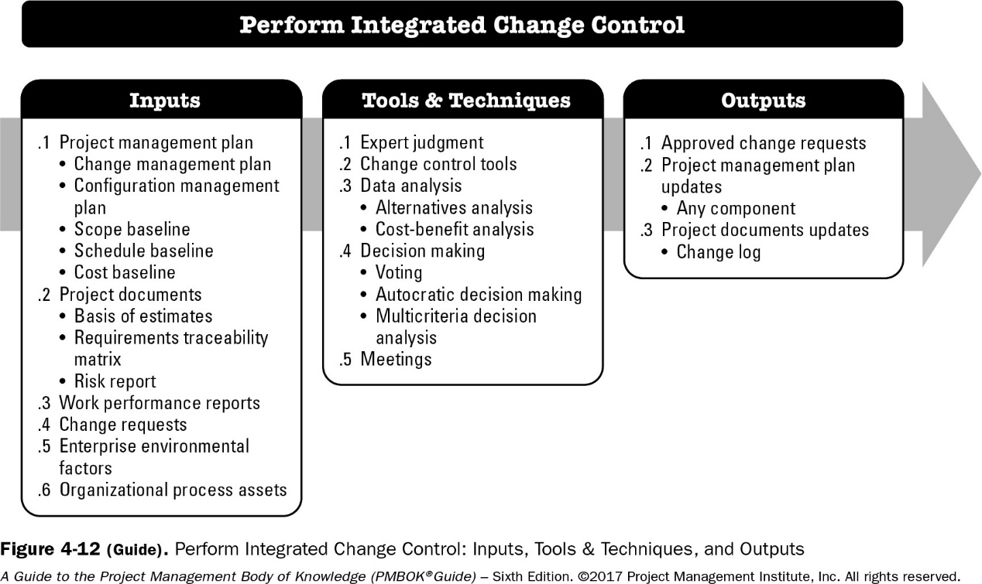
4.6 Perform Integrated Change Control
The PMI Registered Education Provider logo is a registered mark of the Project Management Institute, Inc.
Project Management Institute, A Guide to the Project Management Body of Knowledge, (PMBOK® Guide) – Sixth Edition, Project Management Institute Inc., 2017, Page 113.
Notes:
optional

Slide 135
What is the Perform Integrated Change Control process?
Perform Integrated Change Control is the process of reviewing all change requests; approving changes and managing changes to deliverables, project documents, and the project management plan; and communicating the decisions.
This process reviews all requests for changes to project documents, deliverables, or the project management plan and determines the resolution of the change requests.
The key benefit of this process is that it allows for documented changes within the project to be considered in an integrated manner while addressing overall project risk, which often arises from changes made without consideration of the overall project objectives or plans.
This process is performed throughout the project.
The inputs, tools and techniques, and outputs of the process are depicted in Figure 4-12 that is displayed in the previous slide.
The PMI Registered Education Provider logo is a registered mark of the Project Management Institute, Inc.

Slide 136
Perform Integrated Change Control
Three main objectives:
Influence the factors that create changes to ensure that changes are beneficial.
Determine that a change has occurred.
Manage actual changes as they occur.
A baseline is the approved project management plan plus approved changes.

Slide 137
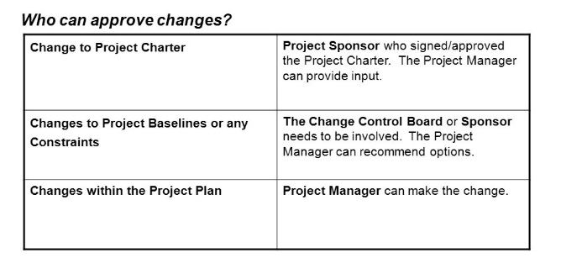
Perform Integrated Change Control

Slide 138
When is a project closed?
When all the work is confirmed to be completed
When all the project management processes have been executed
Stakeholders agree that the project is completed

Slide 139
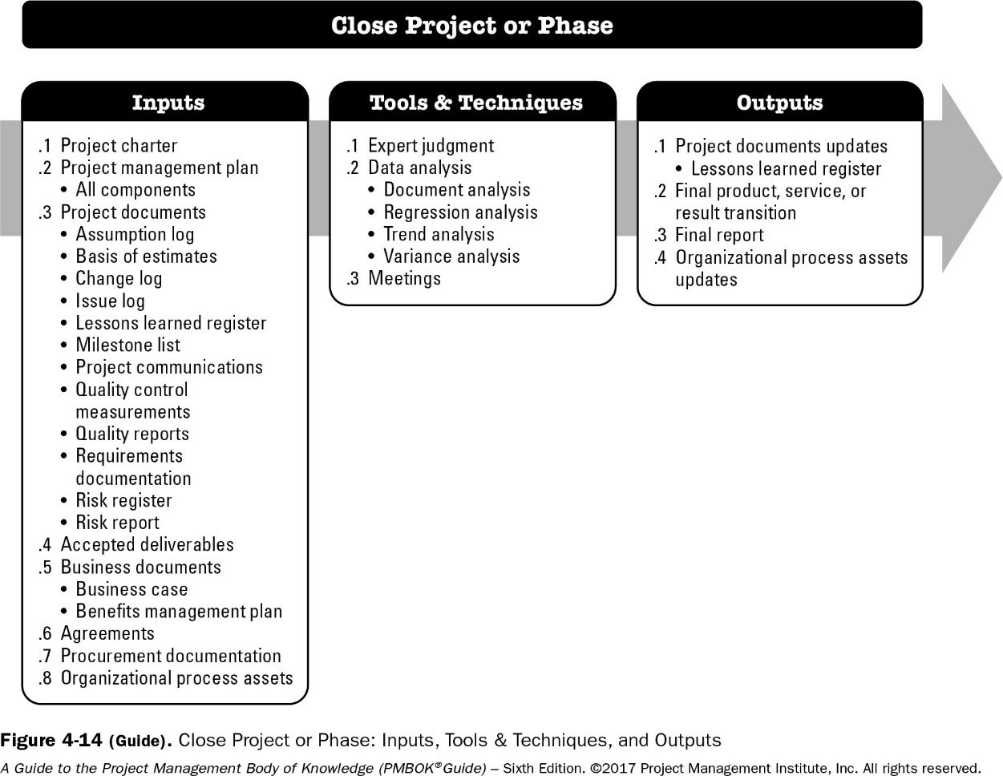
4.7 Close Project or Phase
The PMI Registered Education Provider logo is a registered mark of the Project Management Institute, Inc.
Project Management Institute, A Guide to the Project Management Body of Knowledge, (PMBOK® Guide) – Sixth Edition, Project Management Institute Inc., 2017, Page 121.

Slide 140
What is the Close Project or Phase process?
Close Project or Phase is the process of finalizing all activities for the project, phase, or contract.
The key benefits of this process are:
The project or phase information is archived,
the planned work is completed,
All costs are charged to the project account
and organizational team resources are released to pursue new projects.
This process is performed once or at predefined points in the project.
The inputs, tools and techniques, and outputs of the process are depicted in Figure 4-14 that is displayed in the previous slide.
The PMI Registered Education Provider logo is a registered mark of the Project Management Institute, Inc.

Slide 141
Summary
Project Integration management is the direct responsibility of the project manager
Activities of integration management are conducted through all project process groups
Key project documents such as the charter, project plan, change requests, project progress reports, lessons learned reports and project final report are produced

Slide 142
Activity5- Quiz on Nearpod
Open ended questions. Answers are to be recorded

Slide 143
End of Lesson Checklist
Task​ | Status​
Review slides​ | ​
Complete Independent Learning ​ | ​
Complete Self-assessments in BBlearn​ | ​
Complete Kahoot Quiz​ | ​
Complete Activity​ | ​

Slide 145
Project Stakeholder Management
Prepared by: Dr. Rula Kayyali, Reviewed by: Dr. Heba Mohammad
The PMI Registered Education Provider logo is a registered mark of the Project Management Institute, Inc.
Materials in this course are based on the text, A Guide to the Project Management Body of Knowledge (PMBOK® Guide), Sixth edition, Project Management Institute, Inc. 2017
Notes:
201930-Edited for flipped learning

Slide 146
Document Revision Control
Version | Date | Change Description | Reviewers
1.1 | 15-July-2020 | Reorganized Content Improved slides on Analyzing Stakeholders Added Summary Slides Recommended mode of delivery: Flipped Learning | Sharmila Siddartha, Rula Al Kayyali

Slide 147
Learning Objectives
Identify Stakeholders
Plan Stakeholder Engagement
Manage Stakeholder Engagement
Monitor Stakeholder Engagement
The PMI Registered Education Provider logo is a registered mark of the Project Management Institute, Inc.

Slide 148
Stakeholder Management Mind Map
Initiation
Planning
Execution
Monitoring and Controlling
Identify Stakeholder
Plan Stakeholder Engagement
Manage Stakeholder Engagement
Monitor Stakeholder Engagement

Slide 149
Identify Stakeholders
Stakeholders are people, groups, or organizations that could impact or be impacted by the project. These include:
Customers
Sponsors
Team Members
Suppliers
Labor unions
The PMI Registered Education Provider logo is a registered mark of the Project Management Institute, Inc.

Slide 150
Identify Stakeholders
Identifying and engaging stakeholders is an iterative process and should be reviewed and updated frequently, like in times when the project moves from phase to phase, or when some new stakeholders get involved in the project or some leave.
Identifying stakeholders include analyzing and documenting their interests, involvement, interdependencies, influence, and their potential impact on the project success.
The PMI Registered Education Provider logo is a registered mark of the Project Management Institute, Inc.

Slide 151
Activity: List Stakeholders
Project | Stakeholders
Construction of a shopping center near your campus
Expo 2020/2021 event in Dubai
Project that you do did for one of your previous courses
Project to develop an application to track visitors to your campus

Slide 152
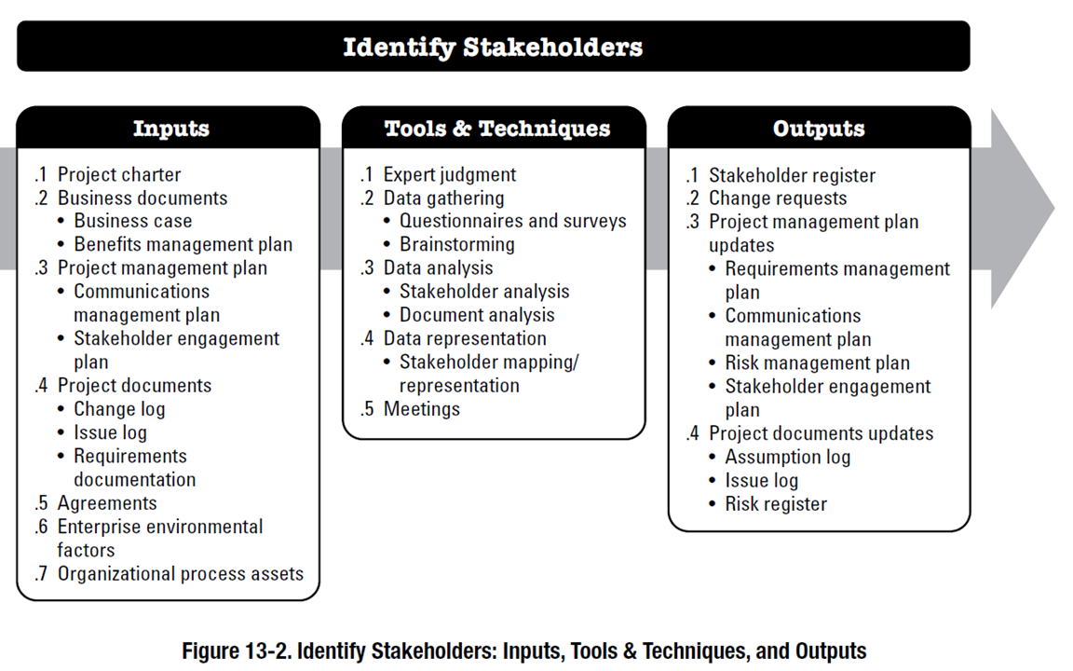
Identify Stakeholders – Inputs, T&T, Outputs
The PMI Registered Education Provider logo is a registered mark of the Project Management Institute, Inc.
Project Management Institute, A Guide to the Project Management Body of Knowledge, (PMBOK® Guide) – Sixth Edition, Project Management Institute Inc., 2017, Page 507

Slide 153
Stakeholder Analysis (Source: https://www.mindtools.com/pages/article/newPPM_07.htm)
Questions that can help you understand your stakeholders include:
What financial or emotional interest do they have in the outcome of your work? Is it positive or negative?
What motivates them? Is it higher profits, better reputation, pride?
What information do they want from you, and what is the best way of communicating with them?
What information do I need from them?
What elements of my project can they influence? Is it resources? Is it scope? Is it the budget?
What is their current opinion of your work? Is it based on good information?
Who influences their opinions general?
If they aren’t likely to be positive, what will win them around to support your project?
If you don't think that you’ll be able to win them around, how will you manage their opposition?

Slide 154
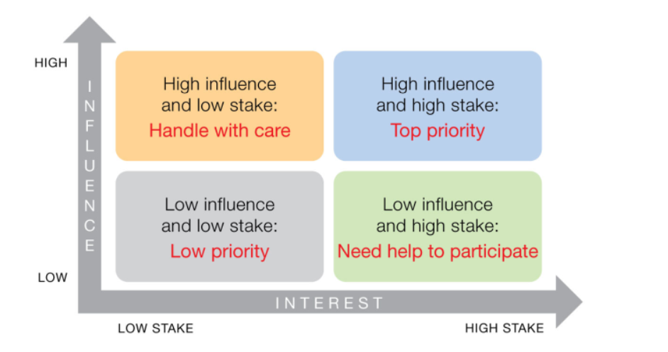
Example of Stakeholder Mapping using the Influence/Power-Interest Grid
https://www.iaea.org/resources/nuclear-communicators-toolbox/methods/planning/stakeholder-analysis

Slide 155
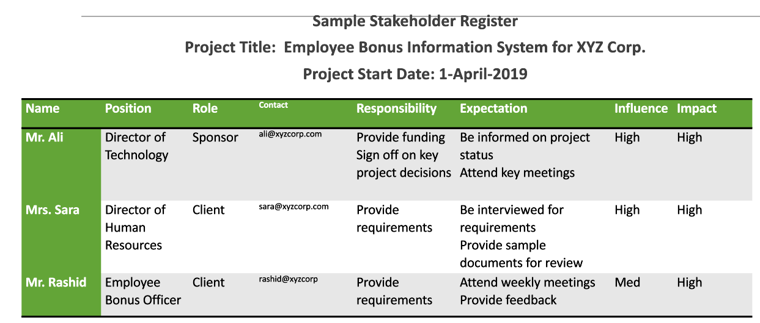
Output of Identify Stakeholder process: Stakeholder Register
Notes:
Influence on Project Outcome
Impact on Project

Slide 156
Plan Stakeholder Engagement
This is the process of developing approaches to involve project stakeholders based on their needs, expectations, interests, and impact on the project.
The key objective is to have a plan to interact effectively with stakeholders.
This process is performed periodically throughout the project as needed.
The PMI Registered Education Provider logo is a registered mark of the Project Management Institute, Inc.

Slide 157
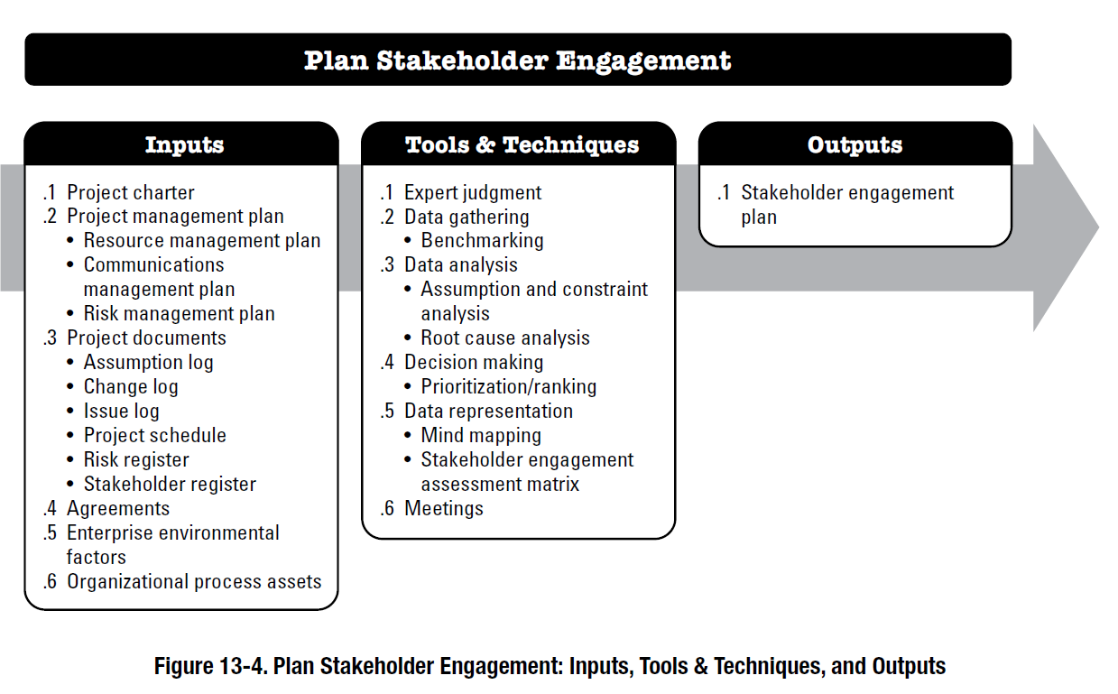
Plan Stakeholder Engagement – Inputs, T&T, Outputs
The PMI Registered Education Provider logo is a registered mark of the Project Management Institute, Inc.
Project Management Institute, A Guide to the Project Management Body of Knowledge, (PMBOK® Guide) – Sixth Edition, Project Management Institute Inc., 2017, Page 516

Slide 158
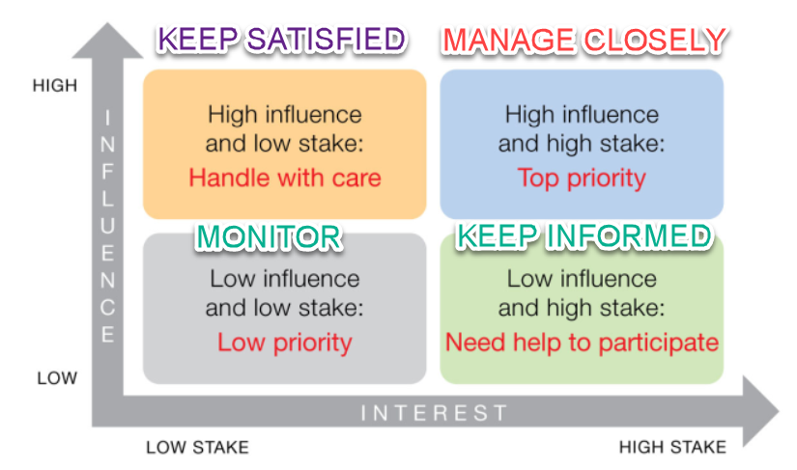
Engagement Plan: Stakeholder Mapping
Notes:
Engagement is all about:
Which group of stakeholders must you keep in close contact and engage in the best possible way?
Which group of stakeholders must you keep satisfied?
Which group of stakeholders must you keep informed and not ignored?
Which group of stakeholders requires the least amount of attention?

Slide 159
Sample: Stakeholder Engagement Plan Source: Template from www.nzta.govt.nz
For each stakeholder, determine the engagement purpose (eg share, listen, consult, explore, collaborate). Determine the engagement technique (eg workshops, one-to-one meeting, focus groups). Determine the frequency of engagement required for each stakeholder (eg daily, weekly, monthly, quarterly, annually). Provide a schedule outlining dates and locations where stakeholder engagement activities will take place. List for each engagement activity the designated activity owner.
Stakeholder | Engagement purpose | Engagement technique | Engagement frequency | Date(s) and location | Activity owner | Activity progress
Mr. Ali | Consult | workshop | monthly | 2nd Monday every month, HO | Mr. Rashid | Ongoing

Slide 160
Manage Stakeholder Engagement
This is the process of communicating and working with stakeholders. The key to effective stakeholder engagement is a focus on continuous communication with all stakeholders, including team members.
This is to help us understand their needs and expectations; and address issues as they occur.
This process allows the project manager to increase support and minimize resistance from stakeholders.
The PMI Registered Education Provider logo is a registered mark of the Project Management Institute, Inc.

Slide 161
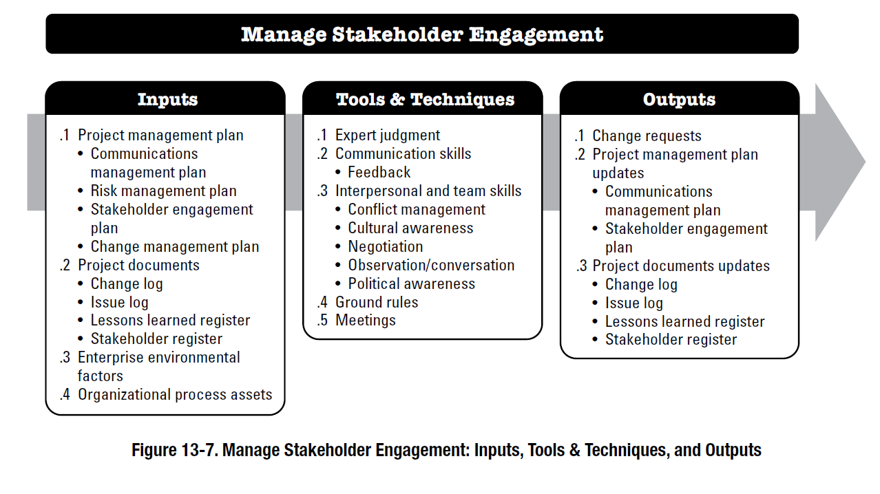
Manage Stakeholder Engagement – Inputs, T&T, Outputs
The PMI Registered Education Provider logo is a registered mark of the Project Management Institute, Inc.
Project Management Institute, A Guide to the Project Management Body of Knowledge, (PMBOK® Guide) – Sixth Edition, Project Management Institute Inc., 2017, Page 523

Slide 162
Monitor Stakeholder Engagement
This is the process of monitoring project stakeholder relationships and tailoring strategies for engaging them through revisions and modification of engagement strategies and plans.
The objective of this process is to maintain the efficiency and effectiveness of stakeholder engagement activities as the project evolves and its environment changes.
The PMI Registered Education Provider logo is a registered mark of the Project Management Institute, Inc.

Slide 163
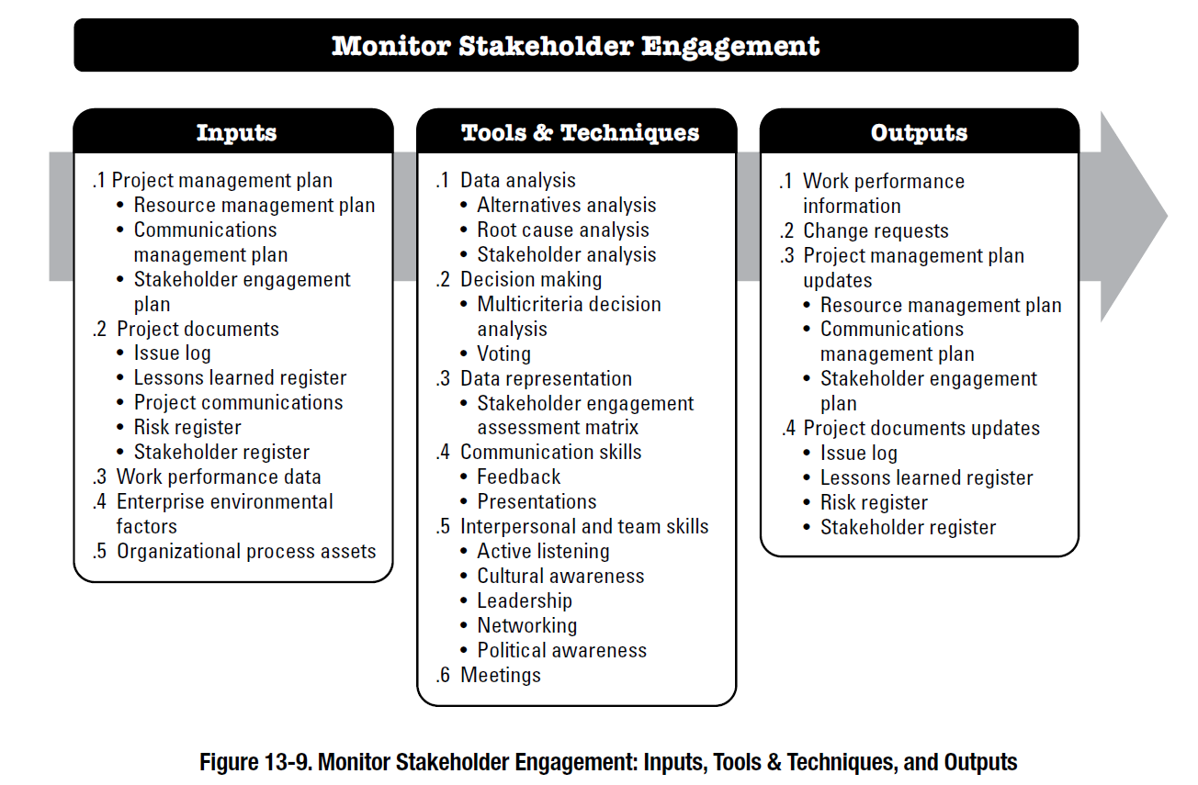
Monitor Stakeholder Engagement – Inputs, T&T, Outputs
The PMI Registered Education Provider logo is a registered mark of the Project Management Institute, Inc.
Project Management Institute, A Guide to the Project Management Body of Knowledge, (PMBOK® Guide) – Sixth Edition, Project Management Institute Inc., 2017, Page 530

Slide 164
Summary
Stakeholders can impact the success of a project
Stakeholders need to be identified at the beginning and their interests and influence analyzed.
Stakeholder engagement must be planned
Engagement includes communication and consultation with stakeholders

Slide 165
End of Lesson Checklist
End of Lesson Checklist
Task​ | Status​
Review slides​ | ​
Complete Independent Learning ​ | ​
Complete Self-assessments in BBlearn​ | ​
Complete Kahoot Quiz​ | ​
Complete Activity​ | ​

Slide 166
Project Communication Management
Prepared by: Dr. Rula Kayyali, Reviewed by: Dr. Heba Mohammad
The PMI Registered Education Provider logo is a registered mark of the Project Management Institute, Inc.
Materials in this course are based on the text, A Guide to the Project Management Body of Knowledge (PMBOK® Guide), Sixth edition, Project Management Institute, Inc. 2017

Slide 167
Learning Objectives
Plan Communications Management
Manage Communications
Monitor Communications
The PMI Registered Education Provider logo is a registered mark of the Project Management Institute, Inc.

Slide 168
Communication Management Mind Map
Planning
Execution
Monitoring and Controlling
Plan Communication Management
Manage Communications
Control Communications

Slide 169
Project Communication Management
Communication is the exchange of information. Communications describe the possible means by which the information can be sent or received.
Communication can happen through communication activities, such as meetings and presentations, or artifacts, such as emails, social media, project reports, or project documentation.
The communication management processes are plan communication management, manage communications, monitor communications.
Project managers spend a lot of their time communicating with stakeholders and need to aware of the types and features of communications.
The PMI Registered Education Provider logo is a registered mark of the Project Management Institute, Inc.

Slide 170
Communications Management - Methods to communicate
Communications can be conducted using these methods:
Written: Either manual or digital.
Spoken: Either face-to-face or virtually.
Formal or informal: Official media, social media
Gestures: Tone of voice and facial expressions.
Media: Pictures, videos, words

Slide 171
Communication Management: Dimensions of Communication
Communication activities have many dimensions that should be considered:
Internal: Focus on stakeholders within the project and within the organization.
External: Focus on external stakeholders such as customers, vendors, government, and the public.
Formal: Reports, presentations, formal meetings, meeting agendas and minutes.
Informal: General communications activities using emails, social media, websites, and informal discussions.
Official: Annual reports; reports to regulators or government bodies.
Unofficial: Communications that focus on establishing and maintaining the profile and recognition of the project and building strong relationships between the project team and its stakeholders using informal means.
Written and oral: Verbal (words and voice inflections) and nonverbal (body language and actions), social media, websites, and media releases.
The PMI Registered Education Provider logo is a registered mark of the Project Management Institute, Inc.

Slide 172
Communication Management - Skills
Listening actively.
Awareness of cultural and personal differences.
Identifying, setting, and managing stakeholder expectations.
Enhancement of team members skills:
Persuading skills;
Motivating people and providing encouragement or reassurance;
Coaching to improve performance and achieve desired results;
Negotiating to achieve mutually acceptable agreements between parties and reduce decision delays;
Resolving conflict to prevent disruptive impacts.
The PMI Registered Education Provider logo is a registered mark of the Project Management Institute, Inc.

Slide 173
Communication Management – PM Best Practices
Inclusion of stakeholders in project reviews
Inclusion of stakeholders in project meetings
Increased use of social computing: Social networking helps people build networks of accompanied by deeper levels of trust and community.
Multifaceted approaches to communication: Use different approaches to communication in relation to cultural, practical, and personal preferences for language, content, and delivery. Social media and other computing technologies can be included.
The PMI Registered Education Provider logo is a registered mark of the Project Management Institute, Inc.

Slide 174
Communication Management – Barriers/ Challenges to good communication
Work environment: language and cultural differences, attitude of people, prevalent emotions (fear losing jobs, grievances etc.)
Power and authority: Organization structure, power and authority of stakeholders, position of project manager and team
Geographical distances: offices in multiple locations and time zones
Poor quality resources: Lack of training, templates and other supporting resources
To resolve these challenges it is necessary that project communications are well planned, managed and controlled.
The PMI Registered Education Provider logo is a registered mark of the Project Management Institute, Inc.
Notes:
This slide is for reference only.

Slide 175
Plan Communication Management
Plan Communications Management is the process of developing an appropriate approach for project communications activities. This should take into consideration the information needs of each stakeholder, the available organizational assets, and the needs of the project.
The key benefit of this process is a documented approach to effectively and efficiently engage stakeholders by presenting relevant information in a timely manner.
This process is performed periodically throughout the project as needed. The project communication plan needs to be reviewed and modified as needed.
A key project document is the Communications Management Plan
The PMI Registered Education Provider logo is a registered mark of the Project Management Institute, Inc.

Slide 176
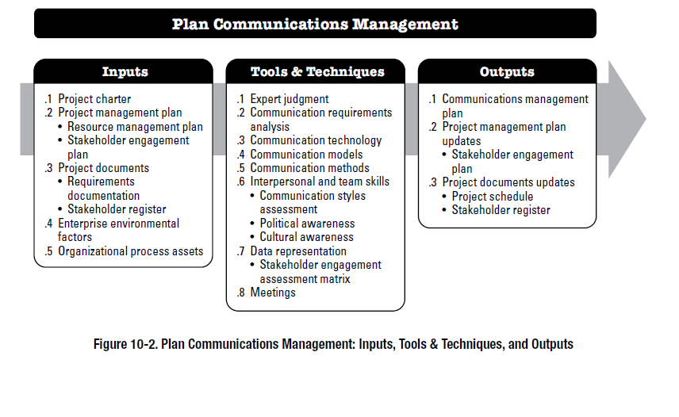
Plan Comm. Management – Inputs, T&T, Outputs
The PMI Registered Education Provider logo is a registered mark of the Project Management Institute, Inc.
Project Management Institute, A Guide to the Project Management Body of Knowledge, (PMBOK® Guide) – Sixth Edition, Project Management Institute Inc., 2017, Page 366

Slide 177
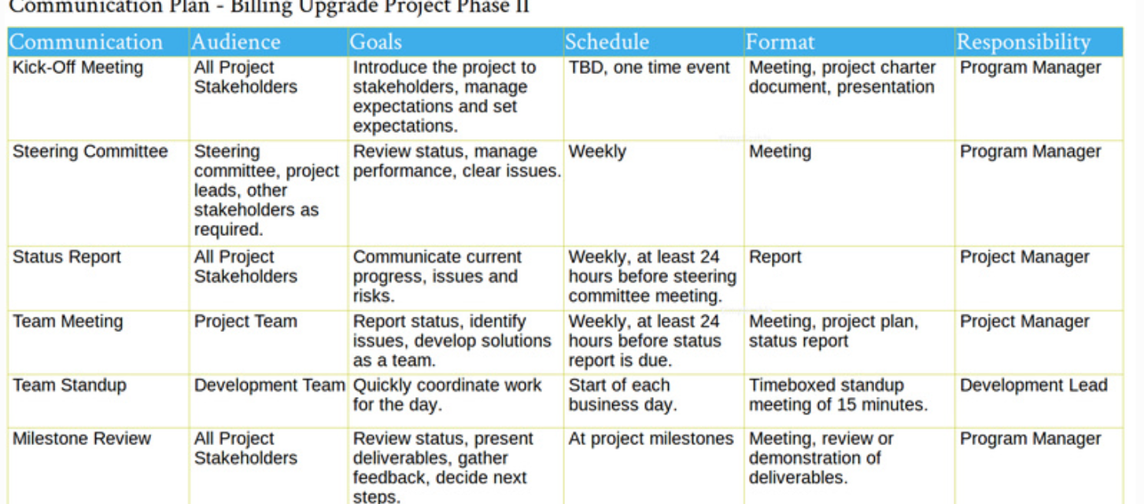
Sample Communication Plan
https://filestage.io/blog/project-communication-plan/​
​
Notes:
https://filestage.io/blog/project-communication-plan/

Slide 178
Manage Communications
Manage Communications is the process of ensuring timely and appropriate collection, creation, distribution, storage, retrieval, management, monitoring, and the ultimate disposition of project information.
The key benefit of this process is enabling an efficient and effective information flow between the project team and the stakeholders.
The Manage Communications process identifies all aspects of effective communication, including choice of appropriate technologies, methods, and techniques. It should allow for flexibility and adjustments in the communications activities, and methods to accommodate the changing needs of stakeholders and the project.
The PMI Registered Education Provider logo is a registered mark of the Project Management Institute, Inc.

Slide 179
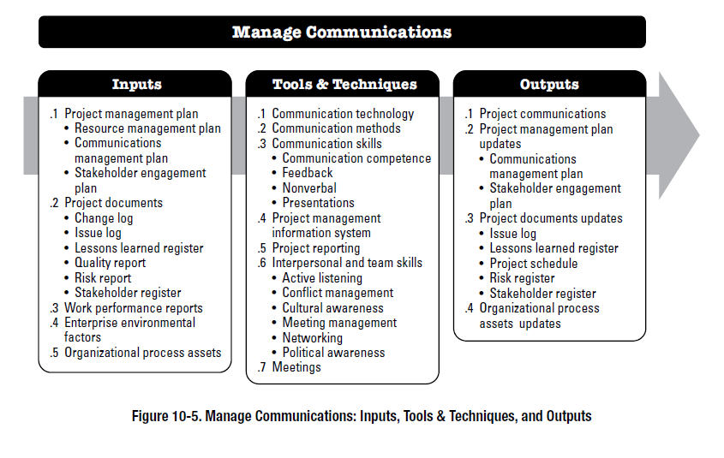
Manage Communications – Inputs, T&T, Outputs
The PMI Registered Education Provider logo is a registered mark of the Project Management Institute, Inc.
Project Management Institute, A Guide to the Project Management Body of Knowledge, (PMBOK® Guide) – Sixth Edition, Project Management Institute Inc., 2017, Page 379

Slide 180
Communication Methods
Successful communication requires the use of the following methods:
Interactive communication: Between two or more parties performing a multidirectional exchange of information in real time. It could be in the form of meeting, phone call, or other forms.
Push communication. Sent or distributed directly to specific recipients who need to receive the information. This ensures that the information is distributed but does not ensure that it reached or was understood. This could be in the form of letters, memos, reports, emails, and other methods.
Pull communication. Used for large complex information sets, or for large audiences, and requires the recipients to access content at their own discretion subject to security procedures. These methods include web portals, intranet sites, e-learning, lessons learned databases, or knowledge repositories.
The PMI Registered Education Provider logo is a registered mark of the Project Management Institute, Inc.

Slide 181
Monitor Communications
Monitor Communications is the process of ensuring the information needs of the project and its stakeholders are met.
The key benefit of this process is the optimal information flow as defined in the communications management plan and the stakeholder engagement plan.
This process is performed throughout the project.
A key output is the Work Performance Information
The PMI Registered Education Provider logo is a registered mark of the Project Management Institute, Inc.

Slide 182

Monitor Communications – Inputs, T&T, Outputs
The PMI Registered Education Provider logo is a registered mark of the Project Management Institute, Inc.
Project Management Institute, A Guide to the Project Management Body of Knowledge, (PMBOK® Guide) – Sixth Edition, Project Management Institute Inc., 2017, Page 388

Slide 183
Summary
Good communication is essential for a successful project
Communications requirements should be analyzed, and a suitable communication strategy must be planned.
Communication should be culturally appropriate and consider the sensibilities of the receivers. Communication should use appropriate media and should be clear, consistent and conclusive
Use of social media is an emerging trend in project communications

Slide 184
End of Lesson Checklist
Task​ | Status​
Review slides​ | ​
Complete Independent Learning ​ | ​
Complete Self-assessments in BBlearn​ | ​
Complete Kahoot Quiz​ | ​
Complete Activity​ | ​

Slide 185
Project Scope Management - 1
Prepared by: Dr. Shanubhog Raghu, Reviewed by: Baraa Yousuf and Dr. Muawia Ramadan.
The PMI Registered Education Provider logo is a registered mark of the Project Management Institute, Inc.
Materials in this course are based on the text, A Guide to the Project Management Body of Knowledge (PMBOK® Guide), Sixth edition, Project Management Institute, Inc. 2017

Slide 186
Learning Objectives
Prepare Project Scope Management Plan
Analyze and Classify Project Requirements
Produce Scope Definition
Create Project WBS
Perform Scope Validation
Define and Apply Scope Control mechanism
The PMI Registered Education Provider logo is a registered mark of the Project Management Institute, Inc.

Slide 187
Project Scope Management: Product and Project Scope
In the project context, the term “scope” can refer to:
Product scope. The features and functions that characterize a product, service, or result. For example:
Create website with pages for login, about us, contact us and shopping cart and secure payment.
Generate daily sales report
Project scope. The work performed to deliver a product, service, or result with the specified features and functions. The term “project scope” is sometimes viewed as including product scope. For example:
Update database, Create online product catalog
Integrate with secure payment gateway
Gather requirements
Develop project charter, requirements document and plans, manage project information, produce lessons learned register
The PMI Registered Education Provider logo is a registered mark of the Project Management Institute, Inc.
This definition is taken from the Glossary of Project Management Institute, A Guide to the Project Management Body of Knowledge, (PMBOK® Guide) – Sixth Edition, Project Management Institute Inc., 2017.

Slide 188
What is Project Scope Management?
PROJECT SCOPE MANAGEMENT
Project Scope Management includes the processes required to ensure that the project includes all the work required, and only the work required, to complete the project successfully. Managing the project scope is primarily concerned with defining and controlling what is and is not included in the project.
The PMI Registered Education Provider logo is a registered mark of the Project Management Institute, Inc.
This definition is taken from the Glossary of Project Management Institute, A Guide to the Project Management Body of Knowledge, (PMBOK® Guide) – Sixth Edition, Project Management Institute Inc., 2017.

Slide 189
Project Scope Management Mind Map
Planning
Monitoring and Controlling
Plan Scope Management
Validate Scope
Collect Requirements
Define Scope
Create WBS
Control Scope

Slide 190
Project Scope Management Processes
Plan Scope Management—The process of creating a scope management plan that documents how the project and product scope will be defined, validated, and controlled.
Collect Requirements—The process of determining, documenting, and managing stakeholder needs and requirements to meet project objectives.
Define Scope—The process of developing a detailed description of the project and product.
Create WBS—The process of subdividing project deliverables and project work into smaller, more manageable components.
Validate Scope—The process of formalizing acceptance of the completed project deliverables.
Control Scope—The process of monitoring the status of the project and product scope and managing changes to the scope baseline.
The PMI Registered Education Provider logo is a registered mark of the Project Management Institute, Inc.
This definition is taken from the Glossary of Project Management Institute, A Guide to the Project Management Body of Knowledge, (PMBOK® Guide) – Sixth Edition, Project Management Institute Inc., 2017.

Slide 191
Project Scope Management Processes
Plan Scope Management.
Collect Requirements.
Define Scope.
Create WBS.
Validate Scope
Control Scope
Part 1
Part 2
The PMI Registered Education Provider logo is a registered mark of the Project Management Institute, Inc.
This definition is taken from the Glossary of Project Management Institute, A Guide to the Project Management Body of Knowledge, (PMBOK® Guide) – Sixth Edition, Project Management Institute Inc., 2017.

Slide 192

Project Scope Management Processes (Inputs, Tools & Techniques, and Outputs of each one of the Project Integration processes)
The PMI Registered Education Provider logo is a registered mark of the Project Management Institute, Inc.
Project Management Institute, A Guide to the Project Management Body of Knowledge, (PMBOK® Guide) – Sixth Edition, Project Management Institute Inc., 2017, Page 130.

Slide 193
Activity1- Quiz on Nearpod
Project and product scope

Slide 194
Plan Scope Management
The PMI Registered Education Provider logo is a registered mark of the Project Management Institute, Inc.
This definition is taken from the Glossary of Project Management Institute, A Guide to the Project Management Body of Knowledge, (PMBOK® Guide) – Sixth Edition, Project Management Institute Inc., 2017.

Slide 195

Plan Scope Management
Plan Scope Management is the process of creating a scope management plan that documents how the project and product scope will be defined, validated, and controlled.
The PMI Registered Education Provider logo is a registered mark of the Project Management Institute, Inc.
Project Management Institute, A Guide to the Project Management Body of Knowledge, (PMBOK® Guide) – Sixth Edition, Project Management Institute Inc., 2017, Page 134.

Slide 196
PLAN SCOPE MANAGEMENT: INPUTS
PROJECT CHARTER
PROJECT MANAGEMENT PLAN
Quality management plan.
Project life cycle description.
Development approach
ENTERPRISE ENVIRONMENTAL FACTORS
Organization’s culture,
Infrastructure,
Personnel administration
Marketplace conditions.
ORGANIZATIONAL PROCESS ASSETS
Policies and procedures
Historical information and lessons learned repositories.
The PMI Registered Education Provider logo is a registered mark of the Project Management Institute, Inc.
This definition is taken from the Glossary of Project Management Institute, A Guide to the Project Management Body of Knowledge, (PMBOK® Guide) – Sixth Edition, Project Management Institute Inc., 2017.

Slide 197
PLAN SCOPE MANAGEMENT: TOOLS AND TECHNIQUES
EXPERT JUDGMENT
Previous similar projects
Information in the industry, discipline, and application area.
DATA ANALYSIS
Various ways of collecting requirements, elaborating the project and product scope, creating the product, validating the scope, and controlling the scope are evaluated.
MEETINGS
Project teams may attend project meetings to develop the scope management plan. Attendees may include the project manager, the project sponsor, selected project team members, selected stakeholders, anyone with responsibility for any of the scope management processes, and others as needed.
The PMI Registered Education Provider logo is a registered mark of the Project Management Institute, Inc.
This definition is taken from the Glossary of Project Management Institute, A Guide to the Project Management Body of Knowledge, (PMBOK® Guide) – Sixth Edition, Project Management Institute Inc., 2017.

Slide 198
PLAN SCOPE MANAGEMENT: OUTPUTS
SCOPE MANAGEMENT PLAN
Process for preparing a project scope statement;
Process that enables the creation of the WBS from the detailed project scope statement;
Process that establishes how the scope baseline will be approved and maintained; and
Process that specifies how formal acceptance of the completed project deliverables will be obtained.
The scope management plan can be formal or informal, broadly framed or highly detailed, based on the needs of the project.
The PMI Registered Education Provider logo is a registered mark of the Project Management Institute, Inc.
This definition is taken from the Glossary of Project Management Institute, A Guide to the Project Management Body of Knowledge, (PMBOK® Guide) – Sixth Edition, Project Management Institute Inc., 2017.

Slide 199
PLAN SCOPE MANAGEMENT: OUTPUTS contd…
REQUIREMENTS MANAGEMENT PLAN
How requirements activities will be planned, tracked, and reported;
Configuration management activities such as: how changes will be initiated; how impacts will be analyzed; how they will be traced, tracked, and reported; as well as the authorization levels required to approve these changes.
The PMI Registered Education Provider logo is a registered mark of the Project Management Institute, Inc.
This definition is taken from the Glossary of Project Management Institute, A Guide to the Project Management Body of Knowledge, (PMBOK® Guide) – Sixth Edition, Project Management Institute Inc., 2017.

Slide 200
Activity2- Matching pairs on Nearpod
scope management plan

Slide 201
COLLECT REQUIREMENTS
The PMI Registered Education Provider logo is a registered mark of the Project Management Institute, Inc.
This definition is taken from the Glossary of Project Management Institute, A Guide to the Project Management Body of Knowledge, (PMBOK® Guide) – Sixth Edition, Project Management Institute Inc., 2017.

Slide 202

COLLECT REQUIREMENTS
The PMI Registered Education Provider logo is a registered mark of the Project Management Institute, Inc.
Project Management Institute, A Guide to the Project Management Body of Knowledge, (PMBOK® Guide) – Sixth Edition, Project Management Institute Inc., 2017, Page 138.

Slide 203

COLLECT REQUIREMENTS: Data Flow Diagram
The PMI Registered Education Provider logo is a registered mark of the Project Management Institute, Inc.
Project Management Institute, A Guide to the Project Management Body of Knowledge, (PMBOK® Guide) – Sixth Edition, Project Management Institute Inc., 2017, Page 139.

Slide 204
COLLECT REQUIREMENTS: INPUTS
PROJECT CHARTER
PROJECT MANAGEMENT PLAN
Scope management plan.
Requirements management plan.
Stakeholder engagement plan.
PROJECT DOCUMENTS
Assumption Log.
Lessons learned register.
Stakeholder Register.
AGREEMENTS
ENTERPRISE ENVIRONMENTAL FACTORS
ORGANIZATIONAL PROCESS ASSETS
The PMI Registered Education Provider logo is a registered mark of the Project Management Institute, Inc.
This definition is taken from the Glossary of Project Management Institute, A Guide to the Project Management Body of Knowledge, (PMBOK® Guide) – Sixth Edition, Project Management Institute Inc., 2017.

Slide 205
COLLECT REQUIREMENTS: TOOLS AND TECHNIQUES
EXPERT JUDGMENT
Expertise should be considered from individuals or groups with specialized knowledge or training in the following topics:
Business analysis,
Requirements elicitation,
Requirements analysis,
Requirements documentation,
Project requirements in previous similar projects,
Diagramming techniques,
Facilitation, and
Conflict management.
The PMI Registered Education Provider logo is a registered mark of the Project Management Institute, Inc.

Slide 206
COLLECT REQUIREMENTS: TOOLS AND TECHNIQUES contd…
DATA GATHERING
Brainstorming.
Interviews.
Focus groups.
Questionnaires and surveys.
Benchmarking.
Data Analysis
Includes different techniques related to document analysis. Document analysis consists of reviewing and assessing any relevant documented information. Examples of documents that can be analyzed:
Agreements, business plans, problem/issue logs etc…
See the footnote for more…
The PMI Registered Education Provider logo is a registered mark of the Project Management Institute, Inc.
Notes:
DATA ANALYSIS
Agreements;
Business plans;
Business process or interface documentation;
Business rules repositories;
Current process flows;
Marketing literature;
Problem/issue logs;
Policies and procedures;
Regulatory documentation such as laws, codes, or ordinances, etc.;
Requests for proposal;
Use cases

Slide 207
COLLECT REQUIREMENTS: TOOLS AND TECHNIQUES contd…
DECISION MAKING
Voting:
Unanimity. A decision that is reached whereby everyone agrees on a single course of action.
Majority. A decision that is reached with support obtained from more than 50% of the members of the group.
Plurality. A decision that is reached whereby the largest block in a group decides, even if a majority is not achieved. This method is generally used when the number of options nominated is more than two.
Autocratic decision making: In this method, one individual takes responsibility for making the decision for the group.
Multicriteria decision analysis: A technique that uses a decision matrix to provide a systematic analytical approach for establishing criteria, such as risk levels, uncertainty, and valuation, to evaluate and rank many ideas.
The PMI Registered Education Provider logo is a registered mark of the Project Management Institute, Inc.
This definition is taken from the Glossary of Project Management Institute, A Guide to the Project Management Body of Knowledge, (PMBOK® Guide) – Sixth Edition, Project Management Institute Inc., 2017.

Slide 208
COLLECT REQUIREMENTS: TOOLS AND TECHNIQUES contd…
DATA REPRESENTATION
Affinity diagrams. Affinity diagrams allow large numbers of ideas to be classified into groups for review and analysis.
Mind mapping. Mind mapping consolidates ideas created through individual brainstorming sessions into a single map to reflect commonality and differences in understanding and to generate new ideas.
INTERPERSONAL AND TEAM SKILLS
Nominal group technique.
Observation/conversation
Facilitation
The PMI Registered Education Provider logo is a registered mark of the Project Management Institute, Inc.
This definition is taken from the Glossary of Project Management Institute, A Guide to the Project Management Body of Knowledge, (PMBOK® Guide) – Sixth Edition, Project Management Institute Inc., 2017.

Slide 209

COLLECT REQUIREMENTS: TOOLS AND TECHNIQUES contd…
CONTEXT DIAGRAM
The context diagram is an example of a scope model. Context diagrams visually depict the product scope by showing a business system (process, equipment, computer system, etc.), and how people and other systems (actors) interact with it (see Figure 5-6).
The PMI Registered Education Provider logo is a registered mark of the Project Management Institute, Inc.
This definition is taken from the Glossary of Project Management Institute, A Guide to the Project Management Body of Knowledge, (PMBOK® Guide) – Sixth Edition, Project Management Institute Inc., 2017.

Slide 210
COLLECT REQUIREMENTS: TOOLS AND TECHNIQUES contd…
PROTOTYPES
Prototyping is a method of obtaining early feedback on requirements by providing a model of the expected product before actually building it. Examples of prototypes are small-scale products, computer generated 2D and 3D models, mock-ups, or simulations.
The PMI Registered Education Provider logo is a registered mark of the Project Management Institute, Inc.
This definition is taken from the Glossary of Project Management Institute, A Guide to the Project Management Body of Knowledge, (PMBOK® Guide) – Sixth Edition, Project Management Institute Inc., 2017.

Slide 211
COLLECT REQUIREMENTS: OUTPUTS
REQUIREMENTS DOCUMENTATION
Requirements documentation describes how individual requirements meet the business need for the project. Business requirements.
Stakeholder requirements. Describes the needs of stakeholder
Solution requirements. (Functional and Nonfunctional requirements)
Transition and readiness requirements.
Project requirements.
Quality requirements.
The PMI Registered Education Provider logo is a registered mark of the Project Management Institute, Inc.
This definition is taken from the Glossary of Project Management Institute, A Guide to the Project Management Body of Knowledge, (PMBOK® Guide) – Sixth Edition, Project Management Institute Inc., 2017.
Notes:
Business requirements: describes in high level the opportunities or issues and reasons why a project has been undertaken.
Transition and readiness requirements.: such as data conversion and training requirements needed to transition from the current state to the desired future state.
Project requirements. Such as milestone dates, contractual obligations, constraints etc..
Quality requirements. Criteria needed to validate the successful completion of a project deliverable or fulfillment of other project requirements.

Slide 212
COLLECT REQUIREMENTS: OUTPUTS
REQUIREMENTS TRACEABILITY MATRIX
The requirements traceability matrix is a grid that links product requirements from their origin to the deliverables that satisfy them. This tool helps connect the requirements from requirements elicitation to product delivery. It may includes the following:
Business needs, opportunities, goals, and objectives;
Project objectives;
Project scope and WBS deliverables;
Product design;
Product development;
Test strategy and test scenarios; and
High-level requirements to more detailed requirements
The PMI Registered Education Provider logo is a registered mark of the Project Management Institute, Inc.
This definition is taken from the Glossary of Project Management Institute, A Guide to the Project Management Body of Knowledge, (PMBOK® Guide) – Sixth Edition, Project Management Institute Inc., 2017.

Slide 213

The PMI Registered Education Provider logo is a registered mark of the Project Management Institute, Inc.
Project Management Institute, A Guide to the Project Management Body of Knowledge, (PMBOK® Guide) – Sixth Edition, Project Management Institute Inc., 2017, Page 149.

Slide 214
Activity3- Collaborative Activity
Collecting Requirements
Notes:
Chose ONE of the tools and techniques necessary to create the requirements document. Explain the benefits and drawbacks of using the selected technique to collect requiremenents.

Slide 215
DEFINE SCOPE
The PMI Registered Education Provider logo is a registered mark of the Project Management Institute, Inc.
This definition is taken from the Glossary of Project Management Institute, A Guide to the Project Management Body of Knowledge, (PMBOK® Guide) – Sixth Edition, Project Management Institute Inc., 2017.

Slide 216

DEFINE SCOPE
Define Scope is the process of developing a detailed description of the project and product.
The PMI Registered Education Provider logo is a registered mark of the Project Management Institute, Inc.
Project Management Institute, A Guide to the Project Management Body of Knowledge, (PMBOK® Guide) – Sixth Edition, Project Management Institute Inc., 2017, Page 150.

Slide 217

The PMI Registered Education Provider logo is a registered mark of the Project Management Institute, Inc.
Project Management Institute, A Guide to the Project Management Body of Knowledge, (PMBOK® Guide) – Sixth Edition, Project Management Institute Inc., 2017, Page 151.

Slide 218
DEFINE SCOPE: INPUTS
PROJECT CHARTER
PROJECT MANAGEMENT PLAN
PROJECT DOCUMENTS
Assumption log.
Requirements documentation.
Risk register.
ENTERPRISE ENVIRONMENTAL FACTORS
Organization’s culture,
Infrastructure,
Personnel administration, and
Marketplace conditions.
The PMI Registered Education Provider logo is a registered mark of the Project Management Institute, Inc.
This definition is taken from the Glossary of Project Management Institute, A Guide to the Project Management Body of Knowledge, (PMBOK® Guide) – Sixth Edition, Project Management Institute Inc., 2017.
Notes:
Assumption log: identifies assumptions and constraints about the product, project environment, stakeholders and other factors that can influence the project and product scope.

Slide 219
DEFINE SCOPE: TOOLS AND TECHNIQUES
EXPERT JUDGMENT
DATA ANALYSIS
DECISION MAKING
INTERPERSONAL AND TEAM SKILLS
PRODUCT ANALYSIS
Examples of product analysis techniques could be:
Product breakdown,
Requirements analysis,
Systems analysis,
Value analysis, and
The PMI Registered Education Provider logo is a registered mark of the Project Management Institute, Inc.
This definition is taken from the Glossary of Project Management Institute, A Guide to the Project Management Body of Knowledge, (PMBOK® Guide) – Sixth Edition, Project Management Institute Inc., 2017.

Slide 220
DEFINE SCOPE: OUTPUTS
PROJECT SCOPE STATEMENT
Product scope description.
Deliverables.
Acceptance criteria.
Project exclusions.
The PMI Registered Education Provider logo is a registered mark of the Project Management Institute, Inc.
This definition is taken from the Glossary of Project Management Institute, A Guide to the Project Management Body of Knowledge, (PMBOK® Guide) – Sixth Edition, Project Management Institute Inc., 2017.
Notes:
Acceptance criteria.: a set of conditions that is required to be met before deliverables are accepted.
Project exclusions. Identifies what is excluded from the project

Slide 221
Sample Scope Statement Source: https://www.projectmanagementdocs.com/template/project-planning/scope-management-plan/
Scope Description and Deliverables | This project includes the design, programming, and testing of a new software application for tracking the company’s finances. This project will be managed using the PMI framework. The deliverables for this project are software application for finance tracking documents related to project management activities including project chart, plans, requirements document, project performance reports and lessons learned reports
Product Description | The finance tracking application shall include the following features: Manage general accounting procedures Manage and report on expenses Mange and report on budget and cash flow Provide three levels access security Product will be tested, implemented for the users in the finance department. Training will be provided to 10 users.
Exclusions | This project does not include purchase of hardware or the ongoing operations and maintenance of the software. This application does not include the management of inventory or payroll information.
Acceptance Criteria | This project will be accepted once the new software has been successfully tested in each department and has been shown to be compatible with the company’s current information technology (IT) infrastructure.
Constraints | Only internal personnel and resources may be used for this project. Additionally, the project is not to exceed 180 days in duration or $450,000 in spending. The database is to be deployed on MS/SQL.
Assumptions | Assumptions for this project are that support will be provided by the project sponsor and all department managers and that adequate internal resources are available for the successful completion of this project.

Slide 222

Project scope statement and project charter are different in the level of detail contained in each.
The scope statement elements is more detailed.
The PMI Registered Education Provider logo is a registered mark of the Project Management Institute, Inc.
Project Management Institute, A Guide to the Project Management Body of Knowledge, (PMBOK® Guide) – Sixth Edition, Project Management Institute Inc., 2017, Page 155.

Slide 223
DEFINE SCOPE: OUTPUTS
PROJECT DOCUMENTS UPDATES
Assumption log.
Requirements documentation.
Requirements traceability matrix.
Stakeholder register.
The PMI Registered Education Provider logo is a registered mark of the Project Management Institute, Inc.
This definition is taken from the Glossary of Project Management Institute, A Guide to the Project Management Body of Knowledge, (PMBOK® Guide) – Sixth Edition, Project Management Institute Inc., 2017.
Notes:
Requirements traceability matrix.

Slide 224
Activity4- Collaborate Activity on Nearpod
Define scope – write a scope statement
Notes:
Read the case and write atleast two sections of the scope statement. Product Description or Product Scope is mandatory. Choose one other heading. Upload an image if necessary.

Slide 225
Summary
Scope is one of the triple constraints and needs to be planned and well defined
Collecting requirements is a key process of planning scope. The requirements document and requirements traceability matrix are key outputs
Defining scope is the process of writing the scope statement, with assumptions, constraints, acceptance criteria and exclusions. The scope statement is a key element of the scope baseline

Slide 226
End of Lesson Checklist
Task​ | Status​
Review slides​ | ​
Complete Independent Learning ​ | ​
Complete Self-assessments in BBlearn​ | ​
Complete Kahoot Quiz​ | ​
Complete Activity​ | ​

Slide 227
Project Scope Management - 2
Prepared by: Dr. Shanubhog Raghu, Reviewed by: Baraa Yousuf and Dr. Muawia Ramadan.
The PMI Registered Education Provider logo is a registered mark of the Project Management Institute, Inc.
Materials in this course are based on the text, A Guide to the Project Management Body of Knowledge (PMBOK® Guide), Sixth edition, Project Management Institute, Inc. 2017

Slide 228
Learning Objectives
Prepare Project Scope Management Plan
Analyze and classify Project Requirements
Produce Scope definition
Create Project WBS
Perform Scope validation
Define and apply Scope Control mechanism
The PMI Registered Education Provider logo is a registered mark of the Project Management Institute, Inc.

Slide 229
Project Scope Management Processes
Plan Scope Management.
Collect Requirements.
Define Scope.
Create WBS.
Validate Scope
Control Scope
Part 1
Part 2
The PMI Registered Education Provider logo is a registered mark of the Project Management Institute, Inc.
This definition is taken from the Glossary of Project Management Institute, A Guide to the Project Management Body of Knowledge, (PMBOK® Guide) – Sixth Edition, Project Management Institute Inc., 2017.

Slide 230
Project Scope Management Processes (Inputs, Tools & Techniques, and Outputs of each one of the Project Integration processes)
The PMI Registered Education Provider logo is a registered mark of the Project Management Institute, Inc.
Project Management Institute, A Guide to the Project Management Body of Knowledge, (PMBOK® Guide) – Sixth Edition, Project Management Institute Inc., 2017, Page 130.

Slide 231
CREATE WBS
The PMI Registered Education Provider logo is a registered mark of the Project Management Institute, Inc.
This definition is taken from the Glossary of Project Management Institute, A Guide to the Project Management Body of Knowledge, (PMBOK® Guide) – Sixth Edition, Project Management Institute Inc., 2017.

Slide 232

CREATE Work Breakdown Structure (WBS)
Create WBS is the process of subdividing project deliverables and project work into smaller, more manageable components and happens during project planning.
The PMI Registered Education Provider logo is a registered mark of the Project Management Institute, Inc.
Project Management Institute, A Guide to the Project Management Body of Knowledge, (PMBOK® Guide) – Sixth Edition, Project Management Institute Inc., 2017, Page 156.

Slide 233

The PMI Registered Education Provider logo is a registered mark of the Project Management Institute, Inc.
Project Management Institute, A Guide to the Project Management Body of Knowledge, (PMBOK® Guide) – Sixth Edition, Project Management Institute Inc., 2017, Page 156.

Slide 234
CREATE WBS: INPUTS contd…
PROJECT MANAGEMENT PLAN
PROJECT DOCUMENTS
Project scope statement.
Requirements documentation.
ENTERPRISE ENVIRONMENTAL FACTORS
ORGANIZATIONAL PROCESS ASSETS
Policies, procedures, and templates for the WBS;
Project files from previous projects; and
Lessons learned from previous projects
The PMI Registered Education Provider logo is a registered mark of the Project Management Institute, Inc.
This definition is taken from the Glossary of Project Management Institute, A Guide to the Project Management Body of Knowledge, (PMBOK® Guide) – Sixth Edition, Project Management Institute Inc., 2017.

Slide 235
CREATE WBS: TOOLS AND TECHNIQUES
EXPERT JUDGMENT
DECOMPOSITION
Identifying and analyzing the deliverables and related work,
Structuring and organizing the WBS,
Decomposing the upper WBS levels into lower-level detailed components,
Developing and assigning identification codes to the WBS components,
Verifying that the degree of decomposition of the deliverables is appropriate.
The PMI Registered Education Provider logo is a registered mark of the Project Management Institute, Inc.
This definition is taken from the Glossary of Project Management Institute, A Guide to the Project Management Body of Knowledge, (PMBOK® Guide) – Sixth Edition, Project Management Institute Inc., 2017.

Slide 236
CREATE WBS: TOOLS AND TECHNIQUES
WBS structure can be represented in a number of forms, such as:
Using phases of the project life cycle as the second level of decomposition, with the product and project deliverables inserted at the third level
Using major deliverables as the second level of decomposition.
The PMI Registered Education Provider logo is a registered mark of the Project Management Institute, Inc.
This definition is taken from the Glossary of Project Management Institute, A Guide to the Project Management Body of Knowledge, (PMBOK® Guide) – Sixth Edition, Project Management Institute Inc., 2017.

Slide 237

CREATE WBS: TOOLS AND TECHNIQUES WBS decomposed down through the work package level
Level 1 is the project title
Work Packages
The PMI Registered Education Provider logo is a registered mark of the Project Management Institute, Inc.
Project Management Institute, A Guide to the Project Management Body of Knowledge, (PMBOK® Guide) – Sixth Edition, Project Management Institute Inc., 2017, Page 158.
Notes:
Work packages are not decomposed further. They have no “children”.

Slide 238

CREATE WBS: TOOLS AND TECHNIQUES WBS Organized by Phases
The PMI Registered Education Provider logo is a registered mark of the Project Management Institute, Inc.
Project Management Institute, A Guide to the Project Management Body of Knowledge, (PMBOK® Guide) – Sixth Edition, Project Management Institute Inc., 2017, Page 159.

Slide 239

CREATE WBS: TOOLS AND TECHNIQUES WBS organized by Deliverables
The PMI Registered Education Provider logo is a registered mark of the Project Management Institute, Inc.
Project Management Institute, A Guide to the Project Management Body of Knowledge, (PMBOK® Guide) – Sixth Edition, Project Management Institute Inc., 2017, Page 160.

Slide 240
Activity1- Time to climb on Nearpod
WBS

Slide 241
CREATE WBS: OUTPUTS
SCOPE BASELINE which is the approved version of:
a. Project scope statement: includes description of the project scope, deliverables, assumptions, and constraints.
b. WBS: The hierarchical decomposition of the total scope of work. Each descending level represents a more detailed definition of the project work.
Work package: This is the lowest level of the WBS. It has a unique identifier. These identifiers provide a structure for hierarchical summation of costs, schedule, and resource information and form a code of accounts.
c. WBS dictionary: is a document that provides detailed deliverable, activity, and scheduling information about each component in the WBS. WBS dictionary may include but is not limited to the following:
Code of account identifier, | Description of work | Assumptions and constraints, | Responsible organization,
Schedule milestones, | Associated schedule activities | Resources required | Cost estimates,
Quality requirements, | Acceptance criteria, | Technical references, | Agreement information.
The PMI Registered Education Provider logo is a registered mark of the Project Management Institute, Inc.
This definition is taken from the Glossary of Project Management Institute, A Guide to the Project Management Body of Knowledge, (PMBOK® Guide) – Sixth Edition, Project Management Institute Inc., 2017.

Slide 242

Sample WBS Dictionary https://www.pmclounge.com/work-breakdown-structure-wbs-dictionary/

Slide 243
CREATE WBS: OUTPUTS contd…
PROJECT DOCUMENTS UPDATES
Assumption log.
Requirements documentation
The PMI Registered Education Provider logo is a registered mark of the Project Management Institute, Inc.
This definition is taken from the Glossary of Project Management Institute, A Guide to the Project Management Body of Knowledge, (PMBOK® Guide) – Sixth Edition, Project Management Institute Inc., 2017.

Slide 244
Templates for WBS Dictionary
Work Package Id
Work Package Name
Responsible Org/Individual
WP Description
Acceptance Criteria
Deliverables
Duration
Cost
Due Date
Dependencies
Approver
WORK BREAKDOWN STRUCTURE DICTIONARY PROJECT TITLE: WBS ITEM NUMBER: (As defined in MS Project) WBS ITEM NAME:
TASK DESCRIPTION (WHAT WORK IS AUTHORIZED)
ACCEPTANCE CRITERIA
DELIVERABLE(S) – What is produced
RESOURCES ASSIGNED – People, Equipment and other expenses
DURATION in Days Optimistic – Most likely - Pessimistic -
COST - Approximate
DEPENDENCIES AFTER (SUCCESSOR) | DEPENDENCIES BEFORE (PREDECESSOR)
DUE DATE | APPROVED: PROJECT MANAGER
Notes:
Use either of these for creating a WBS Dictionary

Slide 245

Activity 2- Collaborate on Nearpod
WBS AND wbs DICTIONARY

Slide 246
VALIDATE SCOPE
The PMI Registered Education Provider logo is a registered mark of the Project Management Institute, Inc.
This definition is taken from the Glossary of Project Management Institute, A Guide to the Project Management Body of Knowledge, (PMBOK® Guide) – Sixth Edition, Project Management Institute Inc., 2017.

Slide 247

VALIDATE SCOPE
Validate Scope is the process of formalizing acceptance of the completed project deliverables.
The PMI Registered Education Provider logo is a registered mark of the Project Management Institute, Inc.
Project Management Institute, A Guide to the Project Management Body of Knowledge, (PMBOK® Guide) – Sixth Edition, Project Management Institute Inc., 2017, Page 163.

Slide 248

VALIDATE SCOPE contd…
Validate Scope: Data Flow Diagram
The PMI Registered Education Provider logo is a registered mark of the Project Management Institute, Inc.
Project Management Institute, A Guide to the Project Management Body of Knowledge, (PMBOK® Guide) – Sixth Edition, Project Management Institute Inc., 2017, Page 164.

Slide 249
VALIDATE SCOPE: INPUTS
PROJECT MANAGEMENT PLAN
Scope management plan.
Requirements management plan.
Scope baseline.
PROJECT DOCUMENTS
Lessons learned register:
Quality reports.
Requirements documentation.
Requirements traceability matrix.
VERIFIED DELIVERABLES
Verified deliverables are project deliverables that are completed and checked for correctness through the Control Quality process.
WORK PERFORMANCE DATA
The PMI Registered Education Provider logo is a registered mark of the Project Management Institute, Inc.
This definition is taken from the Glossary of Project Management Institute, A Guide to the Project Management Body of Knowledge, (PMBOK® Guide) – Sixth Edition, Project Management Institute Inc., 2017.

Slide 250
VALIDATE SCOPE: TOOLS AND TECHNIQUES
INSPECTION
Inspection includes activities such as measuring, examining, and validating to determine whether work and deliverables meet requirements and product acceptance criteria. Inspections are sometimes called reviews, product reviews, and walkthroughs. In some application areas, these different terms have unique and specific meanings.
DECISION MAKING
An example of decision making that may be used in this process includes but is not limited to voting.
The PMI Registered Education Provider logo is a registered mark of the Project Management Institute, Inc.
This definition is taken from the Glossary of Project Management Institute, A Guide to the Project Management Body of Knowledge, (PMBOK® Guide) – Sixth Edition, Project Management Institute Inc., 2017.

Slide 251
VALIDATE SCOPE: OUTPUTS
ACCEPTED DELIVERABLES
Deliverables that meet the acceptance criteria are formally signed off and approved by the customer or sponsor.
WORK PERFORMANCE INFORMATION
Work performance information includes information about project progress, such as which deliverables have been accepted and which have not been accepted and the reasons why.
CHANGE REQUESTS
The completed deliverables that have not been formally accepted are documented, along with the reasons for non-acceptance of those deliverables.
The PMI Registered Education Provider logo is a registered mark of the Project Management Institute, Inc.
This definition is taken from the Glossary of Project Management Institute, A Guide to the Project Management Body of Knowledge, (PMBOK® Guide) – Sixth Edition, Project Management Institute Inc., 2017.

Slide 252
VALIDATE SCOPE: OUTPUTS
PROJECT DOCUMENTS UPDATES
Lessons learned register. The lessons learned register is updated with information on challenges encountered and how they could have been avoided as well as approaches that worked well for validating deliverables.
Requirements documentation. The requirements documentation may be updated with the actual results of validation activity. Of particular interest is when the actual results are better than the requirement or where a requirement was waived.
Requirements traceability matrix. The requirements traceability matrix is updated with the results of the validation, including the method used and the outcome.
The PMI Registered Education Provider logo is a registered mark of the Project Management Institute, Inc.
This definition is taken from the Glossary of Project Management Institute, A Guide to the Project Management Body of Knowledge, (PMBOK® Guide) – Sixth Edition, Project Management Institute Inc., 2017.

Slide 253

Sample Product Acceptance Form https://www.dummies.com/careers/project-management/pmp-certification/what-you-should-know-about-validate-scope-for-the-pmp-certification-exam/

Slide 254
Activity3- Fill in the blanks on Nearpod
Validate scope

Slide 255
Control Scope
The PMI Registered Education Provider logo is a registered mark of the Project Management Institute, Inc.
This definition is taken from the Glossary of Project Management Institute, A Guide to the Project Management Body of Knowledge, (PMBOK® Guide) – Sixth Edition, Project Management Institute Inc., 2017.

Slide 256

CONTROL SCOPE
Control Scope is the process of monitoring the status of the project and product scope and managing changes to the scope baseline
The PMI Registered Education Provider logo is a registered mark of the Project Management Institute, Inc.
Project Management Institute, A Guide to the Project Management Body of Knowledge, (PMBOK® Guide) – Sixth Edition, Project Management Institute Inc., 2017, Page 167.

Slide 257

Control Scope: Data Flow Diagram
The PMI Registered Education Provider logo is a registered mark of the Project Management Institute, Inc.
Project Management Institute, A Guide to the Project Management Body of Knowledge, (PMBOK® Guide) – Sixth Edition, Project Management Institute Inc., 2017, Page 168.

Slide 258
CONTROL SCOPE: INPUTS
PROJECT MANAGEMENT PLAN
Scope management plan.
Requirements management plan.
Change management plan.
Configuration management plan.
Scope baseline.
Performance measurement baseline.
PROJECT DOCUMENTS
Lessons learned register.
Requirements documentation.
Requirements traceability matrix.
The PMI Registered Education Provider logo is a registered mark of the Project Management Institute, Inc.
This definition is taken from the Glossary of Project Management Institute, A Guide to the Project Management Body of Knowledge, (PMBOK® Guide) – Sixth Edition, Project Management Institute Inc., 2017.

Slide 259
CONTROL SCOPE: INPUTS
WORK PERFORMANCE DATA
Work performance data can include the number of change requests received, the number of requests accepted, and the number of deliverables verified, validated, and completed.
ORGANIZATIONAL PROCESS ASSETS
Existing formal and informal scope, control-related policies, procedures, guidelines
Monitoring and reporting methods and templates to be used.
The PMI Registered Education Provider logo is a registered mark of the Project Management Institute, Inc.
This definition is taken from the Glossary of Project Management Institute, A Guide to the Project Management Body of Knowledge, (PMBOK® Guide) – Sixth Edition, Project Management Institute Inc., 2017.

Slide 260
CONTROL SCOPE: TOOLS AND TECHNIQUES
DATA ANALYSIS
Variance analysis.
Variance analysis is used to compare the baseline to the actual results and determine if the variance is within the threshold amount or if corrective or preventive action is appropriate.
Trend analysis.
Trend analysis examines project performance over time to determine if performance is improving or deteriorating.
The PMI Registered Education Provider logo is a registered mark of the Project Management Institute, Inc.
This definition is taken from the Glossary of Project Management Institute, A Guide to the Project Management Body of Knowledge, (PMBOK® Guide) – Sixth Edition, Project Management Institute Inc., 2017.

Slide 261
CONTROL SCOPE: OUTPUTS
WORK PERFORMANCE INFORMATION
Work performance information produced includes correlated and contextualized information on how the project and product scope are performing compared to the scope baseline.
CHANGE REQUESTS
Analysis of project performance may result in a change request to the scope and schedule baselines or other components of the project management plan.
The PMI Registered Education Provider logo is a registered mark of the Project Management Institute, Inc.
This definition is taken from the Glossary of Project Management Institute, A Guide to the Project Management Body of Knowledge, (PMBOK® Guide) – Sixth Edition, Project Management Institute Inc., 2017.

Slide 262
CONTROL SCOPE: OUTPUTS
PROJECT MANAGEMENT PLAN UPDATES
Scope management plan.
Scope baseline.
Schedule baseline.
Cost baseline.
Performance measurement baseline.
PROJECT DOCUMENTS UPDATES
Lessons learned register.
Requirements documentation.
Requirements traceability matrix
The PMI Registered Education Provider logo is a registered mark of the Project Management Institute, Inc.
This definition is taken from the Glossary of Project Management Institute, A Guide to the Project Management Body of Knowledge, (PMBOK® Guide) – Sixth Edition, Project Management Institute Inc., 2017.

Slide 263
Activity 4 - Open Ended Question on Nearpod
Control scope

Slide 264
Summary
The WBS is a hierarchical/linear structure of decomposed project work. The WBS Dictionary is a supporting document that provides detailed information about each element of the WBS
Scope Baseline is the approved project scope statement, WBS and WBS dictionary. This baseline is used as a reference to validate and control scope
Validating scope ensures the acceptance of the product and controlling scope helps to manage changes to the scope baseline

Slide 265
End of Lesson Checklist
Task​ | Status​
Review slides​ | ​
Complete Independent Learning ​ | ​
Complete Self-assessments in BBlearn​ | ​
Complete Kahoot Quiz​ | ​
Complete Activity​ | ​

Slide 267
Schedule Management Technique: Precedence Diagramming Method Network Diagram
Guidelines to draw a Network Diagram
Notes:
Updated Sep 2019

Slide 268
Document Revision Control
Version | Date | Change Description | Reviewers
1.1 | 24-July-2020 | Added Summary Slides | Sharmila Siddartha, Rula Al Kayyali

Slide 269
Network Diagrams
Network diagrams are the preferred technique for showing activity sequencing and is used in Schedule Management
A network diagram is a schematic display of the logical relationships among, or sequencing of, project activities
Two main formats are the arrow and precedence diagramming methods (PDM)
This course will use the PDM method

Slide 270
Start with a list of activities or a activity/task table
Task | Name | Duration (Days) | Predecessors
A | Define Requirements | 2 | -
B | Procure Hardware | 3 | A
C | Test Hardware | 2 | B
D | Procure Software | 2 | A
E | Install Software | 2 | D
F | Test System | 2 | C,E
G | Deploy System | 1 | F
Note: Activity attributes such as duration and predecessors are necessary. WBS Task Id can be used in drawing the network diagram. In this case, a single alphabet code is used for simplicity

Slide 271
Step 1 – Draw a Network Diagram
Begin with a Start indicator
Identify the first task (one which has no predecessor). Draw a square box and label the task and include the duration
Identify activities that run in parallel (usually activities that have the same predecessor)
Identify activities that begin after more than one activity finishes (usually activities that have multiple predecessors)
Draw all activity boxes and link them
Add activity labels and duration for each task
End with a Finish indicator

Slide 272

Step 1 – Draw Network Diagram, Connect and label activities

Slide 273
Step 2 - Adding Numbers to the Network: Forward Pass
Forward Pass - In this stage the Early Start and Early Finish days are calculated for each activity
Early Start (ES)
Float
Early Finish (EF)
Forward Pass:
Early Start:
Is 0 for the first activity after Start
For each subsequent task, the early start day is “the highest number of EF leading into the task”
Early Finish = Early Start + Duration
Duration
Late Start (LS)
Late Finish (LF)

Slide 274

Step 2 - Adding Numbers to the Network: Forward Pass
Forward Pass - In this stage the Early Start and Early Finish days are calculated for each activity
Notes:
Forward Pass:
Early Start:
Is 0 for the first activity after Start
For each subsequent task, the early start day is “the highest number of EF leading into the task”
Early Finish = Early Start + Duration

Slide 275
Step 3 - Adding Numbers to the Network – Backward Pass
Forward Pass - In this stage the Late Finish and Late Start days are calculated for each activity
Early Start (ES)
Float
Early Finish (EF)
Backward Pass
Late Finish
The latest finish day of the last task is the same as its highest early finish
For each subsequent task, late finish is “the lowest value of Late Start for activities leading into the task”
Late Start= Late Finish - Duration
Duration
Late Start (LS)
Late Finish (LF)

Slide 276

Step 3 - Diagram after Backward Pass

Slide 277
Step 4 – Calculating Float
Float is the amount of time an activity may be delayed without delaying a succeeding activity or the project finish date.
Early Start (ES)
Float
Early Finish (EF)
Calculating Float
For each activity, Subtract the early start from the late start.
F = LS - ES
Duration
Late Start (LS)
Late Finish (LF)

Slide 278

Diagram after calculating Float

Slide 279

Step 5 Identify Critical Path
A critical path for a project is the series of activities that determines the earliest time by which the project can be completed
The critical path is the longest path through the network diagram and has the least amount of slack or float

Slide 280
Interpreting Numbers on the Network Diagram
The ES= 4
The earliest day we can start is day 4.
The EF = 11
The earliest day we can finish is day 11
The LS = 6
The latest day we can start is day 6
Float = 2
We can delay the start by 2 days
(6-4)
4
2
11
7
6
13

Slide 281
What is the critical path?
A critical path for a project is the series of activities that determines the earliest time by which the project can be completed
The list of tasks which have no float.
They cannot be delayed without delaying the project.
The critical path is the longest path through the network diagram and has the least amount of slack or float

Slide 282
Using the Critical Path to Shorten the duration of a Project
Crashing – Is a technique used to reduce the duration of an activity by additional resource to an activity. This results in an increase in cost – a tradeoff is necessary.
Fast Tracking – Is a technique in which you do activities in parallel rather than in sequence.

Slide 283
Task 1
Working in pairs, complete the Network Diagram for this activity table
Draw the network diagram
Complete the forward pass
Complete the backward pass
What is the project duration?
Calculate the float
Identify the critical path
Task | Optimistic Duration | Most Likely Duration (days) | Pessimistic Duration | PERT Duration | Predecessors
A | 2 | 3 | 5 |  | C
B | 3 | 4 | 6 |  | D
C | 1 | 2 | 3 |  | --
D | 2 | 3 | 5 |  | --
E | 2 | 3 | 5 |  | A, B

Slide 284
Task 2
Working in pairs, complete the Network Diagram for this activity table
Draw the network diagram
Complete the forward pass
Complete the backward pass
What is the project duration?
Calculate the float
Identify the critical path
Code | Time Required (days) | Immediate Predecessors
A | 3 | --
B | 5 | A
C | 2 | B, F
D | 7 | C
E | 9 | --
F | 2 | E
G | 4 | F

Slide 285
Task 3
Working in pairs, complete the Network Diagram for this activity table
Draw the network diagram
Complete the forward pass
Complete the backward pass
What is the project duration?
Calculate the float
Identify the duration of each path
Identify critical path
Code | Time Estimated (Months) | Immediate Predecessors
D | 4 | --
A | 6 | --
F | 7 | D,A
E | 8 | D
G | 5 | F,E
B | 5 | F
H | 7 | G
C | 8 | H

Slide 286
Task 4
Working in pairs, complete the Network Diagram for this activity table
Draw the network diagram
Complete the forward pass
Complete the backward pass
What is the project duration?
Calculate the float
Identify the critical path
Code | Time Estimated (weeks) | Immediate Predecessors
A | 3 | --
B | 6 | --
C | 8 | A
D | 7 | A
E | 5 | B
F | 10 | C
G | 4 | C
H | 5 | D,E,F
I | 6 | G

Slide 287
Task 5
Working in pairs, complete the Network Diagram for this activity table
Draw the network diagram
Complete the forward pass
Complete the backward pass
What is the project duration?
Calculate the float
Identify the critical path
Activity | Duration | Predecessor
A | 1 | -
B | 2 | -
C | 3 | -
D | 4 | A
E | 5 | B
F | 4 | B
G | 6 | C
H | 6 | D, E
I | 2 | G
J | 3 | H, F, I

Slide 288
Task 6
Working in pairs, complete the Network Diagram for this activity table
Estimate duration using the PERT formula
Draw the network diagram
Complete the forward pass
Complete the backward pass
What is the project duration?
Calculate the float
Calculate the length of each path. Identify the shortest path
Identify the critical path
Create this project in MS Project and produce a Gantt Chart showing the critical path
Code | Estimated Duration in Weeks |  |  | PERT duration | Predecessor
 | Optimistic | Most Likely | Pessimistic
A | 2 | 5 | 8 |  | -
B | 2 | 4 | 6 |  | A
C | 3 | 5 | 15 |  | A
D | 1 | 1 | 3 |  | A
E | 2 | 4 | 6 |  | B,C
F | 2 | 5 | 11 |  | B,C,D
G | 4 | 6 | 9 |  | F
H | 5 | 8 | 10 |  | E,G

Slide 289
End of Lesson Checklist
End of Lesson Checklist
Task | Status
Review slides
Complete Independent Learning
Complete Self-assessments in BBlearn
Complete Kahoot Quiz
Complete Activity

Slide 291
Project Schedule Management
Developed by: Padmaja Vootla, Reviewed by: Baraa Yousuf and Dr. Muawia Ramadan.
The PMI Registered Education Provider logo is a registered mark of the Project Management Institute, Inc.
Materials in this course are based on the text, A Guide to the Project Management Body of Knowledge (PMBOK® Guide), Sixth edition, Project Management Institute, Inc. 2017
Notes:
Updated 8-Sep-2019 by Sharmila. Reviewed by Melina

Slide 292
Document Revision Control
Version | Date | Change Description | Reviewers
1.1 | 24-July-2020 | Added sections. Added Summary Slides | Sharmila Siddartha, Rula Al Kayyali
1.2 | 5-Oct-2020 | Updated slide 26. Lead and Lag notes and image | Sharmila Siddartha

Slide 293
Learning Objectives
Describe project schedule management
Identify and list project activities
Organize project activities in logical sequence
Analyze and estimate activity durations
Develop project schedule and network diagrams
Develop mechanism to control project schedule
The PMI Registered Education Provider logo is a registered mark of the Project Management Institute, Inc.

Slide 294
Importance of Project Schedules
Managers often cite delivering projects on time as one of their biggest challenges
Time spent cannot be recovered and hence needs to be managed efficiently
Attitudes towards time is affected by culture, working environment, geographical location and these should be factored while developing schedules
A project schedule is a detailed plan that represents how and when the project will deliver the products, services, and results deﬁned in the project scope.
Scheduling the process of creating a project schedule and is usually created using a software application.
The PMI Registered Education Provider logo is a registered mark of the Project Management Institute, Inc.

Slide 295
Project Scope Management Mind Map
Planning
Monitoring and Controlling
Control Schedule
Define Activities
Sequence Activities
Estimate Activity Durations
Develop Schedule

Slide 296
Project Schedule Management Processes
Plan schedule management: determining the policies, procedures, and documentation that will be used for planning, executing, and controlling the project schedule
Define activities: identifying the specific activities that the project team members and stakeholders must perform to produce the project deliverables
Sequence activities: identifying and documenting the relationships between project activities
The PMI Registered Education Provider logo is a registered mark of the Project Management Institute, Inc.
*This definition is taken from the Glossary of Project Management Institute, A Guide to the Project Management Body of Knowledge, (PMBOK® Guide) – Sixth Edition, Project Management Institute Inc., 2017.

Slide 297
Project Schedule Management Processes
Estimate activity durations: estimating the number of work periods that are needed to complete individual activities
Develop schedule: analyzing activity sequences, activity resource estimates, and activity duration estimates to create the project schedule
Control schedule: controlling and managing changes to the project schedule
The PMI Registered Education Provider logo is a registered mark of the Project Management Institute, Inc.
*This definition is taken from the Glossary of Project Management Institute, A Guide to the Project Management Body of Knowledge, (PMBOK® Guide) – Sixth Edition, Project Management Institute Inc., 2017.

Slide 298

Project Schedule Management Overview
(Inputs, Tools & Techniques, and Outputs of each component )
The PMI Registered Education Provider logo is a registered mark of the Project Management Institute, Inc.
Excerpt from Project Management Institute, A Guide to the Project Management Body of Knowledge, (PMBOK® Guide) – Sixth Edition, Project Management Institute Inc., 2017, Page 174

Slide 299

PLAN SCHEDULE MANAGEMENT
The PMI Registered Education Provider logo is a registered mark of the Project Management Institute, Inc.
Excerpt from Project Management Institute, A Guide to the Project Management Body of Knowledge, (PMBOK® Guide) – Sixth Edition, Project Management Institute Inc., 2017, Page 179

Slide 300
PLAN SCHEDULE MANAGEMENT
Quick Reading:
https://blog.masterofproject.com/plan-schedule-management-process/
What goes into a schedule management plan?
Identify 3 popular software applications used to manage project schedule data.

Slide 301
Define Activities
Define Activities is the process of identifying and documenting activities or tasks to be performed to produce the project deliverables. Work packages from the WBS are decomposed into activities.
An activity or task is an element of work that has an expected duration, a cost, and resource requirements
The PMI Registered Education Provider logo is a registered mark of the Project Management Institute, Inc.
*This definition is taken from the Glossary of Project Management Institute, A Guide to the Project Management Body of Knowledge, (PMBOK® Guide) – Sixth Edition, Project Management Institute Inc., 2017.

Slide 302

Define Activities
The PMI Registered Education Provider logo is a registered mark of the Project Management Institute, Inc.
Excerpt from Project Management Institute, A Guide to the Project Management Body of Knowledge, (PMBOK® Guide) – Sixth Edition, Project Management Institute Inc., 2017, Page 183
Notes:
Inputs
Scope baseline
The scope baseline is the approved project scope statement, WBS, and WBS dictionary. These define the deliverables and work packages, which are used to create the activity list
Enterprise environmental factors
Any of the many enterprise environmental factors and systems that influence the project should be considered for their impacts on the project management plan. Those can include infrastructure, personnel hiring and firing practices, and availability of project management software (PMIS).
Organizational process assets
Organizational process assets are the source of existing policies, processes, organizational data and knowledge. Of special importance will be historical information from similar projects, organizational methodologies, project closure procedures, change control procedures, and the configuration management knowledge base is available.
Tools and Techniques:
DECOMPOSITION a technique use for dividing & subdividing project scope & deliverables into smaller more manageable parts. Activities represents the effort needed to complete a work package. Activities process defines the final output as activities instead of deliverables each work package in WBS is decomposed into the activities required to produce the work package deliverable
ROLLING WAVE PLANNING an iterative planning technique where near term work is planned in detail while the work in the future is planned at high level. It’s a form of progressive elaboration whereby work can exist at various levels of details depending on where it is in the project life cycle
EXPERT JUDGMENT project team members of other experts who are experienced & skilled in developing detailed project scope statements, wbs, and project schedules can provide the judgment

Slide 303
Defining Activities - Outputs
An activity list is a tabulation of activities to be included on a project schedule that includes
the activity name
an activity identifier or number
a brief description of the activity
Activity attributes provide more information about activities such as predecessors, successors, logical relationships, leads and lags, resource requirements, constraints, imposed dates, and assumptions related to the activity
The PMI Registered Education Provider logo is a registered mark of the Project Management Institute, Inc.
*This definition is taken from the Glossary of Project Management Institute, A Guide to the Project Management Body of Knowledge, (PMBOK® Guide) – Sixth Edition, Project Management Institute Inc., 2017.

Slide 304
Activity1- Open Ended Question on Nearpod
Project schedule management

Slide 305
Defining Activities - Outputs
A milestone is a significant event that normally has no duration
It often takes several activities and a lot of work to complete a milestone
They’re useful tools for setting schedule goals and monitoring progress
Examples include obtaining customer sign-off on key documents or completion of specific products
The PMI Registered Education Provider logo is a registered mark of the Project Management Institute, Inc.
*This definition is taken from the Glossary of Project Management Institute, A Guide to the Project Management Body of Knowledge, (PMBOK® Guide) – Sixth Edition, Project Management Institute Inc., 2017.

Slide 306
Create an activity list
Create an activity list for the following work packages
Develop project charter
Create website prototype
Design poster for an event
Obtain visa for travel
Paint a room

Slide 307
Activity2 – Collaborate on Nearpod
Project schedule management

Slide 308
Discussion
Two techniques used for Defining Activities are
- Decomposition
- Rolling Wave Planning
What do they mean?
Under what development methodology (Agile/Structured) would you use Rolling wave planning? Why?

Slide 309

Sequence Activities
The PMI Registered Education Provider logo is a registered mark of the Project Management Institute, Inc.
Excerpt from Project Management Institute, A Guide to the Project Management Body of Knowledge, (PMBOK® Guide) – Sixth Edition, Project Management Institute Inc., 2017, Page 187
Notes:
Inputs
Activity list
The activity list is the complete list of project activities that are needed to produce the work packages. It's decomposed from the WBS work packages. It’s the source document this process needs to identify what the activities are that need sequenced.
Activity attributes
The activity attributes document is a companion to the activity list. It provides sufficient detail to fully describe the activity, and any supplementary information about activity, such as its relationships, constraints, assumptions, dependencies, and responsible people.
Milestone list
The milestone lists contains all project milestones regardless of where they originated and whether the milestone is optional or mandatory. Milestones can originate from the customer, performing organization, project manager, or project team. Milestones can generate dependencies and relationships between activities and might necessitate the need for leads and lags.
Project scope statement
The product scope describes the characteristics and functionality of the product, service, or result. Compared to the project scope, it is more focused on explaining what the product will be and how it will be used. The scope statement may identify constraints that will generate dependencies and relationships between activities and might necessitate the need for leads and lags.
Organizational process assets
Organizational process assets are the source of existing policies, processes, organizational data and knowledge. These assets include the entire collection of formal and informal methodologies, policies, procedures, plans, and guidelines, as well as the organization's "knowledge base," which includes historical performance data. Of use to sequencing activities could be data from prior projects.

Slide 310
Sequence Activities
Involves reviewing activities and documenting dependencies or relationships between them.
A dependency or relationship is the sequencing of project activities or tasks
A key output of this process is the Project Schedule Network Diagram.
The PMI Registered Education Provider logo is a registered mark of the Project Management Institute, Inc.

Slide 311
Sequence Activities – Understanding dependencies
Three types of Dependencies
Mandatory dependencies: inherent in the nature of the work being performed on a project, sometimes referred to as hard logic
Discretionary dependencies: defined by the project team., sometimes referred to as soft logic and should be used with care since they may limit later scheduling options
External dependencies: involve relationships between project and non-project activities
The PMI Registered Education Provider logo is a registered mark of the Project Management Institute, Inc.
*This definition is taken from the Glossary of Project Management Institute, A Guide to the Project Management Body of Knowledge, (PMBOK® Guide) – Sixth Edition, Project Management Institute Inc., 2017.

Slide 312

Sequence Activities - Techniques
Network diagrams are the preferred technique for showing activity sequencing
Sequence is the order in which activities are conducted
A network diagram is a schematic display of the logical relationships among, or sequencing of, project activities
The technique used to develop the network diagram is precedence diagramming method (PDM)
The PMI Registered Education Provider logo is a registered mark of the Project Management Institute, Inc.
*This definition is taken from the Glossary of Project Management Institute, A Guide to the Project Management Body of Knowledge, (PMBOK® Guide) – Sixth Edition, Project Management Institute Inc., 2017.

Slide 313
Sequence Activities - Techniques
Precedence Diagramming Method (PDM)
Activities are represented by nodes
graphically linked by one or more logical relationships to show the sequence in which the activities are to be performed.
includes four types of dependencies or logical relationships.
A predecessor activity is an activity that logically comes before a dependent activity in a schedule.
A successor activity is a dependent activity that logically comes after another activity in a schedule.
The PMI Registered Education Provider logo is a registered mark of the Project Management Institute, Inc.

Slide 314

Sequence Activities - Techniques Precedence Diagramming Method (PDM) showing Task Dependency Types
The PMI Registered Education Provider logo is a registered mark of the Project Management Institute, Inc.
Excerpt from Project Management Institute, A Guide to the Project Management Body of Knowledge, (PMBOK® Guide) – Sixth Edition, Project Management Institute Inc., 2017, Page 190
Notes:
Finish to Start

Slide 315

Identify dependencies
Write project report, Obtain feedback from teacher
Write project report, Format project report
Submit project report, Upload project documents
Write individual reflection, Submit group project report (the abstract from the individual reflection must be included in the group project report)

Slide 316


Sequence Activities – Leads and Lags
The concept of lead and lag times are used in scheduling project activities
Lead is the amount of time a successor activity can be brought forward (advanced), reducing the time taken. Leads are prefixed with a “negative” sign.
Landscaping can begin 2 weeks before Complete Punch list
Lag is the amount of time a successor activity will be delayed. Lag results in more time being taken or a delay and is prefixed with a “plus” sign. Edit draft will begin 15 days after writing draft begins.
Reading: https://blog.masterofproject.com/precedence-diagramming-method/
The PMI Registered Education Provider logo is a registered mark of the Project Management Institute, Inc.
Excerpt from Project Management Institute, A Guide to the Project Management Body of Knowledge, (PMBOK® Guide) – Sixth Edition, Project Management Institute Inc., 2017, Page 192.

Slide 317

Sample PDM Network Diagram
Sequence Activities
The PMI Registered Education Provider logo is a registered mark of the Project Management Institute, Inc.
Excerpt from Project Management Institute, A Guide to the Project Management Body of Knowledge, (PMBOK® Guide) – Sixth Edition, Project Management Institute Inc., 2017, Page 193
Notes:
Based on the type of dependency identified among activities, they get sequenced in PDM. The illustration shows how they look like in MS Project.

Slide 318

Activity – Identify dependencies between tasks
Project : Organize Holiday to Europe
Task 1 - Prepare travel schedule
Task 2 - Book Airline
Task 3 - Book Hotel
Task 4 - Apply for a passport
Task 5 - Apply for a Visa online
Note: you can begin the online visa application and save drafts, but you can submit the form only after receiving the passport.

Slide 319
Activity 3- Drawit on Nearpod
Project schedule management

Slide 320
Estimate Activity Duration
It is the process of estimating the number of work periods needed to complete individual activities with estimated resources.
Duration includes the actual length of time worked on an activity
People doing the work should help create estimates, and an expert should review them
The PMI Registered Education Provider logo is a registered mark of the Project Management Institute, Inc.
*This definition is taken from the Glossary of Project Management Institute, A Guide to the Project Management Body of Knowledge, (PMBOK® Guide) – Sixth Edition, Project Management Institute Inc., 2017.

Slide 321

Estimate Activity Duration
The PMI Registered Education Provider logo is a registered mark of the Project Management Institute, Inc.
Excerpt from Project Management Institute, A Guide to the Project Management Body of Knowledge, (PMBOK® Guide) – Sixth Edition, Project Management Institute Inc., 2017, Page. 195
Notes:
Expert judgment
Analogous estimating a technique for estimating the duration or cost using historical data from a similar activity/project. It uses parameter from previous similar project such as duration, budget, size, weight, & complexity. It is a gross value estimating approach (sometimes adjusted for known differences in complexity), it is frequently used to estimating project duration where there is a limited detailed info on the project. It is generally cost less & less time consuming but also less accurate
Parametric estimating an algorithm is used to calculate cost or duration based on historical data & project parameters. It uses statistical relationship between historical data & other variables. Activity duration can be quantitatively determined by multiplying the quantity of work to be performed by labor hours per unit of work. It has higher level of accuracy depending on the sophistication & underlying data built into the model. It can be applied to a total project or to a segment in conjunction with other estimating method

Slide 322
Three-Point Estimates
Estimate Activity Durations - Technique
the accuracy of single point activity duration estimate can be improved by considering uncertainty & risk. This concept originates from Program Evaluation & review Technique (PERT).
Most likely(TM) – most realistic given the duration, availability of resources, dependencies & interruptions
Optimistic (TO) – based on best case scenario
Pessimistic (TP) – based on worst case scenario
Triangular distribution formula: TE = (TO + TM + TP) /3
Beta distribution formula: TE = (TO + 4TM + TP) /6
The PMI Registered Education Provider logo is a registered mark of the Project Management Institute, Inc.
*This definition is taken from the Glossary of Project Management Institute, A Guide to the Project Management Body of Knowledge, (PMBOK® Guide) – Sixth Edition, Project Management Institute Inc., 2017.

Slide 323
Program Evaluation and Review Technique (PERT)
Estimate Activity Durations - Technique
PERT is a network analysis technique used to estimate project duration when there is a high degree of uncertainty about the individual activity duration estimates
PERT uses probabilistic time estimates
duration estimates based on using optimistic, most likely, and pessimistic estimates of activity durations, or a three-point estimate
The PMI Registered Education Provider logo is a registered mark of the Project Management Institute, Inc.
*This definition is taken from the Glossary of Project Management Institute, A Guide to the Project Management Body of Knowledge, (PMBOK® Guide) – Sixth Edition, Project Management Institute Inc., 2017.

Slide 324
PERT Formula and Example:
Estimate Activity Durations - Technique
PERT weighted average =
optimistic time + 4X most likely time + pessimistic time
6
Example:
PERT weighted average =
8 workdays + 4 X 10 workdays + 24 workdays = 12 days 6
where optimistic time= 8 days
most likely time = 10 days, and
pessimistic time = 24 days
Therefore, you’d use 12 days on the network diagram instead of 10 when using PERT for the above example
The PMI Registered Education Provider logo is a registered mark of the Project Management Institute, Inc.
*This definition is taken from the Glossary of Project Management Institute, A Guide to the Project Management Body of Knowledge, (PMBOK® Guide) – Sixth Edition, Project Management Institute Inc., 2017.

Slide 325
Activity – Estimate Activity Durations
Estimate duration using the PERT formula. Round to ZERO decimal places.
Code​ | Estimated Duration in Weeks​ |  |  | PERT duration​
 | Optimistic​ | MostLikely​ | Pessimistic​
A​ | 2​ | 5​ | 8​ | ​
B​ | 2​ | 4​ | 6​ | ​
C​ | 3​ | 5​ | 15​ | ​
D​ | 1​ | 1​ | 3​ | ​
E​ | 2​ | 4​ | 6​ | ​
F​ | 2​ | 5​ | 11​ | ​
G​ | 4​ | 6​ | 9​ | ​
H​ | 5​ | 8​ | 10​ | ​

Slide 326
Activity4- Quiz on Nearpod
Project schedule management

Slide 327
Data Analysis or Reserve analysis
Estimate Activity Durations - Technique
Reserve analysis is used to determine the amount of contingency reserve needed for the project.
Duration estimates may include contingency reserves, sometimes referred to as schedule reserves, to account for schedule uncertainty and are usually applied to tasks with accepted risks
The contingency reserve may be a percentage of the estimated activity duration or a fixed number of work periods.
The PMI Registered Education Provider logo is a registered mark of the Project Management Institute, Inc.

Slide 328
Activity
Task Number | Task Name | Duration - days | Predecessor
1 | Analysis/Software Requirements
2 | Conduct needs analysis
3 | Draft preliminary software specifications
4 | Develop preliminary budget
5 | Review software specifications/budget with team
6 | Incorporate feedback on software specifications
7 | Develop delivery timeline
8 | Obtain approvals to proceed (concept, timeline, budget)
9 | Secure required resources
10 | Analysis complete
11 | Design
12 | Review preliminary software specifications
13 | Develop functional specifications
14 | Develop prototype based on functional specifications
15 | Review functional specifications
16 | Incorporate feedback into functional specifications
17 | Obtain approval to proceed
18 | Design complete
For the activity list above, estimate duration, identify predecessors for non-milestone tasks
The PMI Registered Education Provider logo is a registered mark of the Project Management Institute, Inc.

Slide 329
Develop Schedule
Develop Schedule is the process of analyzing activity sequences, durations, resource requirements, and schedule constraints to create a project schedule.
A project management software such as MS Project can be used to create schedules.
This process aims to create a realistic project schedule that provides a basis for monitoring project progress for the time dimension of the project
Important tools and techniques, critical path method, schedule network analysis, leads and lags and simulations
The key output of this process is the approved schedule baseline
The PMI Registered Education Provider logo is a registered mark of the Project Management Institute, Inc.

Slide 330

Develop Schedule
The PMI Registered Education Provider logo is a registered mark of the Project Management Institute, Inc.
Excerpt from Project Management Institute, A Guide to the Project Management Body of Knowledge, (PMBOK® Guide) – Sixth Edition, Project Management Institute Inc., 2017, Page 205.

Slide 331
Develop Schedule – Techniques
To develop the project schedule, several techniques are used:
Schedule Network Analysis is used to understand the logical relationships between activities.
Critical Path Method (CPM)
Critical Chain Method,
What If Analysis &
Resource Optimization Techniques
Features of CPM is discussed in this course.

Slide 332
Critical Path Method (CPM)
Develop Schedule - Technique
CPM is a network diagramming technique used to predict total project duration
A critical path for a project is the series of activities that determines the earliest time by which the project can be completed
The critical path is the longest path through the network diagram and has the least amount of slack or float
Slack or float is the amount of time an activity may be delayed without delaying a succeeding activity or the project finish date
The PMI Registered Education Provider logo is a registered mark of the Project Management Institute, Inc.
*This definition is taken from the Glossary of Project Management Institute, A Guide to the Project Management Body of Knowledge, (PMBOK® Guide) – Sixth Edition, Project Management Institute Inc., 2017.
Notes:
A METHOD TO ESTIMATE THE MINIMUM PROJECT DURATION & DETERMINE SCHEDULING FLEXIBILITY ON THE LOGICAL NETWORK PATHS WITHIN THE SCHEDULE MODEL.
IT CALCULATES EARLY START, EARLY FINISH, LATE START, & LATE FINISH DATES FOR ALL ACTIVITIES WITH NO REGARDS TO RESOURCE LIMITATIONS BY PERFORMING A FORWARD & BACKWARD PASS ANALYSIS.
A CRITICAL PATH IS THE SEQUENCE ACTIVITIES THAT REPRESENTS THE LONGEST PATH THROUGH A PROJECT, WHICH DETERMINES THE SHORTEST POSSIBLE PROJECT DURATION.
THE RESULTING EARLY & LATE START & FINISH DATES ARE NOT NECESSARILY THE PROJECT SCHEDULE, RATHER THEY INDICATE THE PERIODS WITHIN WHICH THE ACTIVITY COULD BE EXECUTED.
IT IS USED TO CALCULATETHE AMOUNT OF SCHEDULING FLEXIBILITY ON THE LOGICAL NETWORK PATHS WITHIN THE SCHEDULE MODEL
TOTAL FLOAT IS THE AMOUNT OF TIME AN ACTIVITY CAN SLIP BEFORE IT STARTS TO CAUSE DELAY TO THE PROJECT .
ANY ACTIVITY OF A CRITICAL PATH IS CALLED CRITICAL PATH ACTIVITY.
CRITICAL PATH MAY HAVE POSITIVE, ZERO OR NEGATIVE TOTAL FLOAT DEPENDING ON CONSTRAINTS APPLIED

Slide 333
Calculating the Critical Path
Developing the Schedule
Develop network diagram
Using schedule network analysis technique calculates the early start, early ﬁnish, late start, and late ﬁnish dates for all activities
Calculate float for each activity
Determine the critical path on the network. The longest path is the critical path.
If one or more of the activities on the critical path takes longer than planned, the whole project schedule will slip unless the project manager takes corrective action
The PMI Registered Education Provider logo is a registered mark of the Project Management Institute, Inc.

Slide 334

Example of CPM
Note: Early start for the first activity can either begin with 0 or 1. Formula used to calculate early finish on the forward pass and the late start on the backward pass varies based on the value used as the ES for the first activity.
The PMI Registered Education Provider logo is a registered mark of the Project Management Institute, Inc.
Excerpt from Project Management Institute, A Guide to the Project Management Body of Knowledge, (PMBOK® Guide) – Sixth Edition, Project Management Institute Inc., 2017, Page 211

Slide 335
More on the Critical Path
Develop Schedule - Technique
There can be more than one critical path if the lengths of two or more paths are the same
It is important to update project schedule information to meet time goals for a project
The critical path can change as the project progresses
If you know the project completion date will slip, negotiate with the project sponsor
The PMI Registered Education Provider logo is a registered mark of the Project Management Institute, Inc.

Slide 336
Practical Activities for drawing the Network Diagram
Refer to the tutorial CLO2 2020 Schedule Management - How to draw a Network Diagram.
Complete tasks 1 to 6.

Slide 337
Schedule Compression
Develop Schedule - Technique
Three main techniques for shortening schedules
Shortening durations of critical activities/tasks by adding more resources or changing their scope
Crashing activities by obtaining the greatest amount of schedule compression for the least incremental cost
Fast tracking activities by doing them in parallel or overlapping them
The PMI Registered Education Provider logo is a registered mark of the Project Management Institute, Inc.
*This definition is taken from the Glossary of Project Management Institute, A Guide to the Project Management Body of Knowledge, (PMBOK® Guide) – Sixth Edition, Project Management Institute Inc., 2017.
Notes:
Schedule COMPRESSION is a technique used to shorten the schedule duration without reducing the project scope in order to meet schedule constraints. They are:
Crashing: used to shorten the schedule duration for the least incremental cost by adding resources by approving overtime, expedited shipping or bringing in additional resources. Crashing works only on the critical path where additional resources will shorten activity duration. It may not be always viable because it increases risks & costs.
Fast tracking: a schedule compression technique in which activities or phases normally done is sequence are performed in parallel for at least a portion of their duration. Fast tracking may result on rework & increased risk & only work on activities that can be overlapped
for example: construction of foundation before completion of architectural drawing

Slide 338

Develop Schedule - Technique Schedule Compression
The PMI Registered Education Provider logo is a registered mark of the Project Management Institute, Inc.
Excerpt from Project Management Institute, A Guide to the Project Management Body of Knowledge, (PMBOK® Guide) – Sixth Edition, Project Management Institute Inc., 2017, Page 215
Notes:
Schedule COMPRESSION is a technique used to shorten the schedule duration without reducing the project scope in order to meet schedule constraints. They are:
Crashing: used to shorten the schedule duration for the least incremental cost by adding resources by approving overtime, expedited shipping or bringing in additional resources. Crashing works only on the critical path where additional resources will shorten activity duration. It may not be always viable because it increases risks & costs.
Fast tracking: a schedule compression technique in which activities or phases normally done is sequence are performed in parallel for at least a portion of their duration. Fast tracking may result on rework & increased risk & only work on activities that can be overlapped
for example: construction of foundation before completion of architectural drawing

Slide 339
Control Schedule
Control Schedule is the process of monitoring the status of the project to update the project schedule
This process also manages changes to the schedule baseline
This process updates several project documents such as the plan, schedule and cost baselines, risk registers, resource calendars, change requests etc.
The PMI Registered Education Provider logo is a registered mark of the Project Management Institute, Inc.

Slide 340

Control Schedule
The PMI Registered Education Provider logo is a registered mark of the Project Management Institute, Inc.
Excerpt from Project Management Institute, A Guide to the Project Management Body of Knowledge, (PMBOK® Guide) – Sixth Edition, Project Management Institute Inc., 2017, Page 222

Slide 341
Control Schedule
Updating the schedule model requires knowing the actual performance data.
Any change to schedule baseline must go through perform integrated change control process.
Control schedule is concerned with:
Determining the current status of project schedule
Influencing the factors that create schedule change
Reconsidering the necessary schedule reserves
Determining if the project schedule has changed
Managing the actual changes as they occur.
The PMI Registered Education Provider logo is a registered mark of the Project Management Institute, Inc.
*This definition is taken from the Glossary of Project Management Institute, A Guide to the Project Management Body of Knowledge, (PMBOK® Guide) – Sixth Edition, Project Management Institute Inc., 2017.

Slide 342
Activity5- Open Ended Question on Nearpod
Project schedule management

Slide 343
Control Schedule - Technique
Schedule Compression – Fast tracking and Crashing
Read the article.
https://www.dummies.com/careers/project-management/pmp-certification/what-you-should-know-about-schedule-compression-for-the-pmp-certification-exam/
Discuss the circumstances when you would apply schedule compression.

Slide 344
Summary
Project Schedule Management is about planning and controlling the project schedule
Processes to define and sequence activities are used to develop a schedule
Estimation techniques are used to determine duration for each activity
Precedence Diagram Method, Network Analysis and Critical Path Methods are used to identify total duration and critical pat
The approved schedule is known as a project baseline
Fast tracking and compression techniques are used to alter project schedule

Slide 345
End of Lesson Checklist
End of Lesson Checklist
Task | Status
Review slides
Complete Independent Learning
Complete Self-assessments in BBlearn
Complete Kahoot Quiz
Complete Activity

Slide 347
Project Resource Management
Prepared by: Dr. Ismail Ladipo, Reviewed by: Baraa Yousuf and Dr. Muawia Ramadan.
The PMI Registered Education Provider logo is a registered mark of the Project Management Institute, Inc.
Materials in this course are based on the text, A Guide to the Project Management Body of Knowledge (PMBOK® Guide), Sixth edition, Project Management Institute, Inc. 2017
Notes:
We are in Project Resource Management and as the process name implies in the planning process group and we are at the second process Estimate Activity Resources which is defined as the process of estimating team resources and the type and quantities of material, equipment and supplies necessary to perform project work.

Slide 348
Document Revision Control
Version | Date | Change Description | Reviewers
1.1 | 30-July-2020 | Reorganized Content Improved slides. Added content for processes in Execution and M&C process groups Added activities | Sharmila Siddartha, Rula Al Kayyali

Slide 349
Learning Objectives
Recognize the fundamentals of Project resources
Understand the various types of resources
Distinguish Project resource management processes
Create estimations for Project resources
The PMI Registered Education Provider logo is a registered mark of the Project Management Institute, Inc.

Slide 350
Overview
Project Resource Management includes processes that are used in identifying, acquiring, and managing the resources needed for a project.
The PMI Registered Education Provider logo is a registered mark of the Project Management Institute, Inc.
Notes:
Notes:
EEFs may have an impact at the organizational, portfolio, program, or project level.
These may arise from the organization itself, a portfolio, a program, another project, or a combination of these.

Slide 351
Overview contd.
The Project management processes ensures that the right resources in the right quantity will be available to the project team at the right time and place.
Types of resources :
Physical resources - Equipment, materials, facilities and infrastructures.
Human resources - Personnel (human beings).
To manage a project successfully, there is need to estimate properly the required team resources as well as physical resources.
The PMI Registered Education Provider logo is a registered mark of the Project Management Institute, Inc.

Slide 352


Project Resource Management Overview
(Inputs, Tools & Techniques, and Outputs of the Project Resources Management processes)
The PMI Registered Education Provider logo is a registered mark of the Project Management Institute, Inc.
Project Management Institute, A Guide to the Project Management Body of Knowledge, (PMBOK® Guide) – Sixth Edition, Project Management Institute Inc., 2017, Page 308.
Notes:
Notes: EEFs are considered as “Inputs” to many project management processes, specifically for most planning processes. These factors may enhance or constrain project management options.
Inputs can be the result of a compilation of various phases of a particular project. It could be the result of one specific work activity, or it can be data that is independent of the project process.

Slide 353
Resource Management Mind Map
Planning
Monitoring and Controlling
Control Resources
Estimate Activity Resources
Plan Resource Management
Executing
Acquire Resources
Develop Team
Manage Team

Slide 354
Project Resources Management Process
* Plan Resource Management - The process of defining how to estimate, acquire, manage, and utilize physical and team resources.
* Estimate Activity Resources - The process of estimating team resources and the type and quantities of material, equipment, and supplies necessary to perform project work.
* Acquire Resources - The process of obtaining team members, facilities, equipment, materials, supplies, and other resources necessary to complete project work.
* Develop Team - The process of improving competencies, team member interaction, and the overall team environment to enhance project performance.
* Manage Team - The process of tracking team member performance, providing feedback, resolving issues, and managing team changes to optimize project performance
* Control Resources - The process of ensuring that the physical resources assigned and allocated to the project are available as planned, as well as monitoring the planned versus actual use of resources, and performing corrective action as necessary.
The PMI Registered Education Provider logo is a registered mark of the Project Management Institute, Inc.
*These definitions are taken from the Glossary of Project Management Institute, A Guide to the Project Management Body of Knowledge, (PMBOK® Guide) – Sixth Edition, Project Management Institute Inc., 2017.

Slide 355
Activity1- Quiz on Nearpod
Resource management

Slide 356

Estimate Activity Resources
The PMI Registered Education Provider logo is a registered mark of the Project Management Institute, Inc.
Project Management Institute, A Guide to the Project Management Body of Knowledge, (PMBOK® Guide) – Sixth Edition, Project Management Institute Inc., 2017, Page 321
Notes:
Why do we estimate activity resources? Well we want to estimate how many and what type of resources we will need on our project. And how exactly do we accomplish this? We analyze the type and the quantity of resources that we need for each schedule activity so that we can accurately estimate the activity duration.
We apply expert judgment and alternative analysis in order to document activity resources requirements in the activity attributes of our activity list. And we also create a resource breakdown structure.

Slide 357
What is Estimate Activity Resources ?
This is the process of estimating team resources, type and quantities of material, equipment, and supplies necessary to perform project work.
The main benefit of estimating activity resources is that it determines the type, quantity, and characteristics of resources required in a project.
The PMI Registered Education Provider logo is a registered mark of the Project Management Institute, Inc.

Slide 358
Planning Resources Activity # 1
People
Equipment
Material
Project:
Write an online textbook on Programming with Python.
Deliverables:
e-book
Lab exercises
Solutions
Notes:
Edit the smart art graphic to input your answers

Slide 359
Planning Resources Activity # 2
People
Equipment
Material
Project:
Build a gaming lab @ Dubai Campus
Deliverables:
5 gaming stations
Furniture
Mobile app to track usage
Notes:
Edit the smart art graphic to input your answers

Slide 360
Activity2- Collaborate on Nearpod
Planning resources – Upload image

Slide 361

Estimate Activity Resources
The PMI Registered Education Provider logo is a registered mark of the Project Management Institute, Inc.
Project Management Institute, A Guide to the Project Management Body of Knowledge, (PMBOK® Guide) – Sixth Edition, Project Management Institute Inc., 2017, Page 321

Slide 362
Estimate Activity Resources Inputs:
Project Management Plan
Resource Management Plan – The resource management plan is part of the project management plan that provides information. These information includes but are not limited to rates (personnel and other resources), estimation of travel costs, and other foreseen costs that are necessary to estimate the overall project budget.
Scope Baseline -The scope baseline includes the project scope statement, WBS, and WBS dictionary.
Projects documents – Some of the documents in a project that can be considered as inputs for this process include:
Activity attributes
Activity list
Assumption log
Cost estimates
Resource calendars
Risk register
The PMI Registered Education Provider logo is a registered mark of the Project Management Institute, Inc.

Slide 363
Estimate Activity Resources Inputs (Cont.):
Enterprise Environmental Factor
Resource location
Resource availability
Team resource skills
Organizational culture
Marketplace conditions
Published estimating data
Organization Process Assets
Historical information regarding types of resources
Policies and procedures relating to supplies and equipment
Policies and procedure regarding staffing
The PMI Registered Education Provider logo is a registered mark of the Project Management Institute, Inc.
Notes:
Enterprise environmental factors such as resource availability, location and skill can all influence resource selection. And organizational process assets can also influence or even impact resource used. Most common examples are policies or procedures that address staffing, the rental or purchase of materials, equipment and supplies.

Slide 364
Estimate Activity Resources***
Tools and Techniques for Estimation:
Expert Judgement
Bottom-up Estimating
Analogous Estimating
Parametric Estimating
Data Analysis
Project Management Information System
Meetings
The PMI Registered Education Provider logo is a registered mark of the Project Management Institute, Inc.
Notes:
Expert judgment means getting help from people who have already executed similar projects, or people who have the necessary training to gain the knowledge.
Analogous estimating: You look at similar activities with similar resource category and types from similar type of projects executed earlier and base your estimates on this information. This method is most useful when you don’t have enough information in the current project and you are doing progressive elaboration. This technique takes lesser time but at the cost of being less accurate. Best fit for this is the case when current project and the team is similar to the previous project and its team.
Parametric estimating: calculate cost or duration values for activities based on data from similar earlier projects. You put in numbers, or parameters, into a spreadsheet or software that uses data from other similar past projects to calculate estimates. Parametric estimating method gives more accurate results than analogous estimating technique provides.
Bottom-up estimating. This is pretty simple – you break down activity into smaller pieces, to the level where estimating resources is easy. Then you roll up the estimates to the level of original activity. This will be your resource estimate for the activity.
Alternative analysis means considering several different options for how you assign resources. This includes varying the number of resources as well as the kind of resources you use. Many times, there’s more than one way to accomplish an activity and alternative analysis helps decide among the possibilities.
Published estimating data is something that project managers in a lot of industries use to help them figure out how many resources they need. They rely on articles, books, journals, and periodicals that collect, analyze, and publish data from other people’s projects.
Project management software such as Microsoft Project will often have features designed to help project managers estimate resource needs and constraints and find the best combination of assignments for the project.

Slide 365
Estimation Techniques and their features
Technique | Features |  | Example
Expert Judgement | Ask domain experts |  | PM asks a software engineer for durations for building an app
Analogous (Top Down) | Data from previous projects |  | PM refers to budget and schedule estimates from a similar project done one year ago
Parametric | Based on calculable parameters |  | PM needs to budget for 10 posters necessary for an event. Each poster costs 500 dhs to design and 100 dhs to print
Bottom-Up | 1.4.1 Produce Mobile App | 15,000 | PM uses PERT/Parametric/Expert Judgement to estimate costs for subtasks and adds up to get the total for the summary task. Project budget is derived by adding costs all the summary tasks
 | 1.4.1.1 Build App | 12,000
 | 1.4.1.1 Test App | 2,000
 | 1.4.1.1 Transfer Data | 3,000
Notes:
Class discussion on pros & cons of each approach

Slide 366
Advantages and Disadvantages of Estimation Techniques
Technique | Advantages | Disadvantages
Expert Judgement | used to reconcile different estimates | only as good as the Expert
Analogous (Top Down) | fast, useful when you don’t have enough information | less accurate
Parametric | fast, more accurate than Analogous | only applies to activities that can be scaled up / down mathematically
Bottom-Up | most accurate | Needs time to obtain detailed estimates

Slide 367

Notes:
Use this slide to show how Top Down vs Bottom up Estimating COST.
Top Down : The previous router systems project cost $540,000 to build therefore this one should also cost somewhere around $600,000 based on additional requirements and inflation. This value will be apportioned among the tasks. E.g. 50% of the total materials & staffing will be required during the Implementation phase.
Bottom-up : You would estimate resource requirements of individual tasks first. These individual estimates will then roll up into an overall project resource estimate.

Slide 368
Top Down Estimation Activity # 1
Project:
Build a gaming lab @ Dubai Campus
Deliverables:
5 gaming stations
Furniture
Mobile app to track usage
Approved budget 300,000
Notes:
Use the smart art graphic to create a top down hierarchy chart. You may also use a linear format

Slide 369
Activity 3- Draw it on Nearpod
Top down estimation

Slide 370
Estimate Activity Resources Outputs:
Resource Requirements
Basis of Estimates
Resource Breakdown Structure
Project Documents Updates
The PMI Registered Education Provider logo is a registered mark of the Project Management Institute, Inc.

Slide 371
Estimate Activity Resources Outputs contd.
Resource Requirements –
This contains the type and quantity of resources required for each work package or activity in a work package.
The resource requirements documentation can include assumptions that were made in determining which types of resources are applied, their availability and what quantities are needed.
The PMI Registered Education Provider logo is a registered mark of the Project Management Institute, Inc.

Slide 372
Estimate Activity Resources Outputs contd.
Basis of Estimates*
Method used in developing estimate.
Resources used to develop estimates.
Assumption associated with estimates.
Known constraints.
Range of estimates.
Confidence level of estimates.
Documentation of identified risk influencing the estimates.
The PMI Registered Education Provider logo is a registered mark of the Project Management Institute, Inc.
*Based on Project Management Institute, A Guide to the Project Management Body of Knowledge, (PMBOK® Guide) – Sixth Edition, Project Management Institute Inc., 2017, Page 326.

Slide 373

Resource Breakdown Structure Sample***
The PMI Registered Education Provider logo is a registered mark of the Project Management Institute, Inc.
*Project Management Institute, A Guide to the Project Management Body of Knowledge, (PMBOK® Guide) – Sixth Edition, Project Management Institute Inc., 2017, Page 327.

Slide 374
Group Activity Resource Breakdown Structure
What is the Resource Breakdown Structure? Write a short definition in your own words.
Draw the Resource Breakdown Structure for any project that you have done before. You can also create a table of resources using a numbering system. Project Title begins with 1.0

Slide 375
Activity 5 – Collaborate on Nearpod
Resource breakdown structure

Slide 376
Estimate Activity Resources Outputs contd.
Project Documents:
Documents that are updated in the estimate activity resources includes:
Activity attributes
Assumption log
Lesson learned register
The PMI Registered Education Provider logo is a registered mark of the Project Management Institute, Inc.

Slide 377
Apply the correct estimation technique
Write down the estimating technique used in each scenario below.
Omar calls the contractor who installed the new computer network at SWC. He asks him how much resources will be needed to upgrade the SMC network based on the new requirements.
Saif creates a spreadsheet with all of the historical information from similar network upgrade projects. He types in the desired length and the square footage of the room to calculate an estimated cost and quantity of resources.
Yousef estimates each and every activity and resource that he is going to need. Then he adds up all of the estimates into “rolled-up” categories. From there he adds up the categories into an overall number.
Hamad sets up an appointment with the same contractor his friend used. The contractor comes to the clinic, takes a look, and then gives an estimate of the resources needed for the work.
Notes:
Choose from:
Bottom-up estimating
Analogous estimating
Expert judgment
Parametric estimating
Three-point estimates

Slide 378
Activity 6- Quiz on Nearpod
Resource estimation

Slide 379

Resource Management - Executing
Acquire Resources
Acquire Resources is the process of obtaining team members, facilities, equipment, materials, supplies, and other resources necessary to complete project work.
The key benefit of this process is that it guides the selection of resources and assigns them to their respective activities.
This process is performed throughout the project as needed.
Notes:
Must be acquired just in time

Slide 380

Resource Management - Executing
Develop Team
Develop Team is the process of improving competencies, team member interaction, and the overall team environment to enhance project performance.
The key benefit of this process is that it results in improved teamwork, enhanced interpersonal skills and competencies, motivated employees, reduced attrition, and improved overall project performance.
This process is performed throughout the project.

Slide 381

Resource Management - Executing
Manage Team
Manage Team is the process of tracking team member performance, providing feedback, resolving issues, and managing team changes to optimize project performance.
The key benefit of this process is that it influences team behavior, manages conflict, and resolves issues.
This process is performed throughout the project

Slide 382

Resource Management - M&C
Control Resources
Control Resources is the process of ensuring that the physical resources assigned and allocated to the project are available as planned, as well as monitoring the planned versus actual utilization of resources and taking corrective action as necessary.
The key benefit of this process is ensuring that the assigned resources are available to the project at the right time and in the right place and are released when no longer needed.
This process is performed throughout the project.

Slide 383
Activity 7- Quiz on Nearpod
Acquire and control resources

Slide 384
Summary
Project resource management is an important aspect of project management that involves planning, managing and controlling all the types of resources in project management.
Estimate activity resources is found in the project resources management knowledge area and planning activity group.
Failure to efficiently manage the team and physical resources can lead to PROJECT FAILURE.
The PMI Registered Education Provider logo is a registered mark of the Project Management Institute, Inc.

Slide 385
End of Lesson Checklist
Task​ | Status​
Review slides​ | ​
Complete Independent Learning ​ | ​
Complete Self-assessments in BBlearn​ | ​
Complete Kahoot Quiz​ | ​
Complete Activity​ | ​

Slide 387
Project Cost Management
Prepared by: Dr. Shanubhog Raghu, Reviewed by: Baraa Yousuf and Dr. Muawia Ramadan.
The PMI Registered Education Provider logo is a registered mark of the Project Management Institute, Inc.
Materials in this course are based on the text, A Guide to the Project Management Body of Knowledge (PMBOK® Guide), Sixth edition, Project Management Institute, Inc. 2017

Slide 388
Document Revision Control
Version | Date | Change Description | Reviewers
1.1 | 30-July-2020 | Reorganized Content Improved slides Added activity and summary slides | Sharmila Siddartha, Rula Al Kayyali

Slide 389
Project Cost Management
Overview of Project Cost Management KA
What is Project Cost Management?
Plan Cost Management
Estimate Costs
Determine Budget
Control Costs

Slide 390
Project Cost Management
is primarily concerned with the cost of the resources needed to complete project activities.
Project Cost Management should consider:
the effect of project decisions on the subsequent recurring cost of using, maintaining, and supporting the product, service, or result of the project. For example, limiting the number of design reviews can reduce the cost of the project but could increase the resulting product’s operating costs.
Another aspect of cost management is recognizing that different stakeholders measure project costs in different ways and at different times.
Cost management is tailored to the requirements of the organization and the development methodology used (agile Vs SDLC Waterfall)

Slide 391

Project Cost Management processes

Slide 392
Cost Management Mind Map
Planning
Monitoring and Controlling
Plan Cost Management
Control Costs
Estimate Costs
Determine Budget

Slide 393

PLAN COST MANAGEMENT
Plan Cost Management is the process of defining how the project costs will be estimated, budgeted, managed, monitored, and controlled. The key benefit of this process is that it provides guidance and direction on how the project costs will be managed throughout the project.

Slide 394
Output: COST MANAGEMENT PLAN
Cost Management Plan is a component of the project management plan and describes how the project costs will be planned, structured, and controlled.
For example, the cost management plan can establish the following:
Units of measure. Each unit used in measurements (such as staff hours, staff days, or weeks for time measures; meters, liters, tons, kilometers, or cubic yards for quantity measures; or lump sum in currency form) is defined for each of the resources.

Slide 395
Output: COST MANAGEMENT PLAN
For example, the cost management plan can establish the following:
Level of precision. This is the degree to which cost estimates will be rounded up or down (e.g., US$995.59 to US$1,000), based on the scope of the activities and magnitude of the project.
Level of accuracy. The acceptable range (e.g., ±10%) used in determining realistic cost estimates is specified, and may include an amount for contingencies.

Slide 396
Output: COST MANAGEMENT PLAN
Organizational procedures links. The work breakdown structure provides the framework for the cost management plan, allowing for consistency with the estimates, budgets, and control of costs. The WBS component used for the project cost accounting is called the control account. Each control account is assigned a unique code or account number(s) that links directly to the performing organization’s accounting system.
Control thresholds. Variance thresholds for monitoring cost performance may be specified to indicate an agreed-upon amount of variation to be allowed before some action needs to be taken. Thresholds are typically expressed as percentage deviations from the baseline plan. Indicates the variances that are acceptable.

Slide 397
Output: COST MANAGEMENT PLAN
Rules of performance measurement. Earned value management (EVM) rules of performance measurement are set. For example, the cost management plan may:
Define the points in the WBS at which measurement of control accounts will be performed;
Establish the EVM techniques (e.g., weighted milestones, fixed-formula, percent complete, etc.) to be employed; and Specify tracking methodologies and the EVM computation equations for calculating projected estimate at completion (EAC) forecasts to provide a validity check on the bottom-up EAC.
Reporting formats. The formats and frequency for the various cost reports are defined.
Additional details. Additional details about cost management activities include but are not limited to:
Description of strategic funding choices,
Procedure to account for fluctuations in currency exchange rates, and
Procedure for project cost recording.

Slide 398
Activity1- Quiz on Nearpod
cost management

Slide 399

ESTIMATE COSTS
Estimate costs is the process of developing an approximation of the cost of resources needed to complete project work.
The key benefit of this process is that it determines the monetary resources required for the project.
This process is performed periodically throughout the project as needed.​

Slide 400


Types of Cost Estimates
Estimates are usually done at various stages of a project and should become more accurate as time progresses.

Slide 401
ESTIMATE COSTS (T&T)
THREE-POINT ESTIMATING:
The accuracy of single-point cost estimates may be improved by considering estimation uncertainty and risk and using three estimates to define an approximate range for an activity’s cost:
Most likely (cM). The cost of the activity, based on realistic effort assessment for the required work and any predicted expenses.
Optimistic (cO). The cost based on analysis of the best-case scenario for the activity.
Pessimistic (cP). The cost based on analysis of the worst-case scenario for the activity.

Slide 402
ESTIMATE COSTS (T&T)
THREE-POINT ESTIMATING:
The formulas are:
Triangular distribution. cE = (cO + cM + cP) / 3
Beta distribution. cE = (cO + 4cM + cP) / 6

Slide 403
ESTIMATE COSTS (T&T)
Basic tools and techniques for cost estimates:
Analogous or top-down estimates: use the actual cost of a previous, similar project as the basis for estimating the cost of the current project
Bottom-up estimates: involve estimating individual work items or activities and summing them to get a project total
Parametric modeling uses project characteristics (parameters) in a mathematical model to estimate project costs

Slide 404
ESTIMATE COSTS (T&T)
DATA ANALYSIS:
Reserve Analysis: As more precise information about the project becomes available, the contingency reserve may be used, reduced, or eliminated. Contingency should be clearly identified in cost documentation. Contingency reserves are part of the cost baseline and the overall funding requirements for the project.
Cost of quality. Assumptions about costs of quality (Section 8.1.2.3) may be used to prepare the estimates. This includes evaluating the cost impact of additional investment in conformance versus the cost of nonconformance. It can also include looking at short-term cost reductions versus the implication of more frequent problems later on in the product life cycle.

Slide 405
Activity2-Quiz on Nearpod
Estimate costs

Slide 406

Sample Project Cost Estimate
Notes:
This sample uses a variety of techniques such as parametric, bottom-up. Contingency reserve for known risks is included.

Slide 407
Determine Budget
Aggregating the cost estimates of individual activities of work package to establish an authorized cost baseline. The key benefit of this process is that it determines the cost baseline against which project performance can be monitored and controlled.
A project budget includes all the funds authorized to execute the project.
The cost baseline is the approved version of the time-phased project budget that includes contingency reserves, but excludes management reserves.

Slide 408
Estimate costs activity
Activity Details | Estimation Technique? | Subtotals? | Total for Activity?
Purchase and prepare Laptops Purchase 50 laptops @ 4500dhs each Software expenses per laptop is 750 dhs per laptop Installation charges per laptop is 150 per laptop
Furnish computer lab Estimates per historical data not older than 18 months. 10% increase in cost must be factored in calculations: 20 tables at 750 dhs 20 chairs @ 800 dhs

Slide 409
Activity3-Open Ended Question on Nearpod
Estimate costs

Slide 410

Determine Budget (ITTOs)
Notes:
Tools and Techniques
Expert judgment
Expert judgment is based upon the experience and knowledge of subject matter experts. It's used to assess and evaluate the inputs and the information they contain.
Product analysis
Product analysis translates product objectives into tangible project requirements and deliverables by dissecting the product into components.
Alternatives identification
Finding alternatives looks for different approaches in performing the work required by the project or in the methods for achieving the project's objectives. Alternatives identification is applicable to many project components.
Facilitated workshops
Facilitated workshops are interactive discussions with participants usually conducted informally to encourage an open dialogue. Facilitated workshops are central to many different methodologies, and include Quality Function Deployment, Voice of the Customer, and Joint Application Development.

Slide 411
DETERMINE BUDGET: OUTPUTS
COST BASELINE:
The cost baseline is the approved version of the time-phased project budget, excluding any management reserves, which can only be changed through formal change control procedures.
It is used as a basis for comparison to actual results.
The cost baseline is developed as a summation of the approved budgets for the different schedule activities.

Slide 412

Figure 7-4. Surveyor Pro Project Cost Baseline
Information Technology Project Management, Seventh Edition

Slide 413
Control Costs
is the process of the status of the project costs and managing the changes to the cost baseline, includes:
Influencing the factors that create changes to the authorized baseline
Monitoring cost performance to detect variances from the plan
Ensuring that all appropriate changes are recorded
Preventing incorrect, inappropriate, or unauthorized changes
Informing the appropriate stakeholders of authorized changes
Analyzing positive and negative variances and how they affect the other control processes.

Slide 414

Control Costs (ITTOs)

Slide 415
CONTROL COSTS: TOOLS AND TECHNIQUES (T&T)
DATA ANALYSIS
Earned value analysis (EVA).
Earned value analysis compares the performance measurement baseline to the actual schedule and cost performance. EVM integrates the scope baseline with the cost baseline and schedule baseline to form the performance measurement baseline

Slide 416
CONTROL COSTS: TOOLS AND TECHNIQUES (T&T)
DATA ANALYSIS
Trend analysis.
examines project performance over time to determine if performance is improving or deteriorating. Graphical analysis techniques are valuable for understanding performance to date and for comparison to future performance goals such as Charts and Forecasting.

Slide 417
Activity4-Quiz on Nearpod
control costs

Slide 418
Summary
Cost Management includes processes for planning and estimating costs of resources required.
Budgets are determined and refined progressively with higher levels of accuracy from ideation to project initiation.
Various techniques and models are used to estimate costs. Analogous, Bottom-up, PERT or Beta, Parametric modelling and aggregation are used extensively in estimating costs.
Project cost baseline is a summary of the estimated costs of individual activities or work packages from the WBS. Contingency reserves are included in the cost baseline and is authorized

Slide 419
End of Lesson Checklist
Task​ | Status​
Review slides​ | ​
Complete Independent Learning ​ | ​
Complete Self-assessments in BBlearn​ | ​
Complete Kahoot Quiz​ | ​
Complete Activity​ | ​

Slide 421
Project Risk Management
Developed by: Dr. Rula Al Kayyali, Updated by Sharmila Siddartha, Reviewed by: Melina Silva
Materials in this course are based on the text, A Guide to the Project Management Body of Knowledge (PMBOK® Guide), Sixth edition, Project Management Institute, Inc. 2017
Notes:
Updated August 2019.

Slide 422
Document Revision Control
Version | Date | Change Description | Reviewers
1.1 | 30-July-2020 | Reorganized Content Improved slides. Added content for response strategies Added activities | Sharmila Siddartha, Rula Al Kayyali

Slide 423
Project Risk Management
Overview of Project Risk Management KA
Plan Risk Management
Identify Risks
Perform qualitative risk analysis
Perform quantitative risk analysis
Plan risk responses
Control risks

Slide 424
The Importance of Project Risk Management
Project Risk Management includes the processes of conducting risk management planning, identification, analysis, response planning, response implementation, and monitoring risk on a project.
The objectives of project risk management are:
to increase the probability and/or impact of positive risks and
to decrease the probability and/or impact of negative risks, in order
to optimize the chances of project success.

Slide 425


Slide 426
Risk Management Mind Map
Planning
Monitoring and Controlling
Monitor Risk
Plan Risk Management
Executing
Implement Risk Responses
Identify Risks
Perform Qualitative Risk Analysis
Perform Quantitative Risk Analysis
Plan Risk Responses

Slide 427
KEY CONCEPTS FOR PROJECT RISK MANAGEMENT
Each project contains individual risks that can affect the achievement of project objectives. It is also important to consider the riskiness of the overall project, which arises from the combination of individual project risks and other sources of uncertainty. Project Risk Management processes address both levels of risk in projects, and these are defined as follows:
Individual project risk is an uncertain event or condition that, if it occurs, has a positive or negative effect on one or more project objectives.
Overall project risk is the effect of uncertainty on the project as a whole, arising from all sources of uncertainty including individual risks, representing the exposure of stakeholders to the implications of variations in project outcome, both positive and negative.

Slide 428
TAILORING CONSIDERATIONS
Because each project is unique, it is necessary to tailor the way Project Risk Management processes are applied.
Considerations for tailoring include but are not limited to:
Project importance. How strategically important is the project? Is the level of risk increased for this project because it aims to produce breakthrough opportunities, addresses significant blocks to organizational performance, or involves major product innovation?
Development approach. Is this a waterfall project, where risk processes can be followed sequentially and iteratively, or does the project follow an agile approach where risk is addressed at the start of each iteration as well as during its execution?

Slide 429
TAILORING CONSIDERATIONS
Project size. Does the project’s size in terms of budget, duration, scope, or team size require a more detailed approach to risk management? Or is it small enough to justify a simplified risk process?
Project complexity. Is a robust risk approach demanded by high levels of innovation, new technology, commercial arrangements, interfaces, or external dependencies that increase project complexity? Or is the project simple enough that a reduced risk process will suffice?

Slide 430
Negative and Positive Risks
A dictionary definition of risk is “the possibility of loss or injury”
A general definition of project risk is an uncertainty that can have a negative or positive effect on meeting project objectives
Negative risk involves understanding potential problems that might occur in the project and how they might hinder project success
Positive risks are risks that result in good things happening; sometimes called opportunities
The goal of project risk management is to minimize potential negative risks while maximizing potential positive risks

Slide 431
Positive and Negative Risks
Negative Risks
Resolve Issues and threats causing
Positive Risks - Opportunities
Enhance or Exploit opportunities
reduced time and cost
Improve performance or reputation.
delays
loss of reputation
cost overruns
performance shortfall

Slide 432

Plan Risk Management
Plan Risk Management is the process of defining how to conduct risk management activities for a project.
The key benefit of this process is that it ensures that the degree, type, and visibility of risk management are proportionate to both risks and the importance of the project to the organization and other stakeholders.

Slide 433

Plan Risk Management (ITTOs)

Slide 434
Plan Risk Management (Output)
Risk Management Plan Elements
Methodology
Roles and Responsibilities
Budgeting
Timing
Risk Categories**
Definition of probability and impact**
Probability and Impact Matrix
Revised stakeholders’ tolerance
Reporting format
Tracking
Notes:
RISK MANAGEMENT PLAN
The risk management plan is a component of the project management plan that describes how risk management
activities will be structured and performed. The risk management plan may include some or all of the following elements:
uu Risk strategy. Describes the general approach to managing risk on this project.
uu Methodology. Defines the specific approaches, tools, and data sources that will be used to perform risk
management on the project.
uu Roles and responsibilities. Defines the lead, support, and risk management team members for each type of
activity described in the risk management plan, and clarifies their responsibilities.
uu Funding. Identifies the funds needed to perform activities related to Project Risk Management. Establishes
protocols for the application of contingency and management reserves.
uu Timing. Defines when and how often the Project Risk Management processes will be performed throughout the
project life cycle, and establishes risk management activities for inclusion into the project schedule.
uu Risk categories. Provide a means for grouping individual project risks. A common way to structure risk categories
is with a risk breakdown structure (RBS), which is a hierarchical representation of potential sources of risk (see
example in Figure 11-4). An RBS helps the project team consider the full range of sources from which individual
project risks may arise. This can be useful when identifying risks or when categorizing identified risks. The
organization may have a generic RBS to be used for all projects, or there may be several RBS frameworks for
different types of projects, or the project may develop a tailored RBS. Where an RBS is not used, an organization
may use a custom risk categorization framework, which may take the form of a simple list of categories or a
structure based on project objectives.

Slide 435

Risk Breakdown Structure is used to show risk categories organized.
The RBS helps the project team consider all the sources of project risks.
Notes:
Risk categories organized into a risk breakdown structure. An RBS helps the project team consider all the sources of project risks.

Slide 436


Slide 437
Identify Risks
Identifying risks is the process of understanding what potential events might hurt or enhance a particular project

Slide 438

Identify Risks (ITTOs)

Slide 439
Risk Identification Techniques
Reviewing Project Documents
Project charter, assumption logs, plan, scope, etc.
Brainstorming
Project team, users and other experts
Interviewing
Subject matter experts and project stakeholders
Delphi Technique
An anonymous method to query experts about foreseeable events
SWOT Analysis
Analysis of Strengths, Weaknesses, Opportunities & Threats
Diagramming Techniques
Ishikawa (Fishbone), Process diagrams, Flow charts, Influence diagrams
Usually a combination of these methods is used to assess risk involved

Slide 440
Diagramming Techniques Reading and Diagramming Activity
Read this article and review the diagrams.
https://project-management.com/diagramming-techniques-to-identify-risks/
For a risk of your choice draw a fishbone diagram/ flowchart/ influence chart
Present your result

Slide 441
Identify Risks (Out)
The risk register captures details of identified individual project risks. On completion of the Identify Risks process, the content of the risk register may include but is not limited to:
List of identified risks.
Potential risk owners.
List of potential risk responses.

Slide 442

Identify Risks (Output) Risk Register

Slide 443
Perform Qualitative Risk Analysis
The process of prioritizing risks for further analysis or action by assessing and combining their probability of occurrence and impact

Slide 444

Perform Qualitative Risk Analysis (ITTOs)
Notes:
Tools and Techniques
Expert judgment
Expert judgment is based upon the experience and knowledge of subject matter experts. It's used to assess and evaluate the inputs and the information they contain.
Product analysis
Product analysis translates product objectives into tangible project requirements and deliverables by dissecting the product into components.
Alternatives identification
Finding alternatives looks for different approaches in performing the work required by the project or in the methods for achieving the project's objectives. Alternatives identification is applicable to many project components.
Facilitated workshops
Facilitated workshops are interactive discussions with participants usually conducted informally to encourage an open dialogue. Facilitated workshops are central to many different methodologies, and include Quality Function Deployment, Voice of the Customer, and Joint Application Development.

Slide 445

Qualitative Risk Analysis: Technique
Probability and Impact Matrix

Slide 446
Perform Qualitative Risk Analysis (Out)
Risk Register Updates
Relative ranking or priority list of project risks
Risks grouped by categories
Causes of risk or project areas requiring particular attention
List of risks requiring response in the near-term
List of risks for additional analysis and response
Watch lists of low-priority risks
Trends in qualitative risk analysis results

Slide 447
Perform Qualitative Risk Analysis (Output)

Slide 448
Perform Quantitative Risk Analysis
The process of numerically analyzing the effect of identified risks on overall project objectives.
Quantitative analysis is performed on risks that have been prioritized by the qualitative risk analysis process as potentially and substantially impacting the project's competing demands.

Slide 449

Perform Quantitative Risk Analysis (ITTOs)

Slide 450

Quantitative Risk Analysis

Slide 451

Quantitative Risk Analysis – Data Collection

Slide 452


Slide 453
Perform Quantitative Risk Analysis (Out)
Project documents updates:
Probabilistic analysis of the project
Probability of achieving cost and time objectives
Prioritized list of quantified risks
Trends in quantitative risk analysis results

Slide 454
Plan Risk Responses
It is the process of developing options and actions to enhance opportunities and to reduce threats to project objectives.
The key benefit is to address the risks by their priority, have strategies to handle the risks and assigned resources & budget to handle those risks

Slide 455

Plan Risk Responses (ITTOs)

Slide 456
Response Strategies for Negative Risks
Escalate
Risk is outside the scope of the project
Escalate to program/portfolio level
Avoid
Reduce the possibility of occurrence to zero
Alter scope, change strategy, acquire new resource
Transfer
Shift ownership of risk to a third party for better management
Mitigate
Reduce the probability of occurrence and/or impact of a threat
Accept
No proactive action is taken
Passive acceptance – do nothing
Active acceptance - establish a reserve

Slide 457
Response Strategies for Positive Risks
Exploit
Exploit the risk to ensure that it realizes or make sure it happens and the project gains as a result
Share
Allocate ownership of risk to another party eg: partnering with another company to share benefits
Increase the size of the opportunity by maximizing key drivers of the positive risk
Accept
No action is taken to maximize the positive risk or opportunity
Enhance
Escalate
Opportunities that are outside the scope of the project manager are escalated to higher authorities

Slide 458
Plan Risk Responses (T&T)
Contingency plans are predefined actions that the project team will take if an identified risk event occurs
Fallback plans are developed for risks that have a high impact on meeting project objectives, and are put into effect if attempts to reduce the risk are not effective
Contingency reserves or allowances are provisions held by the project sponsor or organization to reduce the risk of cost or schedule overruns to an acceptable level; management reserves are funds held for unknown risks

Slide 459
Activity – Recommend Response Strategies

Slide 460
Plan Risk Responses (T&T)
It is also important to identify residual and secondary risks
Residual risks are risks that remain after all of the response strategies have been implemented
Secondary risks are a direct result of implementing a risk response

Slide 461

Plan Risk Responses (T&T)
General Risk Mitigation Strategies for Technical, Cost, and Schedule Risks

Slide 462

Risk Management - Executing
Implement Risk Responses
Implement Risk Responses is the process of implementing agreed-upon risk response plans.
The key benefit of this process is that it ensures that agreed-upon risk responses are executed as planned in order to address overall
project risk exposure, minimize individual project threats, and maximize individual project opportunities.
This process is performed throughout the project.

Slide 463
Control Risks
Involves executing the risk management process to respond to risk events and ensuring that risk awareness is an ongoing activity performed by the entire project team throughout the entire project
Workarounds are unplanned responses to risk events that must be done when there are no contingency plans

Slide 464

Control Risks (ITTOs)

Slide 465
Summary
Risks are either opportunities or threats to project. They need to managed so that opportunities are realized or threats are reduced
Risks are categorized, identified and analyzed using various techniques such as the RBS, data analysis and diagramming techniques
Risk Management Plan and the risk register are key project documents
Several strategies are available to respond to risks. Monitoring high priority risks is a continuous activity
When risks happen, risk responses are implemented.
Failure to manage the risks can lead to project failure
The PMI Registered Education Provider logo is a registered mark of the Project Management Institute, Inc.

Slide 466
End of Lesson Checklist
Task​ | Status​
Review slides​ | ​
Complete Independent Learning ​ | ​
Complete Self-assessments in BBlearn​ | ​
Complete Kahoot Quiz​ | ​
Complete Activity​ | ​

Slide 468
Earned Value Analysis Problems
Compiled by: Sharmila Siddartha
June 2020

Slide 469
Formulas

Slide 470
Problem 1
You are given these 3 values, calculate variances and indices
PV | 56000
EV | 48000
AC | 52000
SV? (EV-PV)
CV? (EV - AC)
SPI?
CPI?
Schedule Performance
Cost Performance

Slide 471
Problem 2
You are given these 3 values, calculate variances and indices
PV | 36000
EV | 45000
AC | 38000
SV? (EV-PV)
CV? (EV - AC)
SPI?
CPI?

Slide 472
Problem 3
Your project has an approved budget of $50,000 and a duration of 18 months. At end of the 14th month, 60% of the work is complete and 38,000 is spent. CPI is 0.77 and SPI is 0.75. a. Compute and explain the Variance at Completion (VAC) for the project? b. Compute and explain the ETC or the estimated time to complete this project?
VAC = BAC-EAC
EAC is calculated as BAC/CPI
Estimate Time to complete = OT/SPI

Slide 473
Problem 4
You are working on a software development project to be completed in 24 months and the total cost of the project is 200,000 USD. Twelve months have passed and 110,000 USD has been spent, and 60% of the work has been completed so far. Find the EAC and Estimate Time to Complete, in this case.
EVA Item | Value/Formula
BAC
Project Duration in weeks or months or Total Time
Total Work (units)
Actual Cost
Actual Time Spent in weeks/months
Actual work completed in units
Earned Value
Planned Value
Variances
What is the Cost Variance?
What is the Schedule Variance?
Ratios
What is the CPI?
What is the SPI?
Forecast
What is the estimate cost at completion EAC?
What is the estimate time to complete ETC?
What is the variance at completion?
Cost Performance? Schedule Performance?

Slide 474
Problem 5
The project to install new wireless adapters began on 1st January and is expected to be completed by 31st May with a budget of 450,000 dhs. Project Duration is 5 months.
After 2 months from the start of the project, 45% of the work is completed and 200,000 has been spent on the project.
EVA Item | Value/Formula
BAC
Project Duration in weeks or months or Total Time
Total Work (units)
Actual Cost
Actual Time Spent in weeks/months
Actual work completed in units
Earned Value
Planned Value
Variances
What is the Cost Variance?
What is the Schedule Variance?
Ratios
What is the CPI?
What is the SPI?
Forecast
What is the estimate cost at completion EAC?
What is the estimate time to complete ETC?
What is the variance at completion?
Cost Performance? Schedule Performance

Slide 475
Problem 6
Project Title: Install CCTV Cameras in XYZ campus
The expected duration of the project is 9 weeks. The expected cost of the project is 23000 dhs The project will cover 14 rooms in the campus. After 5 weeks the progress report from the technician states: 8 rooms have been completed. Money spent is 14000 dhs. Write a report to the finance manager commenting on the progress of your project.
EVA Item | Value/Formula
BAC
Project Duration in weeks or months or Total Time
Total Work (units)
Actual Cost
Actual Time Spent in weeks/months
Actual work completed in units
Earned Value
Planned Value
Variances
What is the Cost Variance?
What is the Schedule Variance?
Ratios
What is the CPI?
What is the SPI?
Forecast
What is the estimate cost at completion EAC?
What is the estimate time to complete ETC?
What is the variance at completion?
Cost Performance? Schedule Performance?

Slide 477
Monitor and Control Project Work - (EVA Analysis)
Prepared by: Dr. Shanubhog Raghu, Reviewed by: Baraa Yousuf and Dr. Muawia Ramadan.
The PMI Registered Education Provider logo is a registered mark of the Project Management Institute, Inc.
Materials in this course are based on the text, A Guide to the Project Management Body of Knowledge (PMBOK® Guide), Sixth edition, Project Management Institute, Inc. 2017

Slide 478
Document Revision Control​
Version​ | Date​ | Change Description​ | Reviewers​
1.1​ | 8-Aug-2020​ 10-Nov-202 | Added sections. ​ Reorganized Content​ Additional slides with one demo problem | SharmilaSiddartha, RulaAl Kayyali​

Slide 479

Monitor and Control Project Work
This is the process of tracking, reviewing and reporting the progress of the project against the project management plan.
When there are deviations, changes are initiated
Earned value analysis is an important technique that enables the monitoring and controlling of project work

Slide 480

Monitor and Control Project Work – Inputs, T&T, Outputs
The PMI Registered Education Provider logo is a registered mark of the Project Management Institute, Inc.
Project Management Institute, A Guide to the Project Management Body of Knowledge, (PMBOK® Guide) – Sixth Edition, Project Management Institute Inc., 2017, Page 105.

Slide 481
Monitor and Control Project Work
Earned value analysis (EVA).
Earned value analysis is a technique used to monitor and control project work. It compares the performance measurement baseline to the actual schedule and cost performance. EVM integrates the scope baseline with the cost baseline and schedule baseline to form the performance measurement baseline.
Earned value analysis provides an integrated perspective on scope, schedule, and cost performance.

Slide 482
Earned Value Analysis Terminology

Slide 483
Earned Value Analysis (EVA)
EVA is a project performance measurement technique that integrates scope, time, and cost data.
Given a baseline (original plan plus approved changes), you can determine how well the project is meeting its goals.
The project team must enter actual work performance information periodically to use EVA.
More and more organizations around the world are using EVA to help monitor and control project costs and schedules.

Slide 484
Budget At Completion
The budget at completion (BAC) is the original total budget for the project. it is the sum of all budgets established for the work to be completed, including contingency reserves.
Example
The estimated costs of all planned work packages is 80,000 and the contingency reserve is 20,000
BAC = 80,000 + 20,000 = 100,000

Slide 485
Basic Inputs to EVA: BAC, Project Duration, Total Work to be accomplished
Project - Create a website for a new hospital in Dubai. There are 4 pages to be developed and each page is budgeted at 2000 dhs. The planned schedule is 1 week per page
Scope | Rate of Performance | Schedule in Weeks | Budget
Page 1 | 25% | 1 | 2,000
Page 2 | 25% | 1 | 2,000
Page 3 | 25% | 1 | 2,000
Page 4 | 25% | 1 | 2,000
Work = 4 pages | 100% | 4 weeks is the total time | 8000 is the Budget at Completion: BAC

Slide 486
Earned Value Terms
The planned value (PV), is that portion of the approved total cost estimate planned to be spent on an activity during a given period.
PV = (Time Spent/Total Time)*BAC
Actual cost (AC), is the total of direct and indirect costs incurred in accomplishing work on an activity during a given period.
The earned value (EV), is an estimate of the value of the physical work actually completed.
EV= (Work Completed/Total Work) *BAC
EV is based on the original planned costs for the project or activity and the rate at which the team is completing work on the project or activity to date.

Slide 487
Rate of Performance
Rate of performance (RP) is the ratio of actual work completed to the percentage of work planned to have been completed at any given time during the life of the project or activity.
Brenda Taylor, Senior Project Manager in South Africa, suggests this term and approach for estimating earned value.
For example, suppose the server installation was halfway completed by the end of week 1. The rate of performance would be 50% because:
by the end of week 1, the planned schedule reflects that the task should be 100 percent complete and
only 50 percent of that work has been completed

Slide 488
Example - Progress and Status Actual Cost, Percent of Work Completed and Percent of Time Completed
Work | Week 1 |  | Week 2 |  | Week 3 |  | Week 4
Page 1 | Work 100% Complete | Money Spent = 1000
Page 2 |  |  | Work 100% Complete | Money Spent = 3000
Page 3 |  |  |  |  | Work 30% Complete | Money Spent = 2500
Page 4
Actual Cost: What is the amount spent? | 6500 | =1000+3000 +2500
What is the percent of work completed? | 57.50% | 1+1+ (1*0.3) = 2.3 =2.3/4
What is the percent of time completed? | 75.00% | = ¾ *100

Slide 489
Variances
Schedule variance – the cost comparison of what has been earned with what was budgeted.
The amount by which the project is ahead or behind the planned delivery date, at a given point in time, expressed as the difference between the earned value and the planned value
Cost variance – the cost comparison of what has been earned with what has been spent:
The amount of budget deficit or surplus at a given point in time, expressed as the difference between the earned value and the actual cost.

Slide 490

Earned Value Formulas

Slide 491
Variances

Slide 492

Performance Indices or Ratios
Interpretation
Notes:
SPI measures schedule efficiency. Where SPI is less than 1 it means that you are behind schedule – you have completed less than planned
CPI measures cost efficiency. Where CPI is less than 1 it means that you are spending more than the planned budget. The value of work completed is lesser than the actual money that you have spent

Slide 493

Quick Quiz EV Activity after Week1
Consider the Variances and Performance Indices. What can you conclude?

Slide 494
Activity1- Quiz on Nearpod
Earned value analysis - terms

Slide 495

CPI and SPI

Slide 496
Interpretation of EV Numbers
Negative numbers for cost and schedule variance indicate problems in those areas.
CPI and SPI less than 1 indicate problems.
Problems mean the project is costing more than planned (over budget) or taking longer than planned (behind schedule).
The CPI can be used to calculate the estimate at completion (EAC)—an estimate of what it will cost to complete the project based on performance to date. The budget at completion (BAC) is the original total budget for the project.

Slide 497
Forecasting Project Progress

Slide 498
Forecasting: EAC, VAC, ETC or Estimate Time to Complete

Slide 499
EVA Example1 CV, CPI
PV = AED 42,000
EV = AED 38,000
AC = AED 48,000
CV = EV – AC
= AED 38,000 – AED 48,000 = - AED 10,000
CPI = EV/AC
= AED38,000/ AED48,000 = 79% (Less than 1.0, over planned Cost)
This means that for each AED1.00 spent, a work worth of AED0.79 was actually completed.

Slide 500
EVA Example1 – SV, SVI
PV = AED 42,000
EV = AED 38,000
AC = AED 48,000
SV = EV – PV
= AED 38,000 – AED 42,000 = AED -4,000
SPI = EV/PV
= AED38,000/ AED42,000 = 90% (Less than 1.0, Behind Schedule)
It also means 90% worth of work was completed for each AED1.00 worth of work that was planned.

Slide 501
EVA Example1 - Estimate at Completion
Management assesses the cost of project at completion, Budget at Completion (BAC).
After variance analysis, the estimated cost at completion is calculated, Estimate at Completion (EAC).
EAC = BAC/ CPI
For Example 1 in the previous two slides, if BAC = AED80,000
EAC = AED 80,000 /0.79 = AED 101,265
This is a variance in the cost.

Slide 502
EVA Example1 - Variance at Completion
VAC = BAC – EAC (BAC = AED80,000)
VAC = AED 80,000 – AED101,265
VAC = -AED 21,265
Based on the past performance, project will exceed planned budget by AED21,265.
Estimate to Completion is how much money is needed to complete the project from this stage.
ETC = EAC – AC
ETC = AED101,265 – AED48,000 = AED53,265

Slide 503
To-Complete Performance Index
This index helps to answer the question: How well do we need to perform in order to get back on track?
This is the calculated project cost performance that must be achieved on the remaining work to meet a specified goal (BAC or EAC).
TCPI = Work Remaining (BAC-EV) / Funds Remaining (BAC-AC) or (EAC-AC)

Slide 504
Activity2- Quiz on Nearpod
Earned value analysis - terms

Slide 505

Exercise 1
PV = AED 1,500,000
EV = AED 1,500,000
AC = AED 1,500,000
Evaluate - How is this project performing in terms of cost and time?
Is there a variance here? What are SPI and CPI in this case?

Slide 506
Activity3- Open Ended Question on Nearpod
Earned value analysis – Ex. 1

Slide 507

Exercise 2
PV = AED 1,500,000
EV = AED 1,200,000
AC = AED 1,800,000
Evaluate how is this project performing in terms of cost and time
What are the variances?
What do the indices tell you?
What can you forecast about the project in terms of time and cost?

Slide 508
Activity4- Quiz on Nearpod
Earned value analysis – Ex. 2

Slide 509
Exercise 3
PV = AED 1,500,000
EV = AED 1,700,000
AC = AED 2,000,000
Evaluate how is this project performing in terms of cost and time.
What are the variances?
What do the indices tell you?
What can you forecast about the project in terms of time and cost?

Slide 510
Activity5- Quiz on Nearpod
Earned value analysis – Ex. 3

Slide 511
Exercise 4
PV = AED 1,500,000
EV = AED 1,700,000
AC = AED 1,400,000
Evaluate how is this project performing in terms of cost and time.

Slide 512
Activity6- Quiz on Nearpod
Earned value analysis – Ex. 4

Slide 513

Earned Value Calculations
The PMI Registered Education Provider logo is a registered mark of the Project Management Institute, Inc.
Project Management Institute, A Guide to the Project Management Body of Knowledge, (PMBOK® Guide) – Sixth Edition, Project Management Institute Inc., 2017, Page 267.

Slide 514

More Earned Value Calculations
The PMI Registered Education Provider logo is a registered mark of the Project Management Institute, Inc.
Project Management Institute, A Guide to the Project Management Body of Knowledge, (PMBOK® Guide) – Sixth Edition, Project Management Institute Inc., 2017, Page 267.

Slide 515
End of Lesson Checklist
End of Lesson Checklist
Task | Status
Review slides
Complete Independent Learning
Complete Self-assessments in BBlearn
Complete Kahoot Quiz
Complete Activity

